Slide 1
Survey on the impact of high energy prices on industrial investments and employment in Belgium
1 February 2024

Slide 2
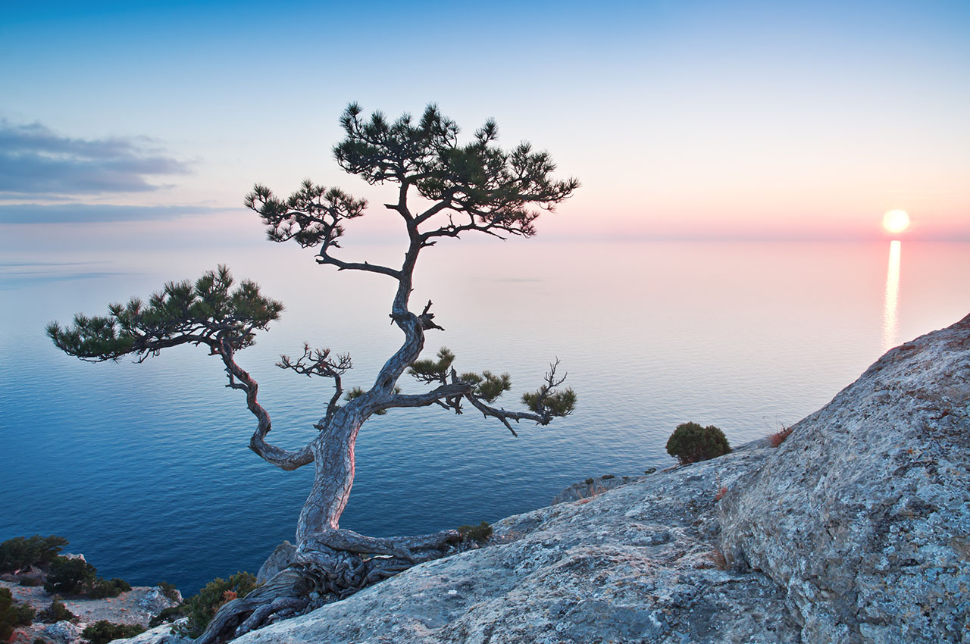
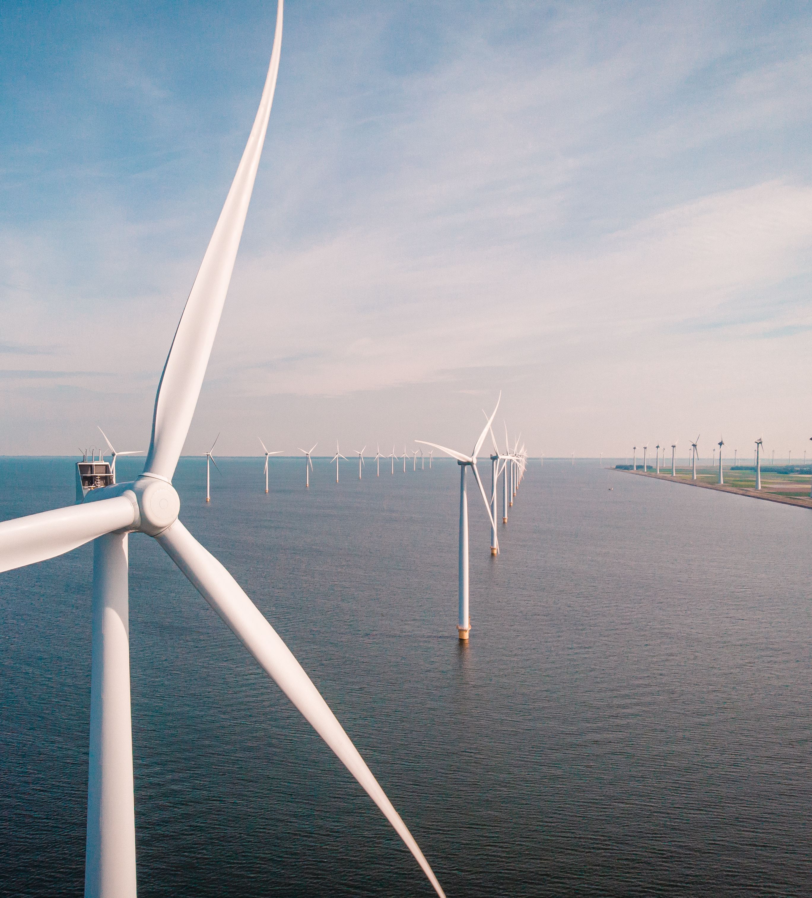
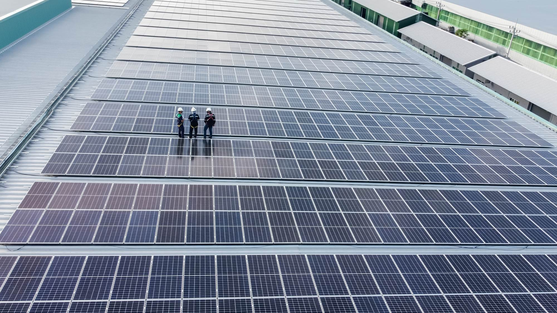
Agenda
01
02
03
04
05
Context of the study
Our approach.
Key messages
Conclusion
How can KPMG help Energy Managers?

Slide 3
Context of the study
01

Slide 4
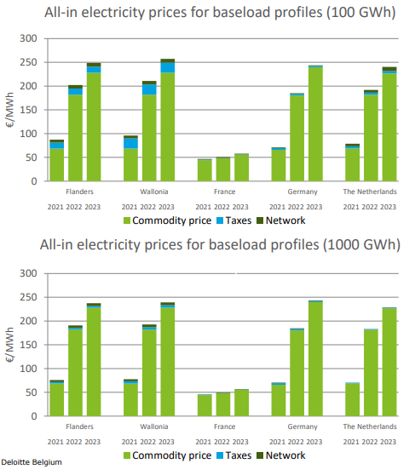
The Belgian energy market and the link with investments
Based on the yearly energy price benchmark, commissioned by Febeliec, the all-in electricity price in Belgium is consistently higher than the electricity price in our neighbouring countries.
The VIVES/KULeuven study, dated March 2018 and also requested by Febeliec, empirically proved that there is a correlation between energy prices and investment/employment rates within the manufacturing industry.
(…) a price drop of 10% of the Belgian electricity price would lead within the manufacturing industry to an increase of 12,000 full-time jobs and an increase of €550 Million in yearly investment.”
Febeliec wanted to test the conclusions on the ground by interviewing a representative group of energy-intensive companies, active in Belgium (including its own members). The scope covers both electricity, natural gas and other molecules.

Slide 5
Our approach
02

Slide 6
22 large industrials were interviewed, out of which 6 decided to remain anonymous
Air Liquide
Industrial manufacturing
Tiense suiker*
Life sciences
Vandemoortele*
Evonik
GSK
UCB
4 companies
Aluminium Duffel
Kronos
Aperam
Food processing
VPK
Oleon
LCL
Lhoist
ETEX
Vynova
Nyrstar
10 TWh electricity
40.000 jobs
Unilin
Chemical industry & life sciences
Google
6 companies
Microsoft*
12 companies
* Currently not a Febeliec member

Slide 7
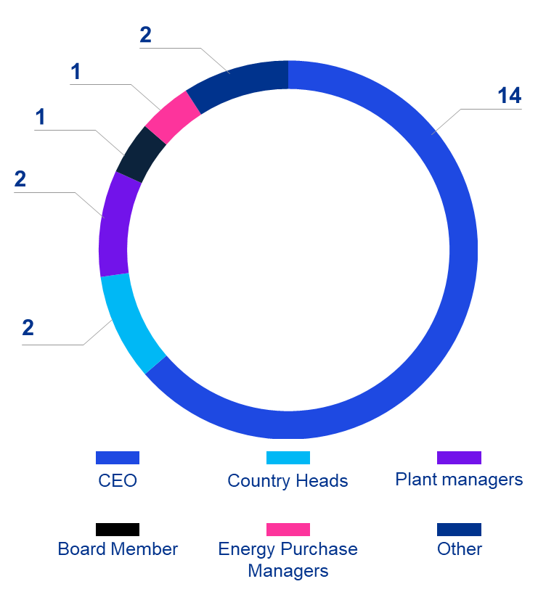
Interviews were held during the period June ’23-September ’23
Main topics covered
Persons interviewed
Perception & importance
Impact on investments
Possible measures
Impact on employment

Slide 8
Key messages
03

Slide 9
Key findings
Total electricity costs per MWh in Belgium considered
Security of electricity supply in Belgium is a major source of concern, in a context of significant demand growth
> neighbouring countries
> the rest of Europe
> the rest of the world
Crucial need for a clear, stable, coherent energy strategy in Belgium/Europe
Decarbonisation of the industry will require substantial investments with limited financial return and job creation

Slide 10
Key findings
Total electricity costs per MWh are considered in Belgium > neighbouring countries > the rest of Europe > the rest of the world
Industrial companies operate on a global scale. Competitiveness on energy costs is key as well as long term visibility on price levels
Several countries have taken measures to keep energy costs low for their industrial companies (France with Arenh, Germany, Italy, Spain, etc.)
Volatility of electricity prices is expected to increase due to growing share of renewables, adding uncertainty
“Spiral effect” (energy prices → inflation → wage indexation) is weighing on competitiveness
CO₂ related (over)regulation (EU ETS, CBAM) drives costs up

Slide 11
Key findings
Security of electricity supply in Belgium is a major source of concern, in a context of significant demand growth
The challenge concerning security of supply is well-known, but we do not see solutions yet. … As a company, we need certainty of supply and stability of prices because we cannot invest 100 to 200 million euros on decarbonization projects without the required visibility on this matter” Anonymous
There are several concerns to operate in Belgium. …Can we be confident that there will be enough electricity available in the future?” Anonymous
Intermittency of renewables is a major source of concern, as we need a stable baseload profile for our operations” Anonymous
Security of supply concerns relate both to production capacity as well as to the grid

Slide 12
Key findings
Crucial need for a clear, stable, coherent energy strategy in Belgium/Europe
Europe needs to adopt a unified approach to remain globally competitive and reduce its dependence on Asia. Within this European framework, Belgium must carefully safeguard its position in the energy market and ensure its competitiveness … .” Anonymous
There has been no clear energy strategy for years, leading to a lot of uncertainty. Under these circumstances, companies cannot easily make investment decisions.” Anonymous

Slide 13
Key findings
Decarbonisation of the industry will require substantial investments with limited returns and job creation
Many environmental rules are stricter in Europe than elsewhere in the world. … Europe must therefore understand that if the industry leaves Europe due to unfair competition with the rest of the world and uncertainties regarding the security of electricity supply, it will have only negative consequences on a global scale for the environmental footprint.” Anonymous
The investments we will have to do to achieve decarbonization objectives are substantial and yield low returns. Besides this, they will not generate a lot of employment” Anonymous

Slide 14
Consequences
All these elements weigh on investment decisions of industrials
Investment decisions are delayed, or other countries are favoured.
No significant investments in expanding production capacity mentioned, except for the life sciences sector
Medium term impact on growth rate of the country & employment
Investments mainly focused on license-to-operate investments, cost efficiencies & energy savings
Some sectors are heavily impacted by high energy prices and risk to run out of business ➔ risk of a “domino effect”

Slide 15
Key requirements for the future
Stable long term energy strategy
Clear path towards decarbonisation
Measures to create equal level playing field

Slide 16
Conclusions
04

Slide 17
How can KPMG help Energy Managers?
05

Slide 18
Energy supply uncertainty | The need for an appropriate mix…
Challenge for heavy industry to electrify
Disruptive evolutions required to meet the targets
Use of gas fired plants
Nuclear?
Low carbon fuels
Hydrogen
Gap
A clear Belgian energy strategy is required to ensure security of supply at reasonable costs. Corporates can increase their energy resilience via a strong focus on energy efficiency, self-generation, flexibility solutions and cPPAs.

Slide 19
Your current reality as starting point …
Supply
Demand (volume + profile)
Conventional
1
Petroleum
Hydrocarbon gas liquids
Core activities
Natural gas
Grey electricity
2
Renewables
Facilities
Renewable elec.
Geothermal energy
3
Biogas
Biomass
Logistics

Slide 20
… as a basis for your future energy strategy
3. Continuous monitoring
2. RfPs + contract negotiation
Enablers
Key step resulting in energy sourcing blueprint
1. Energy strategy development
Creation of a methodology to embed the contract in the accounting processes and to follow up on the results
Establishment of a process and model to enable comparison of offers and to negotiate appropriate contracts
Early-on assessment of and ongoing focus on overall organisational impact (technical, accounting, tax, internal capabilities)
Articulation of an energy strategy, based on qualitative and quantitative input
Leveraging on deep energy sector know-how
… while respecting the appropriate balance between cost, security of supply and additionality…
… and focusing on both tactical as strategic opportunities
01
Low and uncertain
Certificates
Decarbonization
02
Corporate PPA
Additionality
Security of supply
03
Cost impact/structure
Renewable self-generation
High and probable

Slide 21
Energy strategy development and action levers An integrated and dynamic energy strategy as cornerstone
Preliminary deliverability test of different identified sourcing alternatives
Incorporation of regulatory context
A
Data collection
on energy needs, load profile, energy mix, available (land)space for renewables and key decision drivers
C
Scenario analysis and sourcing strategy
B
Preliminary market sounding
Initial overview of possible sourcing alternatives based on your energy consumption data and self-generation potential
Definition of decision drivers (examples: additionality, accounting impact, tax impact, budget impact,…)
Qualitative and/or quantitative assessment of sourcing alternatives based on the data collection & market sounding
Assessment of the ability to win/internal capability set
Articulation of a sourcing strategy and implementation roadmap including governance

Slide 22
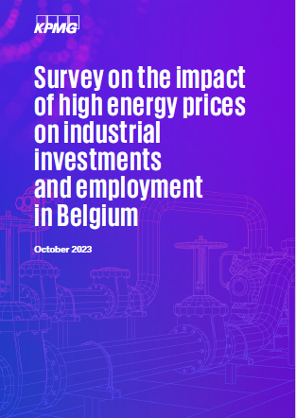
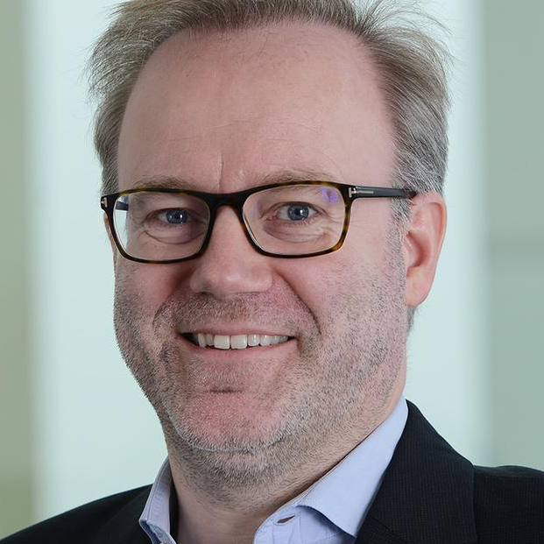
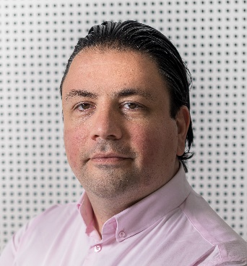
Thanks!
Daniël Pairon
dpairon@kpmg.com
Tel. +32 495 53 02 02
Magali Vercammen
mvercammen@kpmg.com
Tel. +32 474 94 05 90
Thomas De Ruyck
tderuyck@kpmg.com
Tel. +32 477 79 12 54

