Slide 2
De volgende stap in warmtepompen
Steven Lecompte, Elias Vieren, Kenny Couvreur

Slide 3
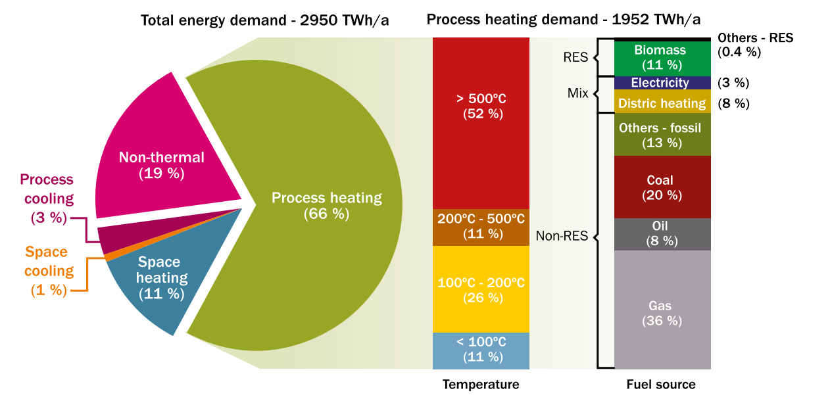
Industrial energy demand in europe
De Boer et al. (2020)
HeatRoadMap (EU 2015)

Slide 4
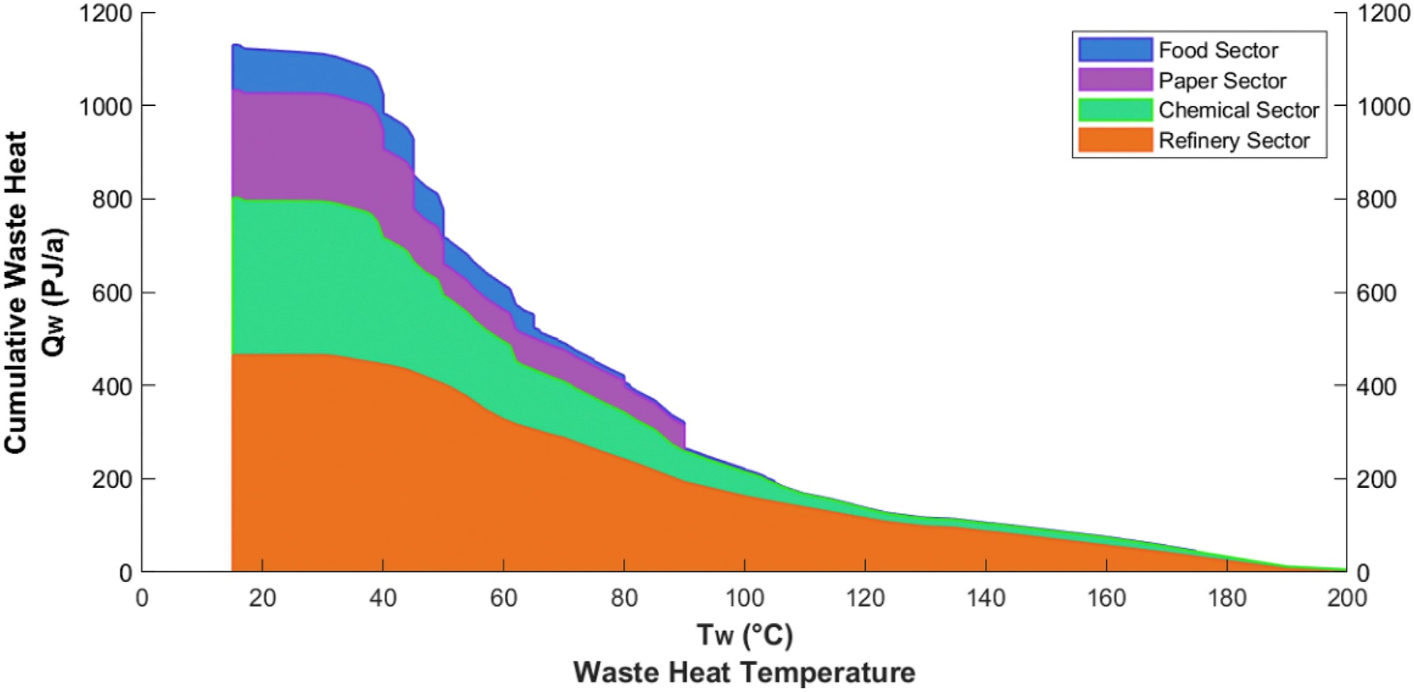
Matching cooling (residual heat) and heating
Heat pump technologies
1200
1200
Cumulative Process heat
(PJ\a)
Cumulative Process heat
(PJ\a)
0
0
0 20 40 60 80 100 120 140 160 180 200
0 20 40 60 80 100 120 140 160 180 200
Waste heat temperature (°C)
Demand heat temperature (°C)
Marina et al. (2021)

Slide 5
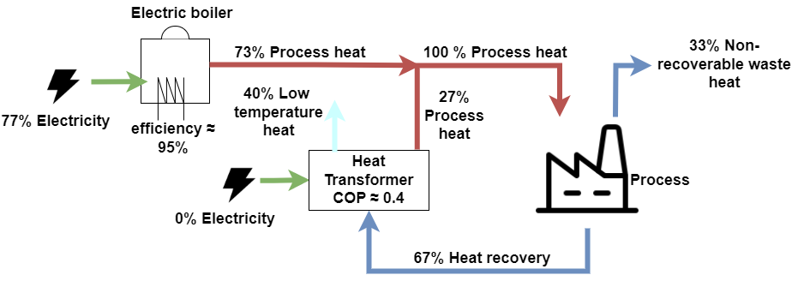
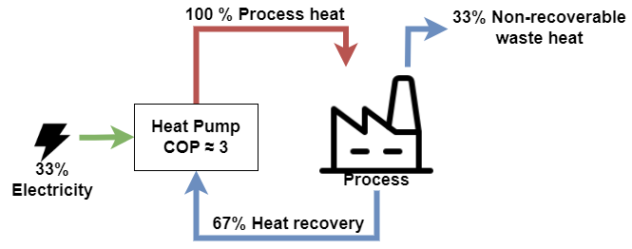
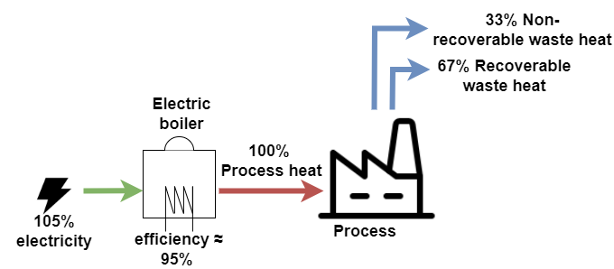
Heat pump technologies
Vapour compression heat pump (CAPEX: $$$)
Heat transformer (CAPEX: $$$$)
Electric boiler (CAPEX: $)
Hydrogen boiler (CAPEX: $$)

Slide 6
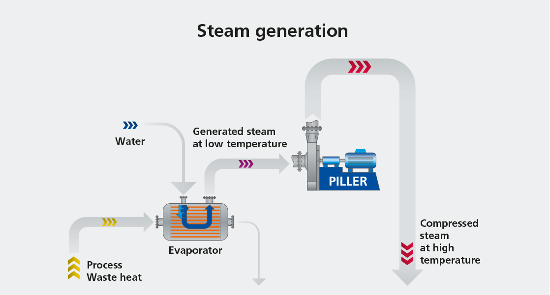
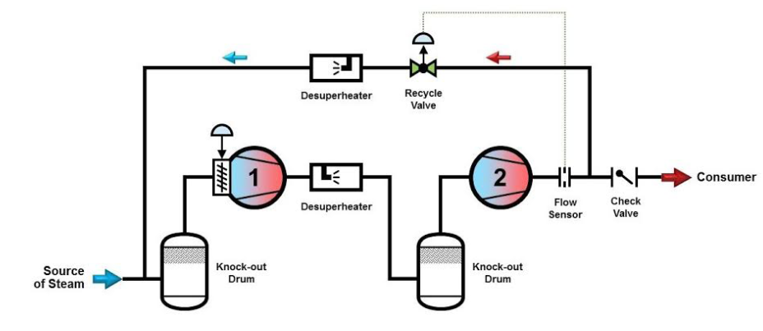
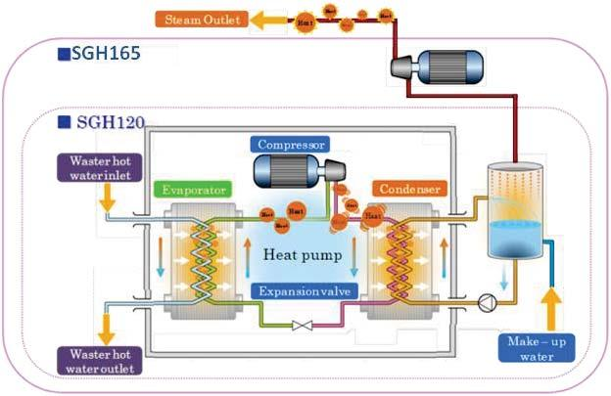
MVR and Cascaded systems
Mechanical vapour recompression (MVR)
Atlas Copco
Vapour compression heat pump + MVR

Slide 7
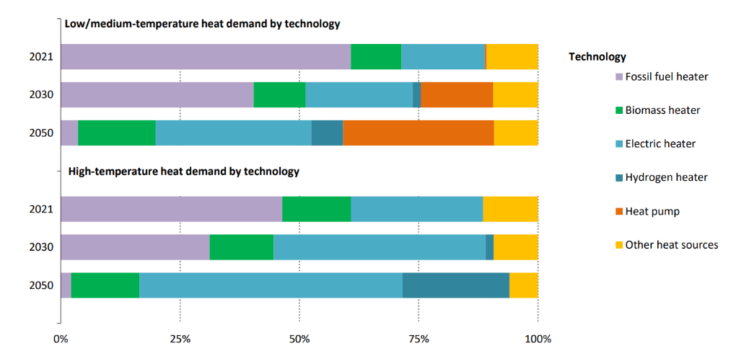
Possible scenario (IEA)
Net Zero By 2050, IEA
Additional 500 MW installed capacity each month over the next 30 years!

Slide 8
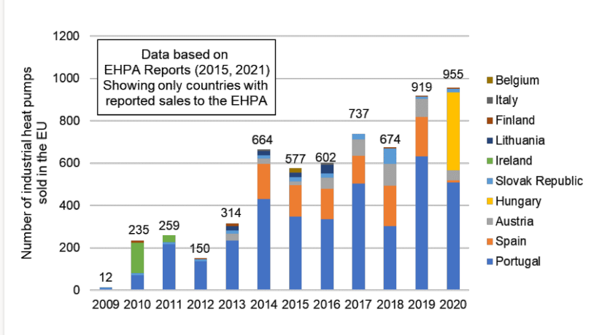
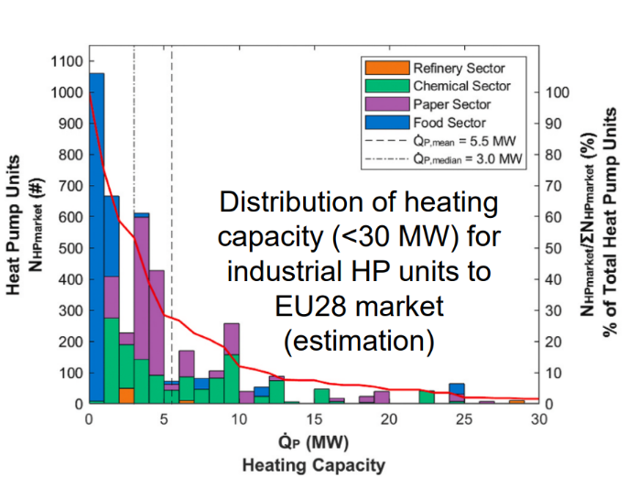
Sale statistics
Marina et al. (2021)

Slide 9
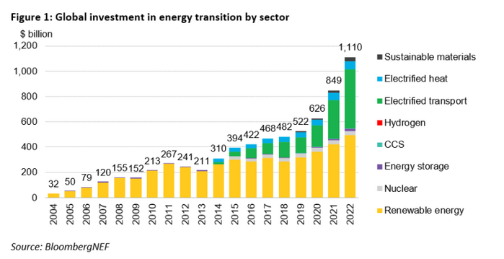
What's the market potential?
The Next Half-Trillion-Dollar Market Electrification of Heat [BloombergNEF]
2030
Notes:
clean energy transition had broken through the $1 trillion mark in 2022

Slide 10
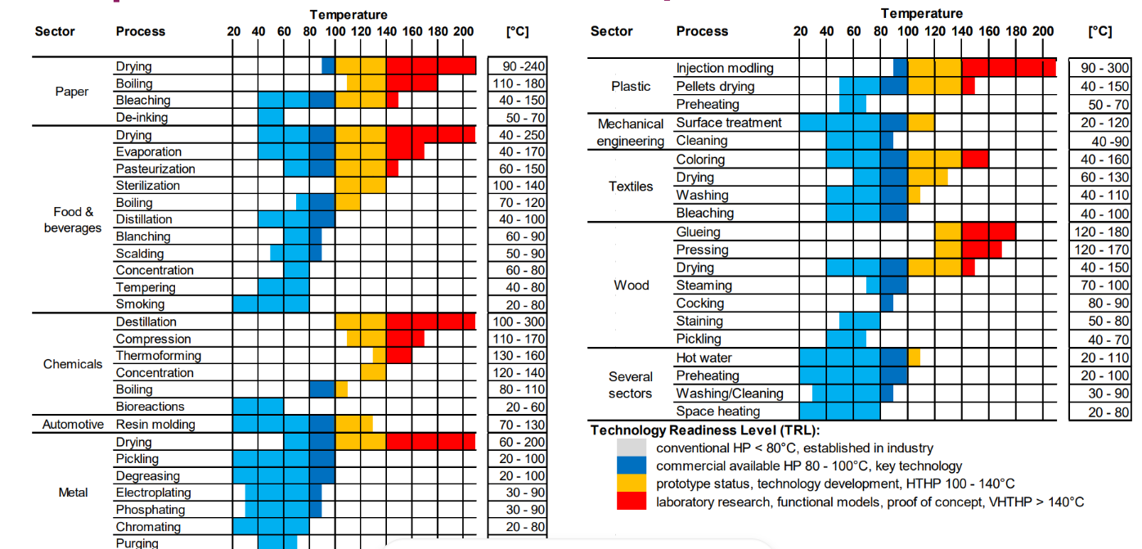
Zooming in on applications
Deep Dive Application Potential by C. Arpagaus

Slide 11
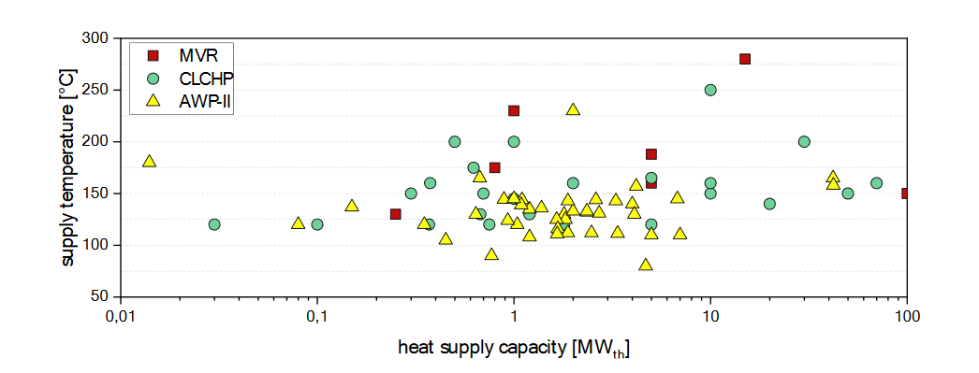
Steam applications: capacity

Slide 12
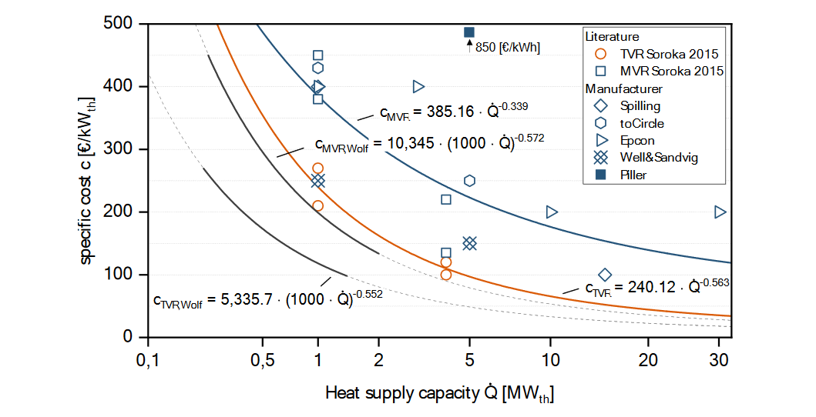
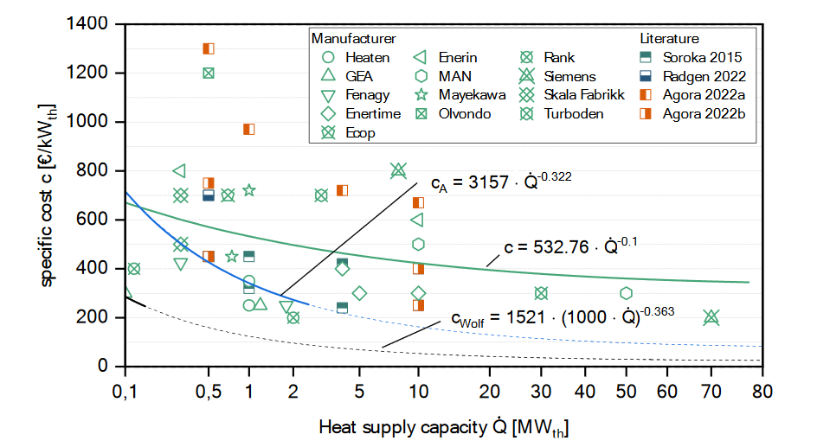
Steam applications: cost
Klute et al. 2024

Slide 13
What’s the catch?
Unfavorable electricity / fossil-fuel price ratio
To be competitive: US: $10/MWhe, EU: $24/MWhe [BloombergNEF]
Large variability!
Insufficient grid capacity
Storage solutions
Projected growth similar as between 1990 and 2007 [Transformation of Europe’s power system until 2050, McKinsey]
Low technology readiness
Technology status and perspectives, Jonas Lundstedt Poulsen
Insubstantial policy incentives

Slide 14
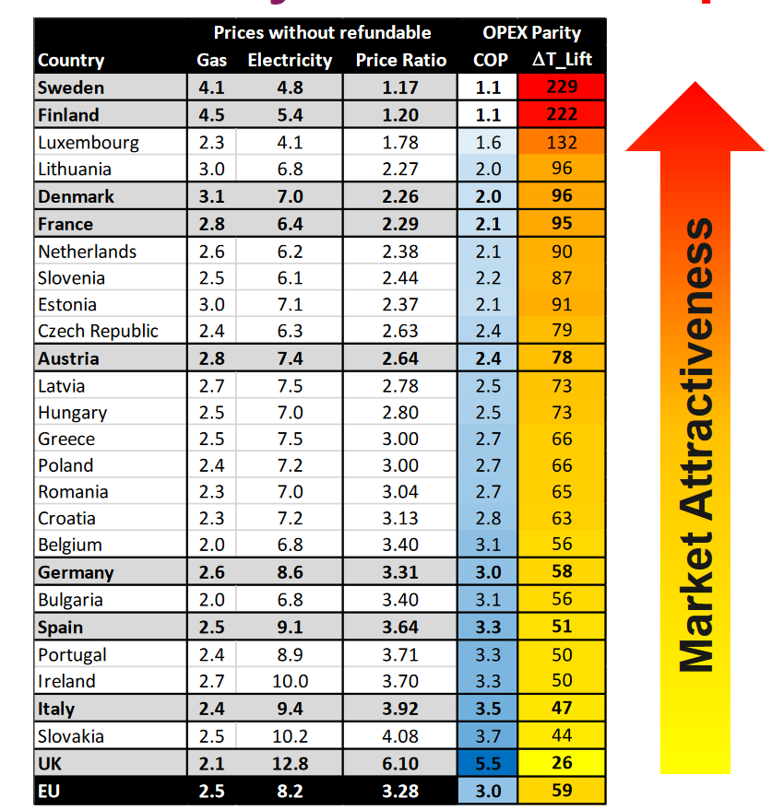
electricity / fossil-fuel price ratio
Deep Dive Application Potential by C. Arpagaus

Slide 15
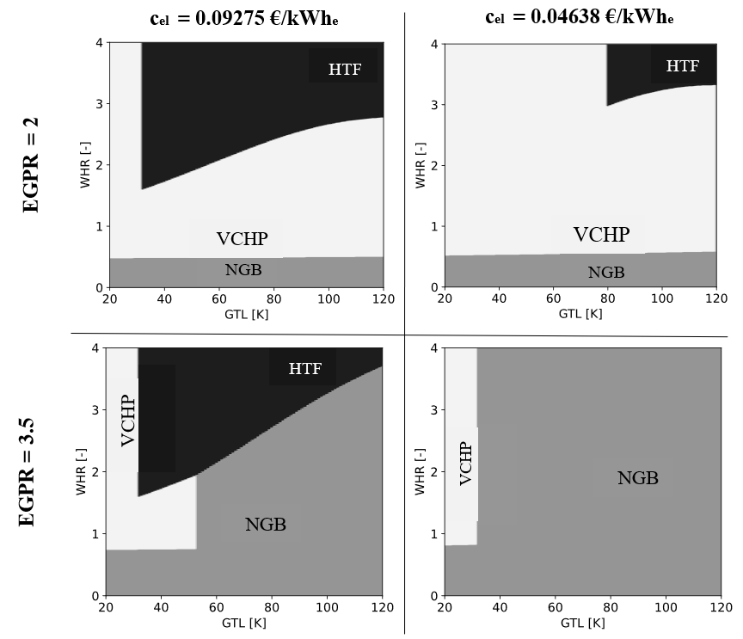
electricity / fossil-fuel price ratio
HTF: Heat transformer
VCHP: Vapour compression heat pump
NGB: Natural gas boiler
EGPR: Electricity to gas price ratio = $\frac{c_{el}}{c_{ng}}$
WHR: Waste heat ratio $= \frac{{\dot{Q}}_{residual}}{{\dot{Q}}_{process}}$
Study considers electric heater when not sufficient waste heat available
Vieren et al. (2023), accepted for International Congress of Refrigeration

Slide 16
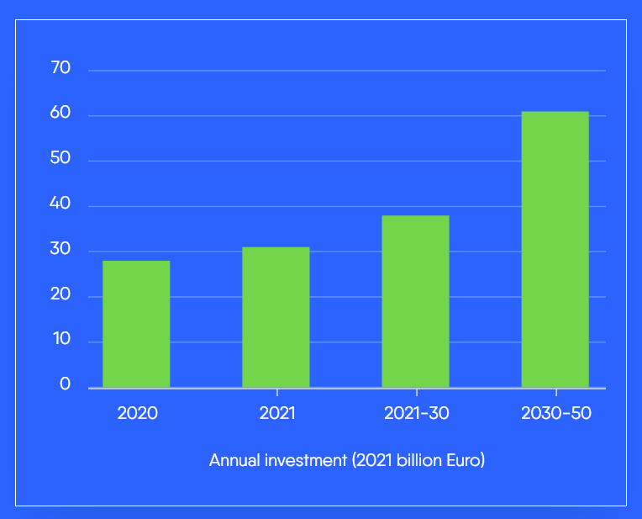
Grid capacity and RE availability
Installed grid-scale battery storage capacity in the Net Zero Scenario
GW
Powerbarometer 2022
IEA

Slide 17
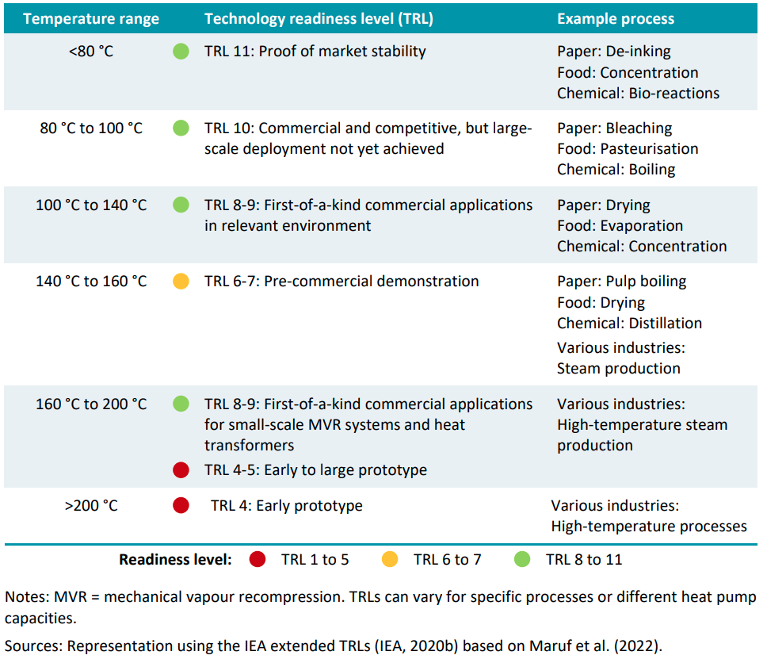
technology readiness
IEA

Slide 18
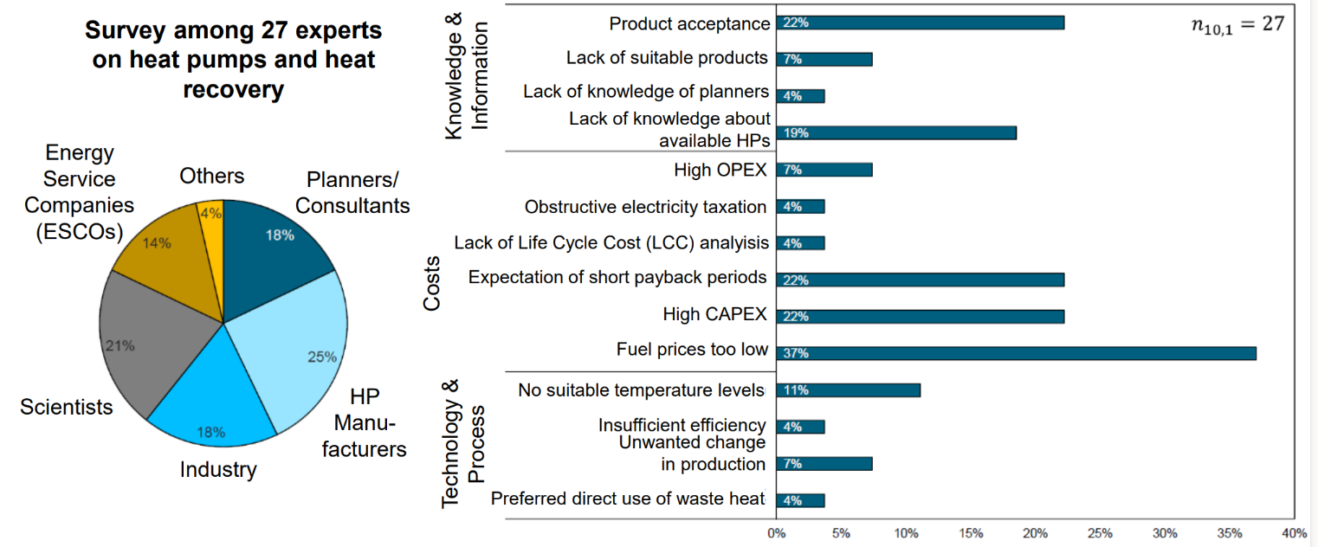
Other Market barriers
Wolf et al (2017, 2020), Deep Dive Application Potential by C. Arpagaus

Slide 19
POLICY
EU RED III: art. 22:
Increase alternatives to fossil-fuel based energy use in industry
End fossil fuel use for processes up to 200°C by 2027
EU EED: Member States shall remove regulatory barriers
for waste heat utilization and data centers with a total
rated energy input exceeding 100 kW shall use waste heat
or waste heat recovery applications
EU EED 2022, art. 23: heating and cooling plans

Slide 20
conclusion
‘There is a huge potential, but that it requires an immediate, common and interdisciplinary effort to exploit the full potential’

Slide 21
Steven Lecompte DEPARTMENT OF electromechanical, systems and metal engineering E steven.lecompte@ugent.be T +32 9 264 33 55 M +32 470 04 55 24 www.ugent.be
Ghent University @ugent Ghent University

Slide 22
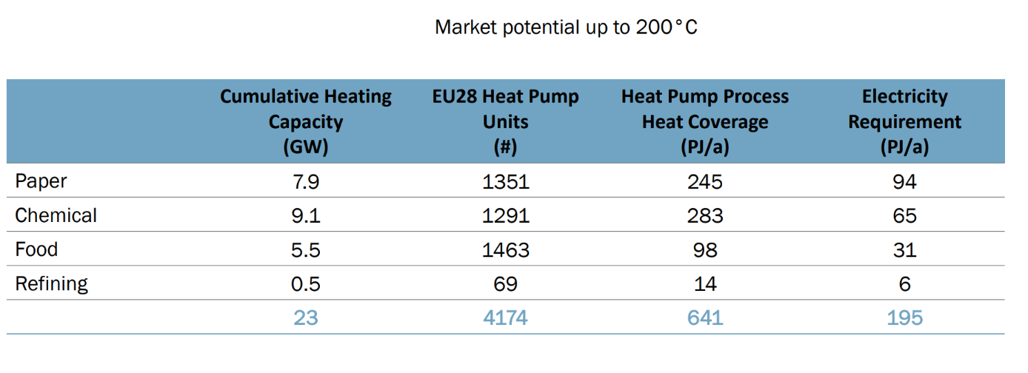
Market potential EU
An estimation of the EU industrial heat pump market potential, TNO, 2022

Slide 23
Global final energy use US

Slide 24
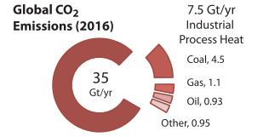

Slide 25
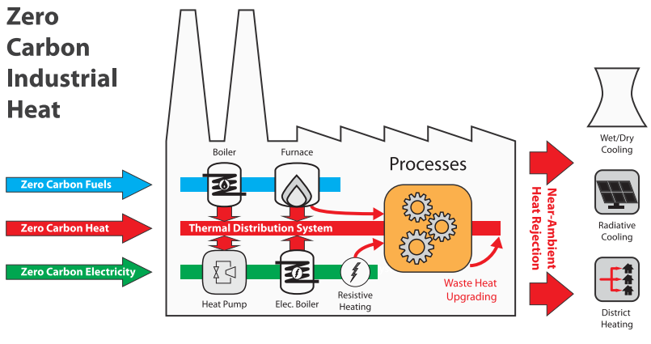
The decarbonize industry: we must decarbonize heat.
Pathways to decarbonize heat
zero-carbon fuels,
zero-carbon heat sources,
electrification of heat,
better heat management.

Slide 26
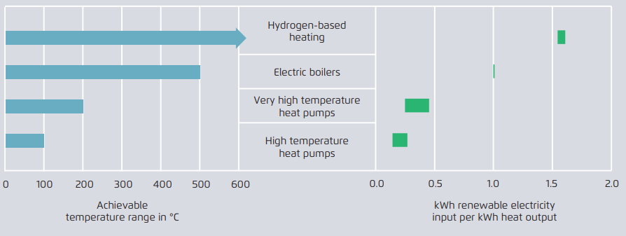

Slide 27
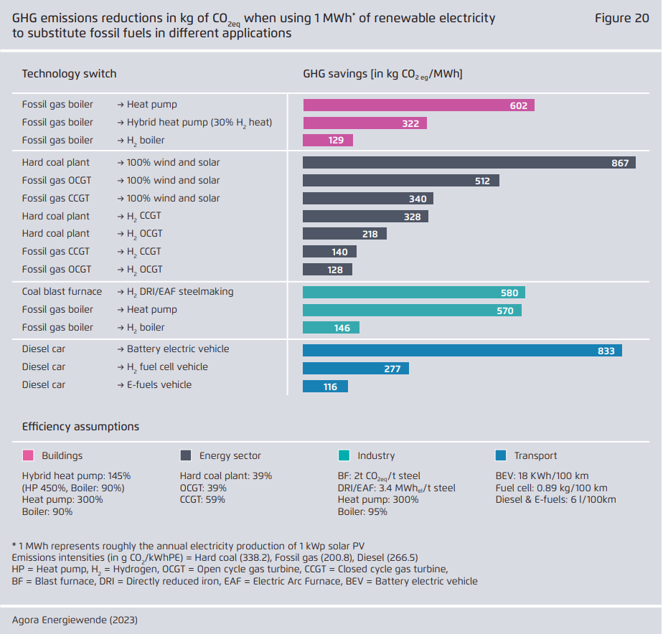

Slide 29
