Slide 2
Water-Ammonia HTHP with liquid injected and refrigerant lubricated twin-screw compressor
Department of ElectroMechanical, Systems and Metal Engineering
  Sustainable Thermo-Fluid Energy Systems (STFES)
Koelplatform - Masterclass, Tim van Craeynest, Kenny Couvreur, Robin Tassenoy, Xander van Heule, Michel De Pape, Steven Lecompte

Slide 3
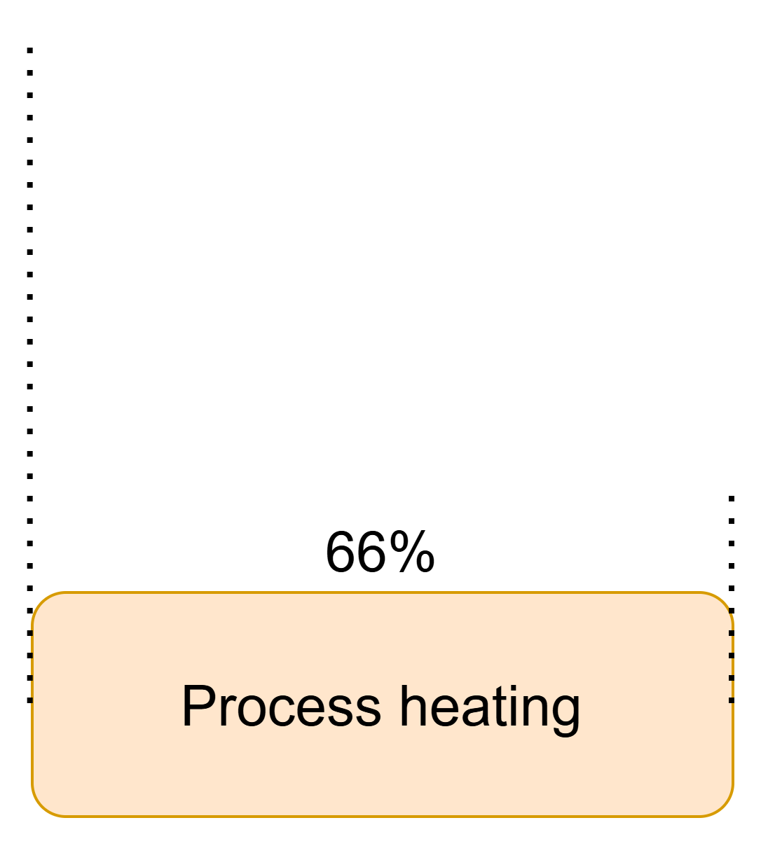
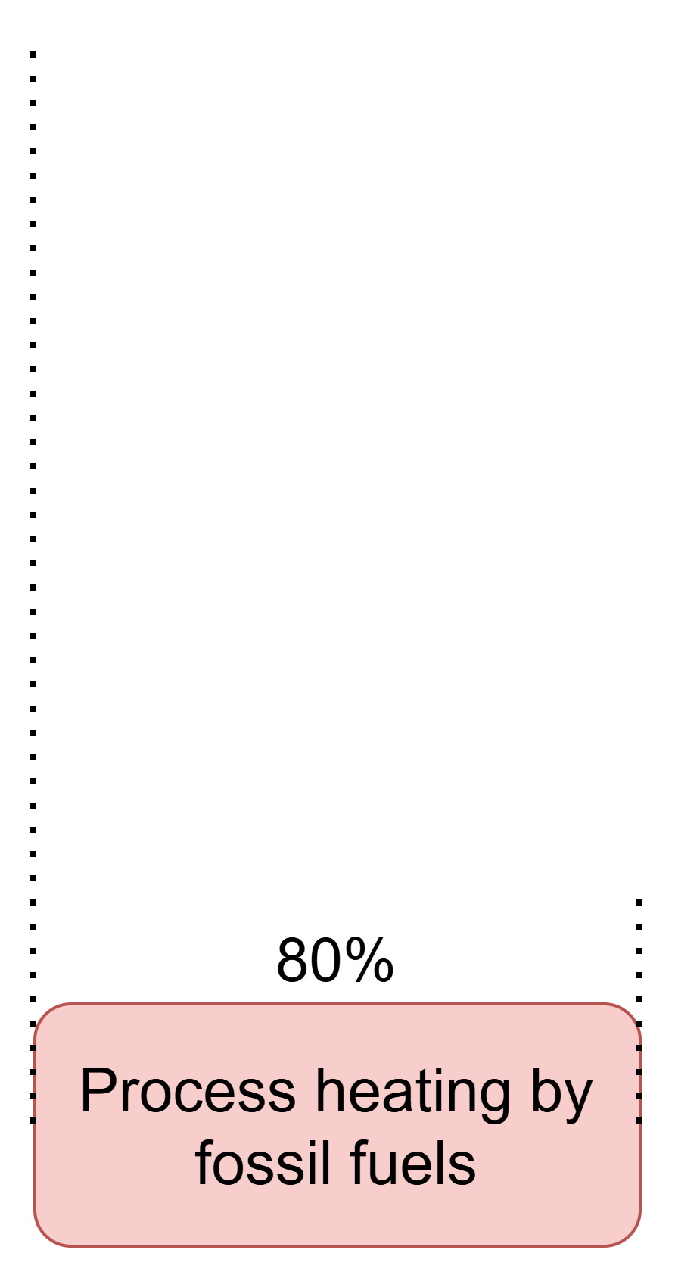

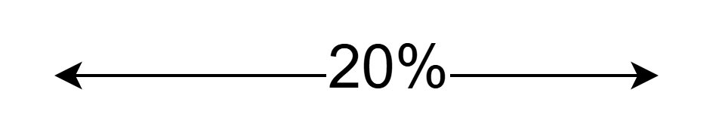
Global Energy Use
Boehlé et al., Energy Efficiency 2025: Industry, 2025
Weiss et al., Tackling heat electrification to decarbonize industry, 2024
Notes:
Let’s put the research into perspective. To do this we start from the global energy use.
Of the total energy use, 38% is used by industry.
66% of industries’ energy use is for process heating.
And still 80% of that process heating is supplied by burning fossil fuels.

Slide 4

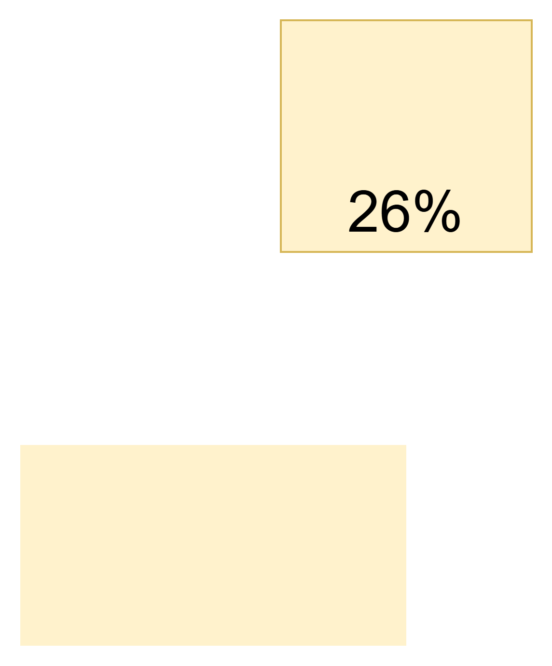



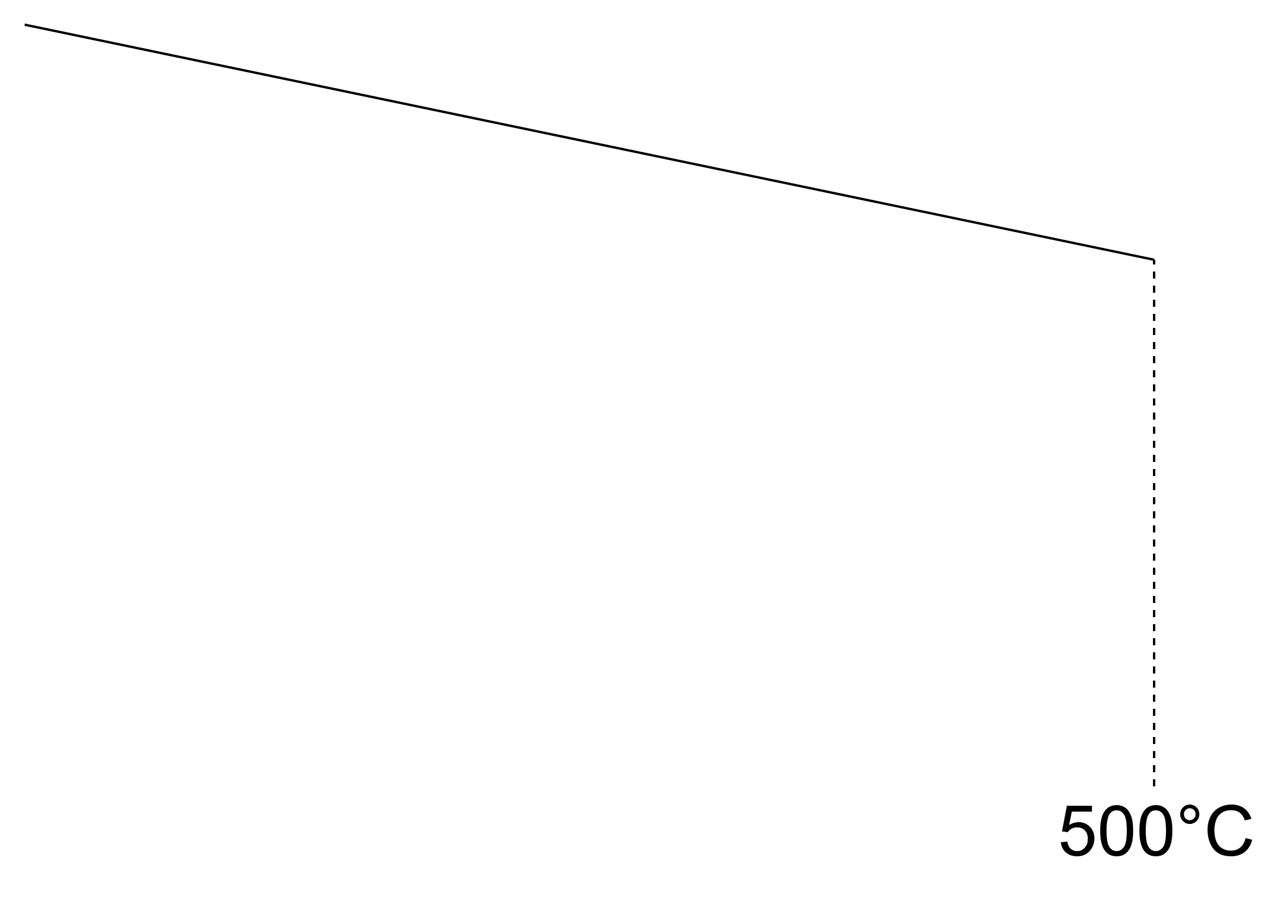
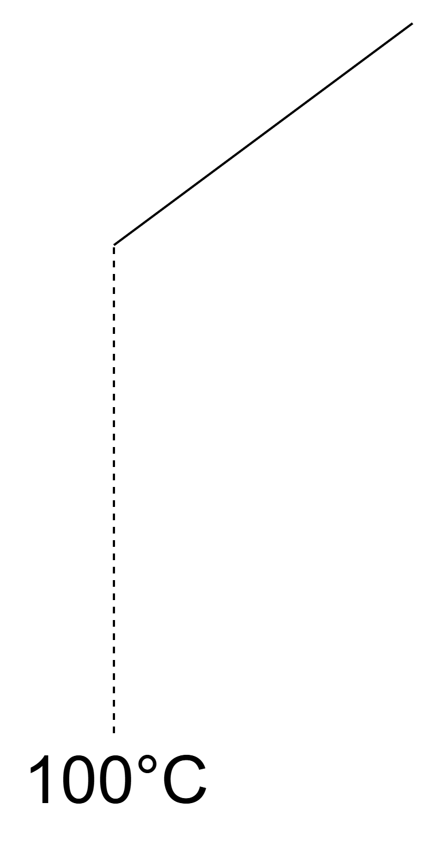
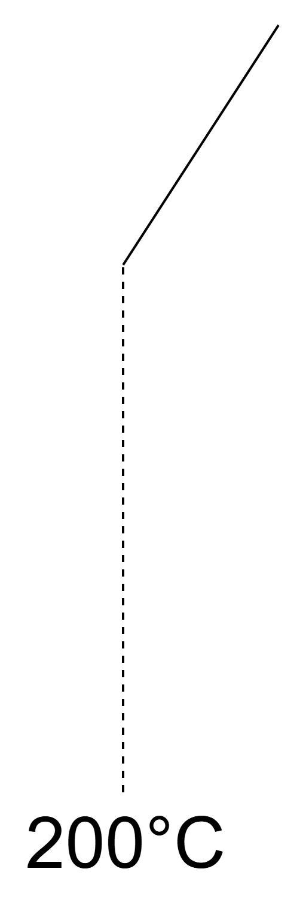
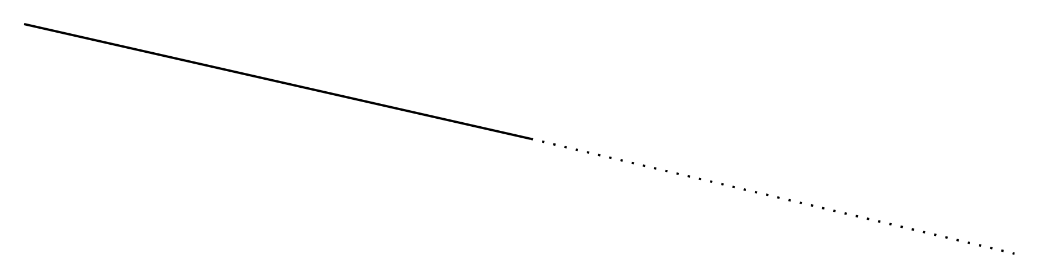
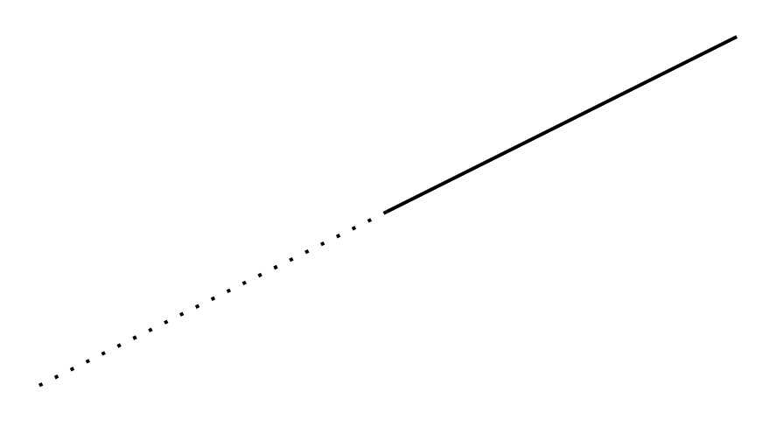
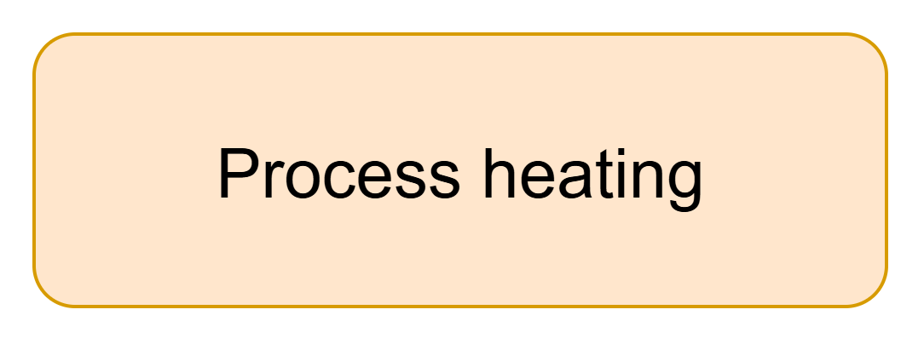

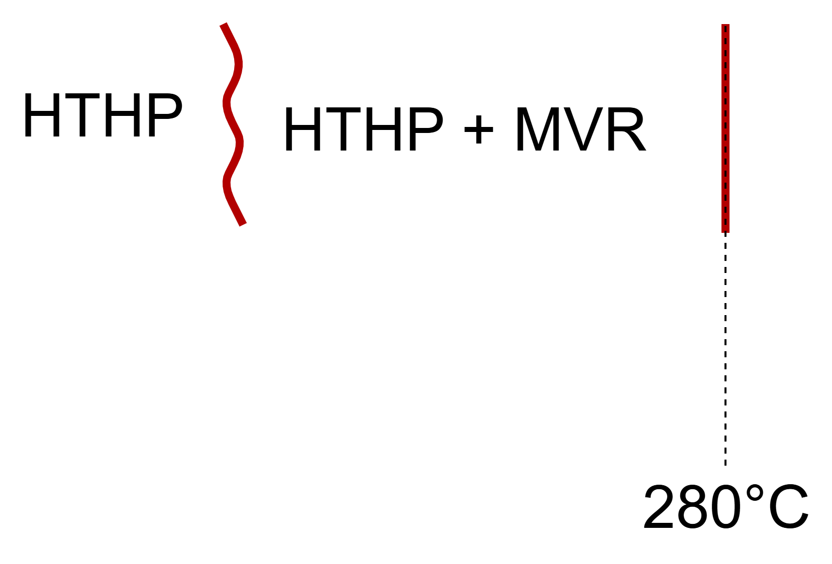
Current Situation
de Boer et al., Strengthening Industrial Heat Pump Innovation: Decarbonizing Industrial Heat, 2020
Zühlsdor et al., Project 68 - industrial high-temperature heat pumps. task 1–technologies. yearly report 2025, 2025
Arpagaus, High-temperature heat pumps: market overview, state of the art, and application potential, 2026
Notes:
Energy use for process heating can be split up per temperature range:
11% below 100°C, 26%between 100°C and 200°C, 11% between 200°C and 500°C and the remaining part is above 500°C
HP cover everything up to about 100°C, most HTHPs can cover up to between 100°C and 200°C, for a higher temperature, mostly MVR is added.

Slide 5

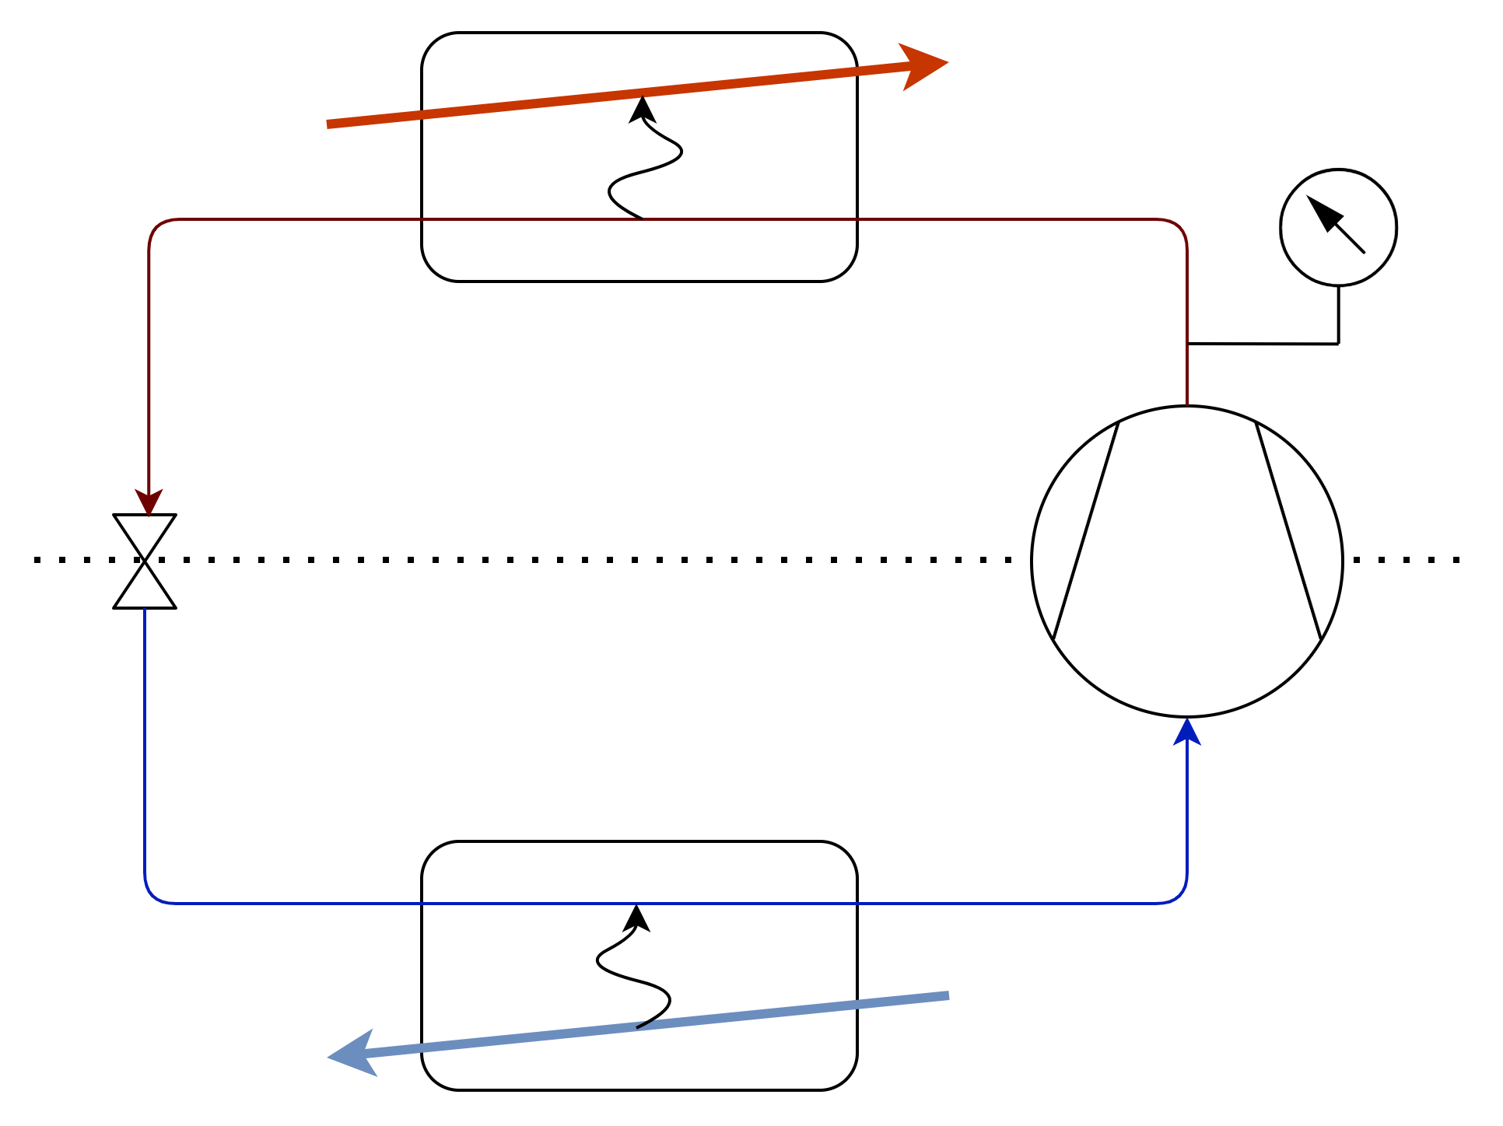




Heat Upgrading in Energy Intensive Industry
Max: 250°C
25bar
200°C
200°C
170°C
~100kWth
Max lift:
100°C
Single stage
100°C
120°C
Notes:
Therefor the upheat project from the moonshot initiative were started up.
The goal was to achieve 200°C with a HTHP, reaching a maximum lift of 100°C.

Slide 6





Refrigerant Selection
HCFC
Natural refrigerants
HFC
No ODP
CFC
HFO
Low GWP
No PFAS
CO2
Subcritical (small temperature glides)
hydrocarbons
Water(R718)
Non-/low flammability
NH3 (R717)
McLinden et al., (R)Evolution of Refrigerants, 2020
McLinden et al, New refrigerants and system configurations for vapor-compression refrigeration, 2020
Garavagno et al., Trifluoroacetic Acid: Toxicity, Sources, Sinks and Future Prospects,2024
Vieren et al., Selection of pure and binary working fluids for high-temperature heat pumps: A financial approach, 2024
Notes:
Once the temperature range was fixed, the refrigerant had to be selected.
1 no ODP
2 low or no GWP
3 No PFAS
4 due to the relatively small temperature glide, the cycle is best to be subcritical
5 No/ low flammability is required
This leaves us with water

Slide 7
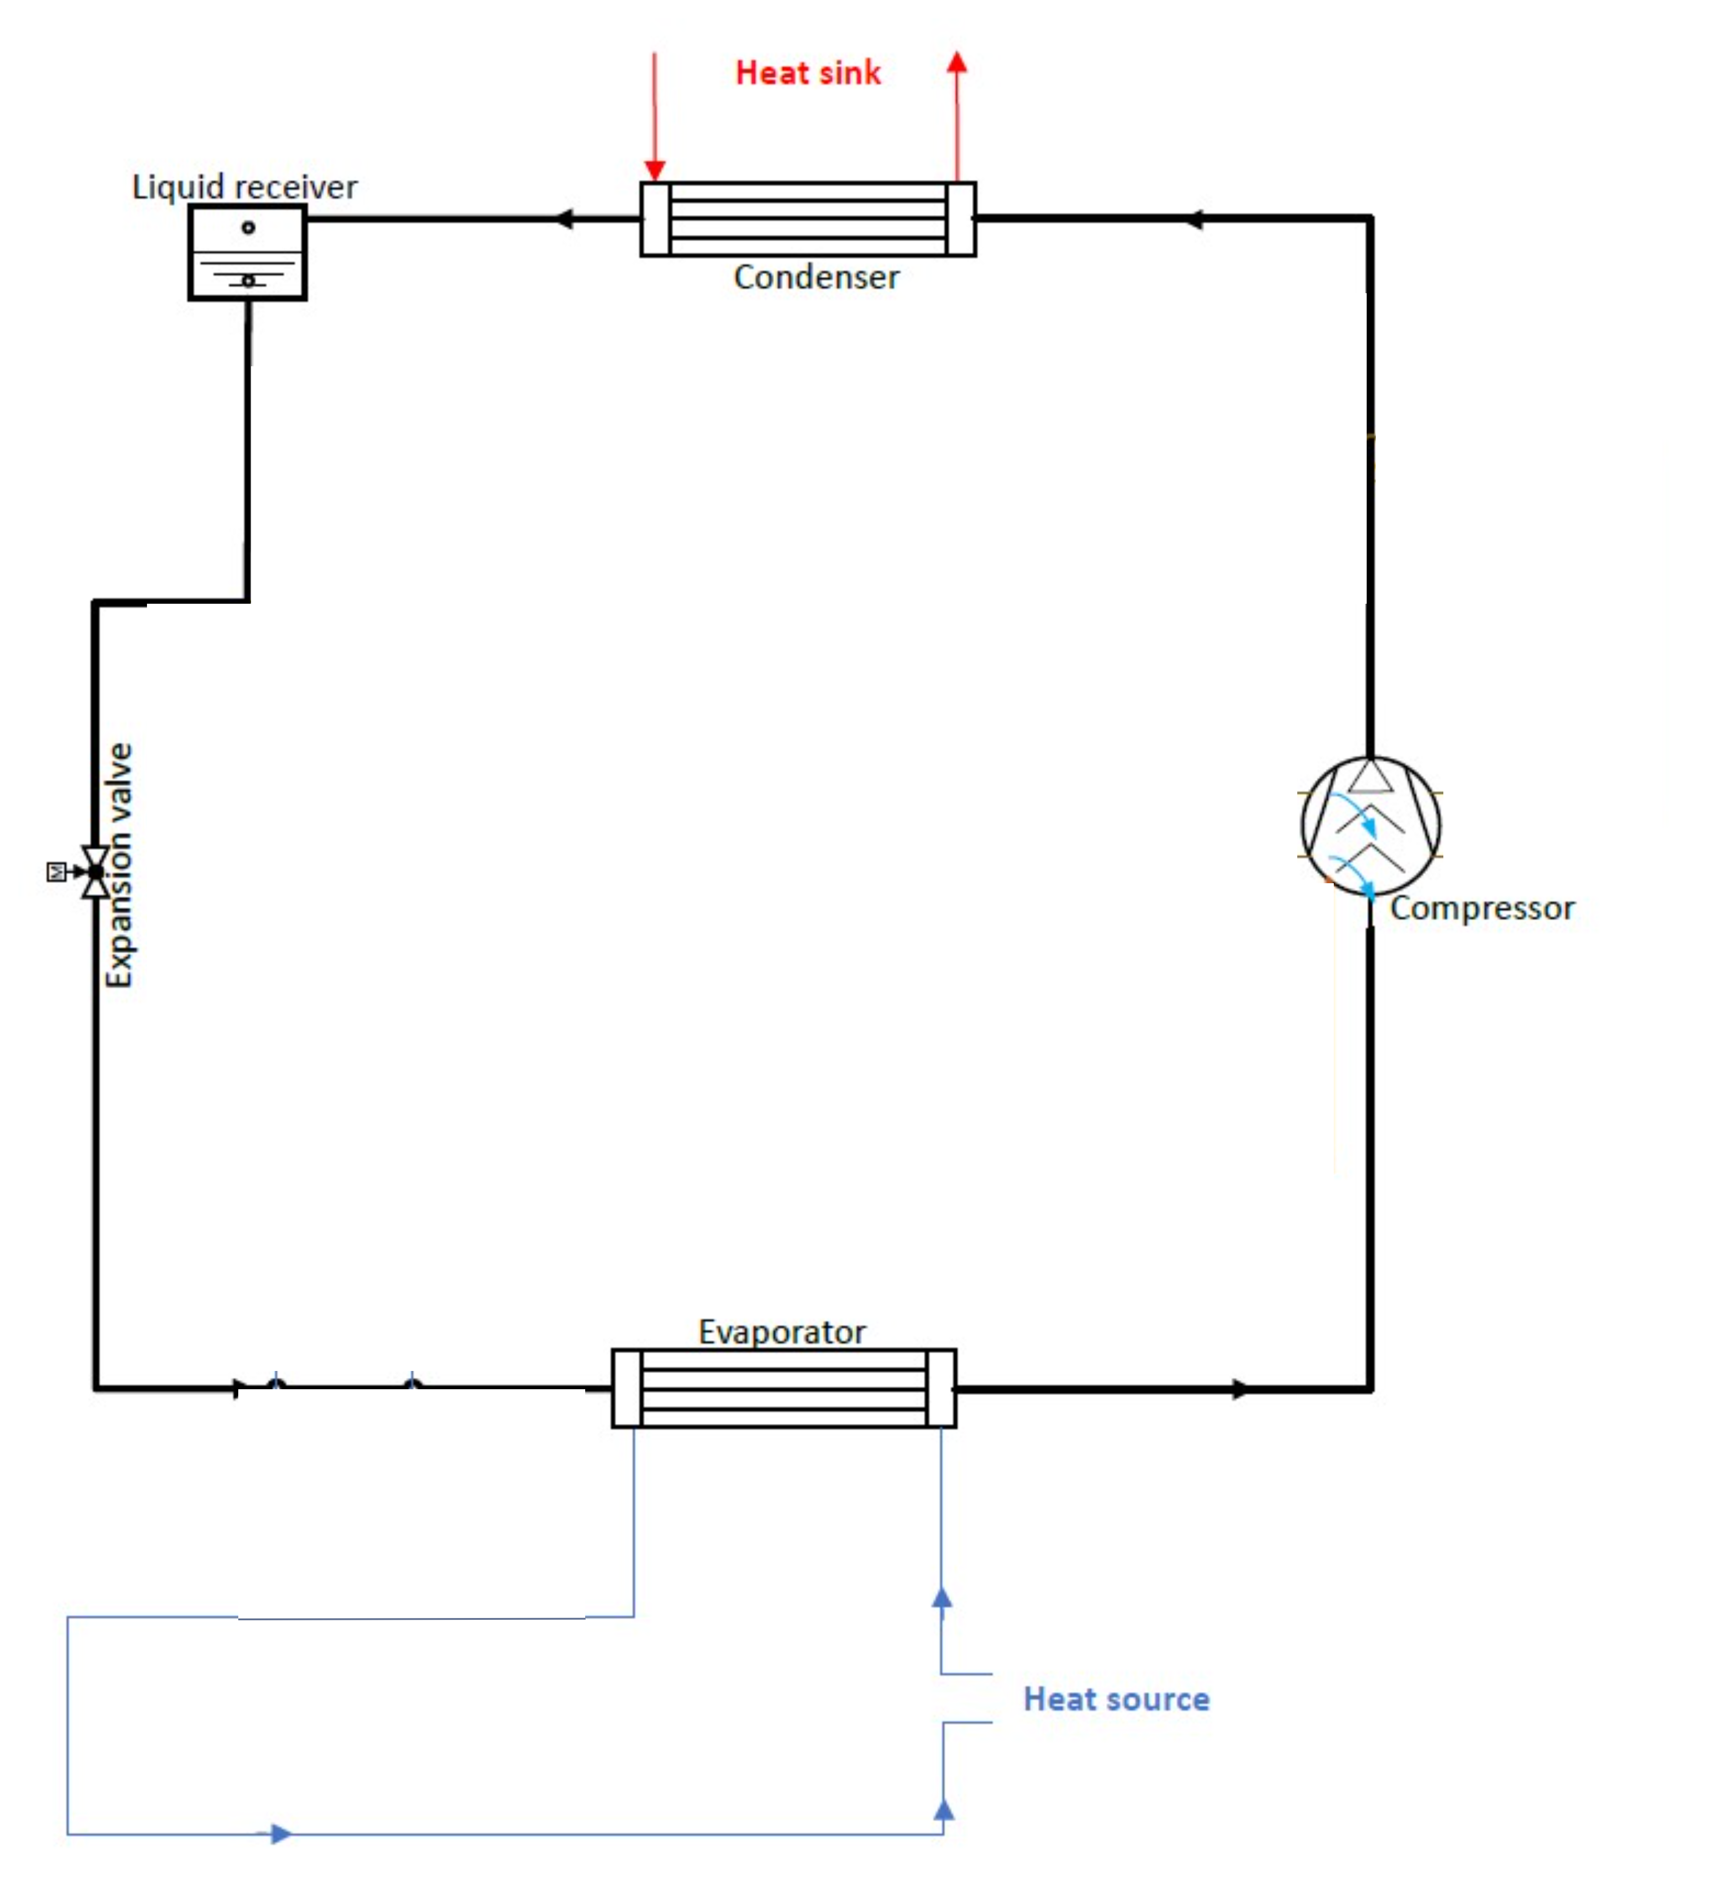

Demonstrator Setup
Main refrigerant circuit
water
Notes:
With the refrigerant selected, the demonstrator can be constructed.
Important is that all the parts are stainless steel to resist the ammonia.
The complete

Slide 8
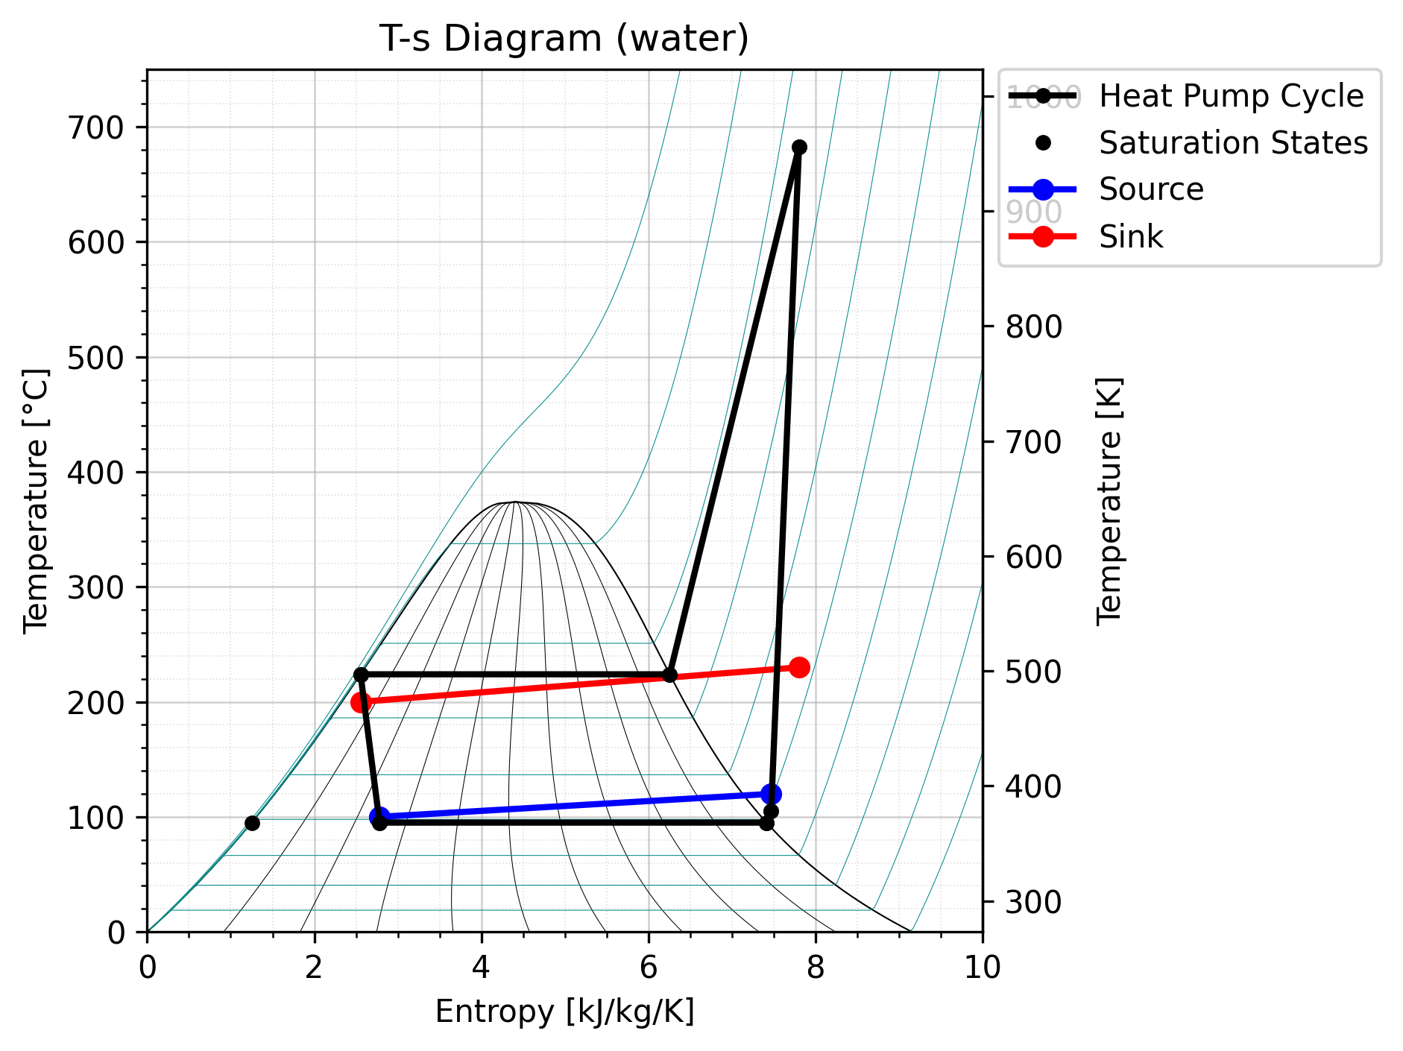
Water
High discharge temperature
Liquid/2-phase-injection
250°C
Notes:
But using water as a refrigerant results in some challenges.
First of all the high discharge temperature
This will be solved by using liquid or 2-phase injection.
But the high normal boiling temperature of 100°C also provides us with some challenges.

Slide 9
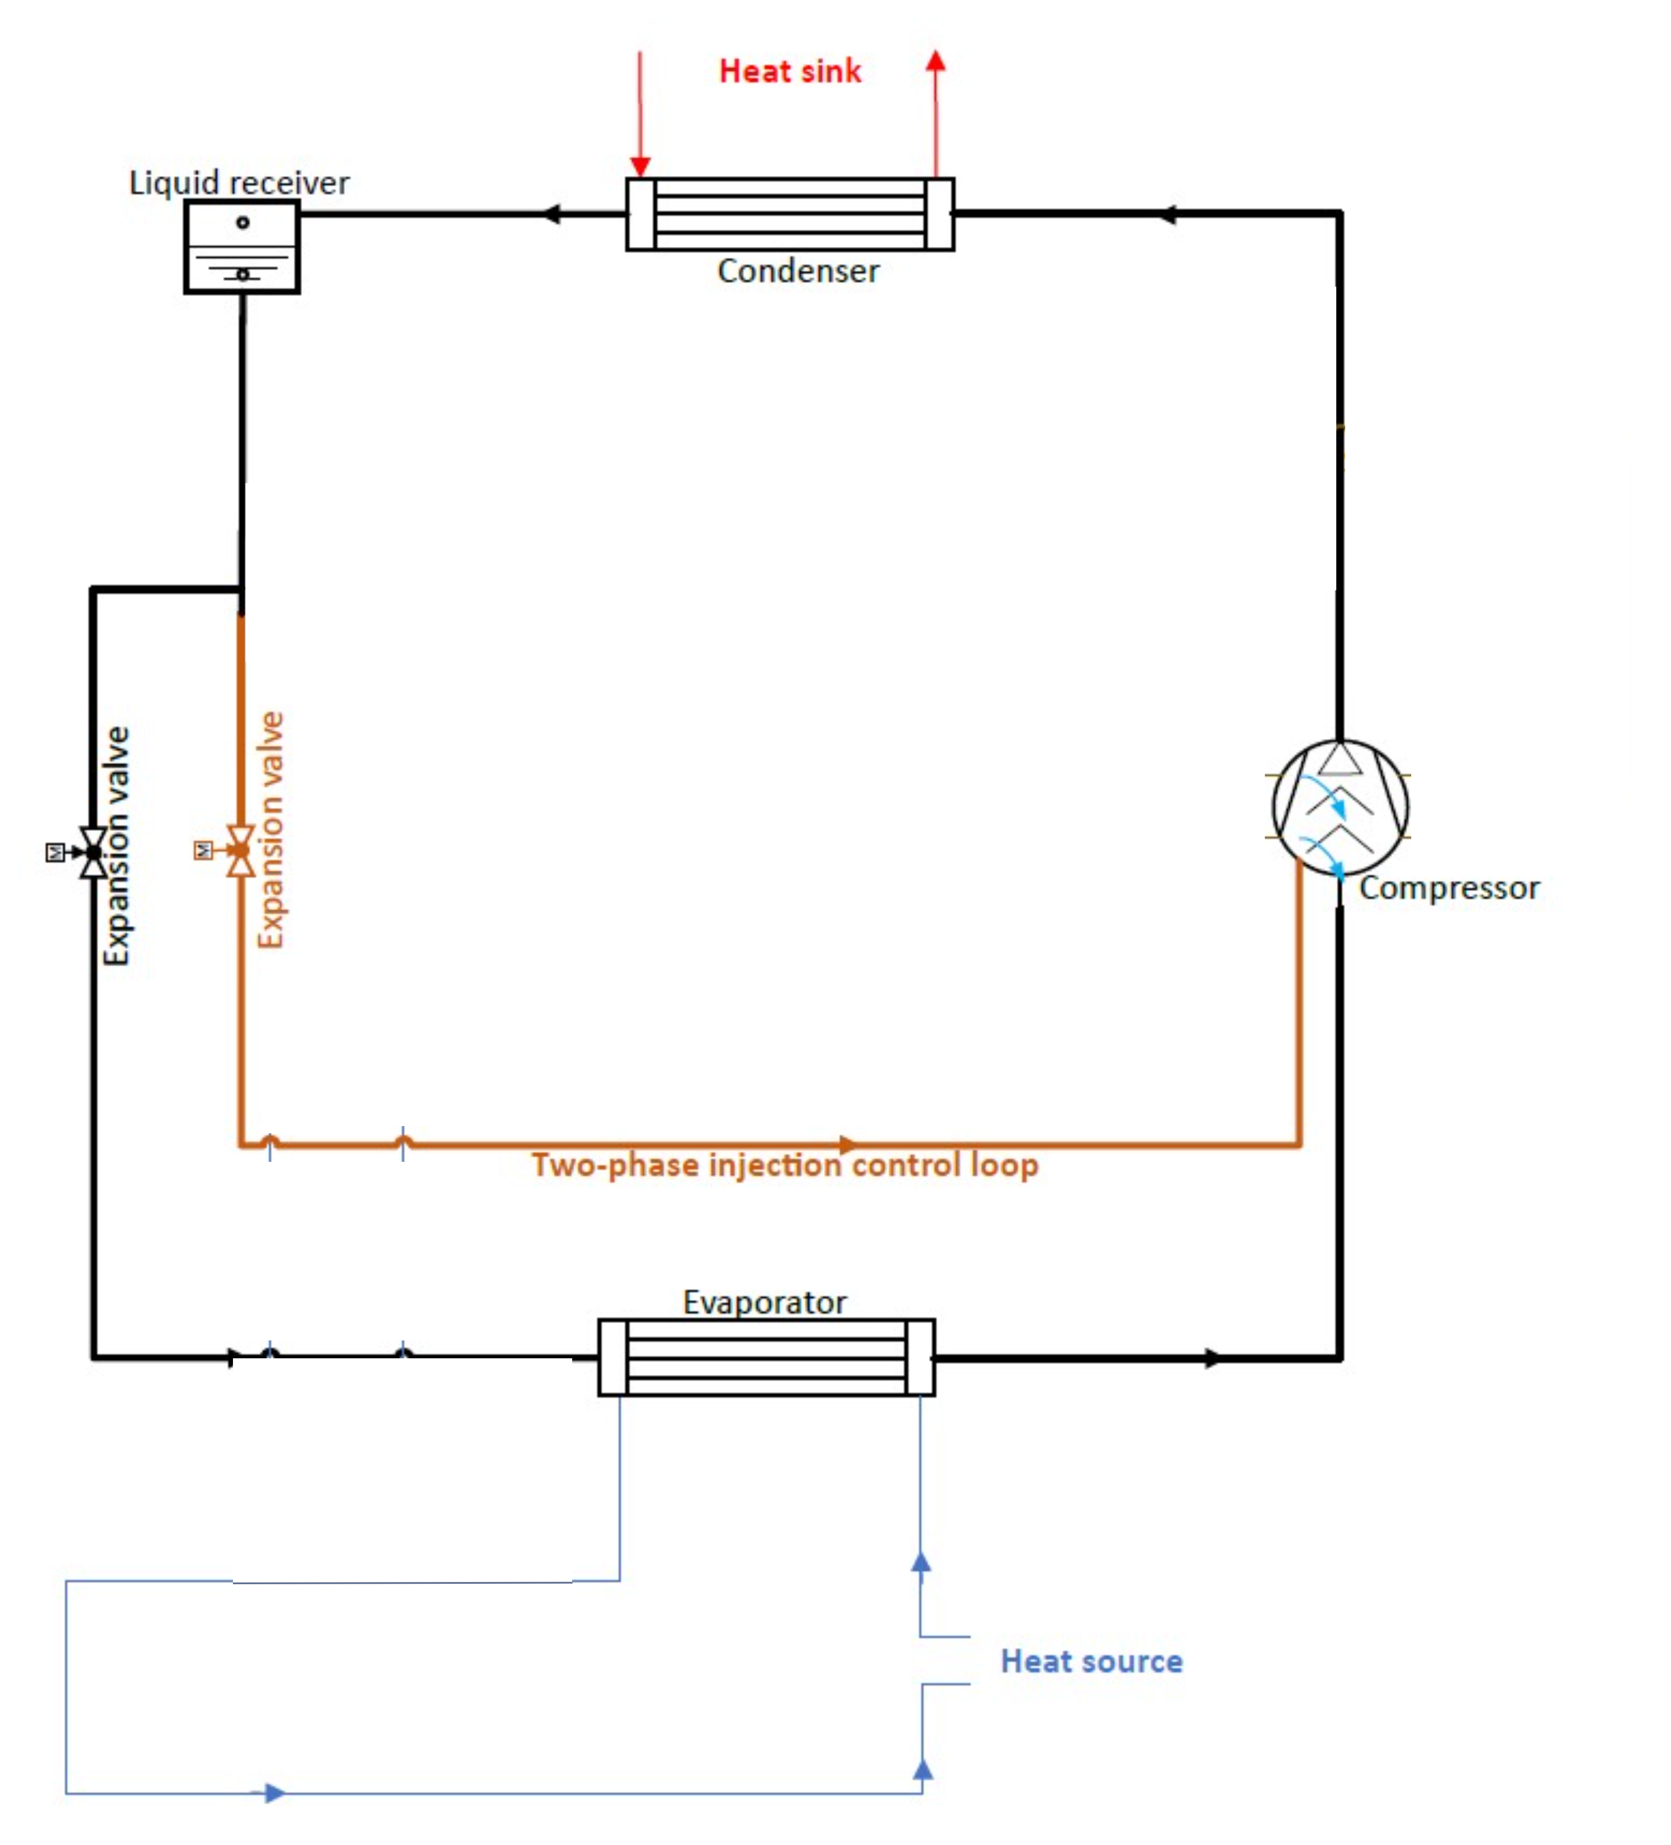

Water
High discharge temperature
Liquid/2-phase-injection
Notes:
But using water as a refrigerant results in some challenges.
First of all the high discharge temperature
This will be solved by using liquid or 2-phase injection.
But the high normal boiling temperature of 100°C also provides us with some challenges.

Slide 10
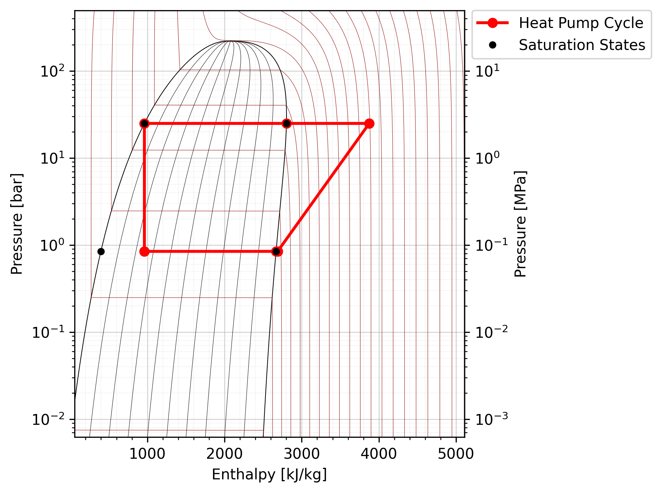
Water
Sub-atmospheric pressures
Vacuum pressure testing!
High pressure ratios
Low volumetric heating capacity
Addition of ammonia
normal boiling point 100°C
Notes:
This leads to sub-atmospheric pressures, high pressure ratios and low volumetric capacities.
To mitigate these challenges, ammonia is added.

Slide 11
Water And Ammonia
Notes:
How does adding ammonia relief these issues:
The sub-atmospheric pressures can be increased by adding ammonia
Not only the pressure, but the density will increase as well, resulting in a higher volumetric heating capacity
Adding ammonia will also increase the condensing pressure, but the pressure ratio will be reduced.
An added benefit of adding ammonia is that the mixture becomes zeotropic which allows for a better exergetic efficiency by matching the glides.

Slide 12

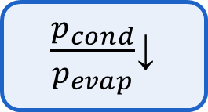
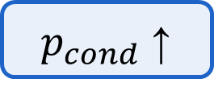
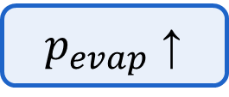
Water And Ammonia
$p_{cond}$↑
High pressure ratios
$\frac{p_{cond}}{p_{evap}}$↓
Sub-atmospheric pressures
$p_{evap}$↑
Low volumetric heating capacity
$ρ$↑
Vieren et al., Design of a high-temperature heat pump providing heat up to 200 °C, 2024
Notes:
How does adding ammonia relief these issues:
The sub-atmospheric pressures can be increased by adding ammonia
Not only the pressure, but the density will increase as well, resulting in a higher volumetric heating capacity
Adding ammonia will also increase the condensing pressure, but the pressure ratio will be reduced.
An added benefit of adding ammonia is that the mixture becomes zeotropic which allows for a better exergetic efficiency by matching the glides.

Slide 13
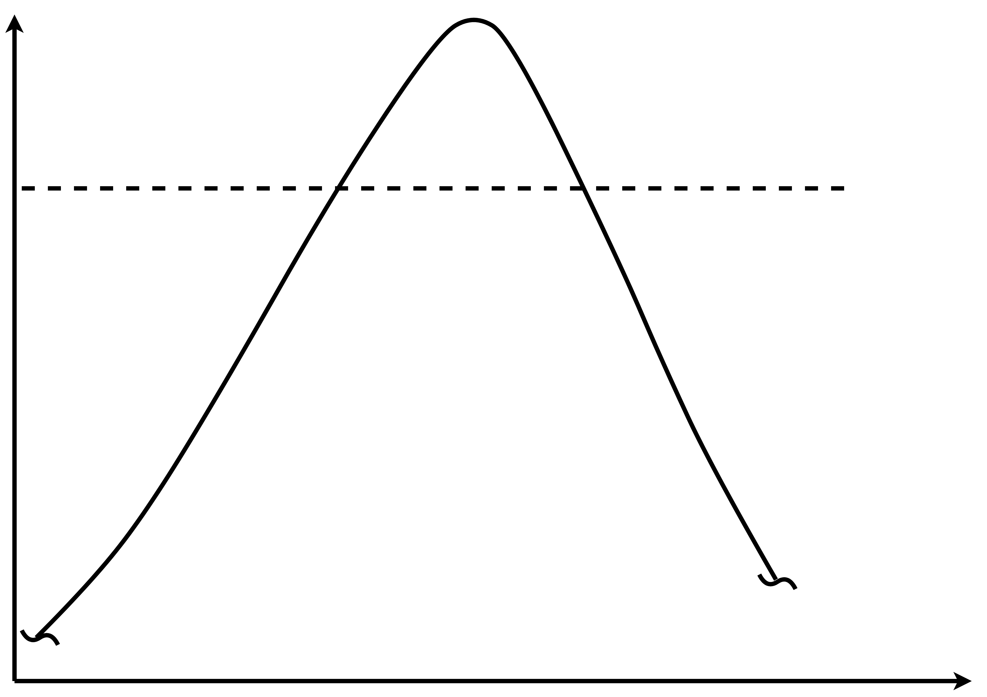

Temperature glide
T
250°C
Ammonia fraction condenses last
(and evaporates first)
condensing
Temperature glide
s

Slide 14
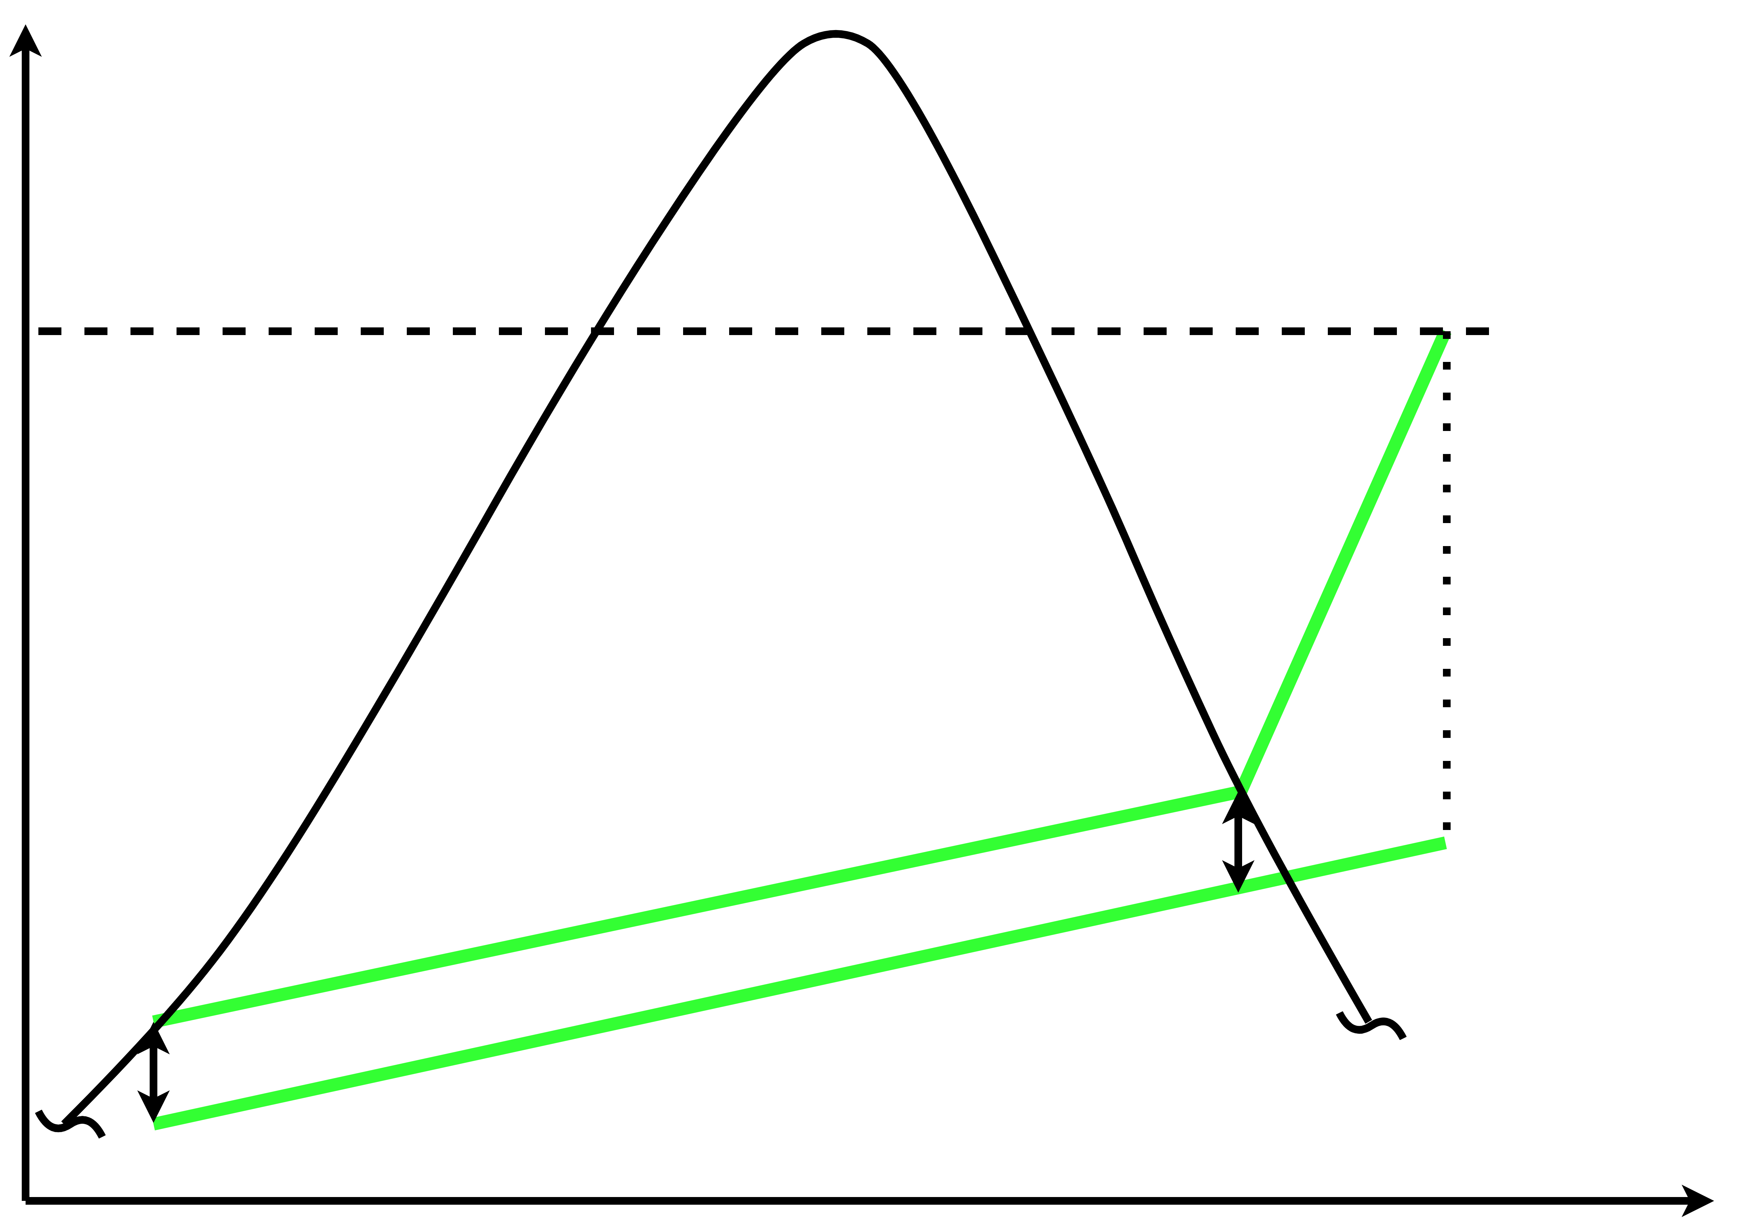
Water And Optimal Ammonia Concentration
T
250°C
86,5 mol % water
13,5 mol % ammonia
Pure water
Optimal ammonia fraction
200°C
Sink
170°C
s
Smaller temperature difference between fluids:
Reduce exergy losses

Slide 15
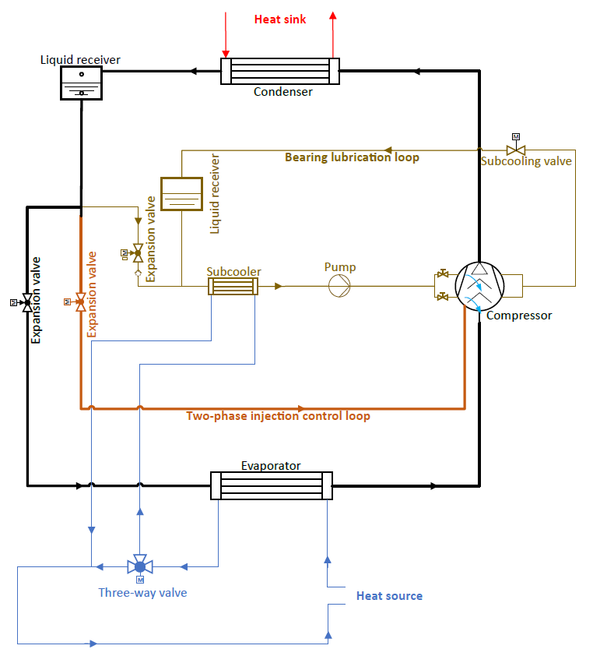


Demonstrator Setup
Main refrigerant circuit
Injection circuit
High T: Oil degradation
Oil-free, hydrodynamic bearings
Lubrication circuit
Challenge: Prevent evaporation
Stainless steel parts
(resistant to ammonia)
Notes:
With the refrigerant selected, the demonstrator can be constructed.
Important is that all the parts are stainless steel to resist the ammonia.
The complete

Slide 16
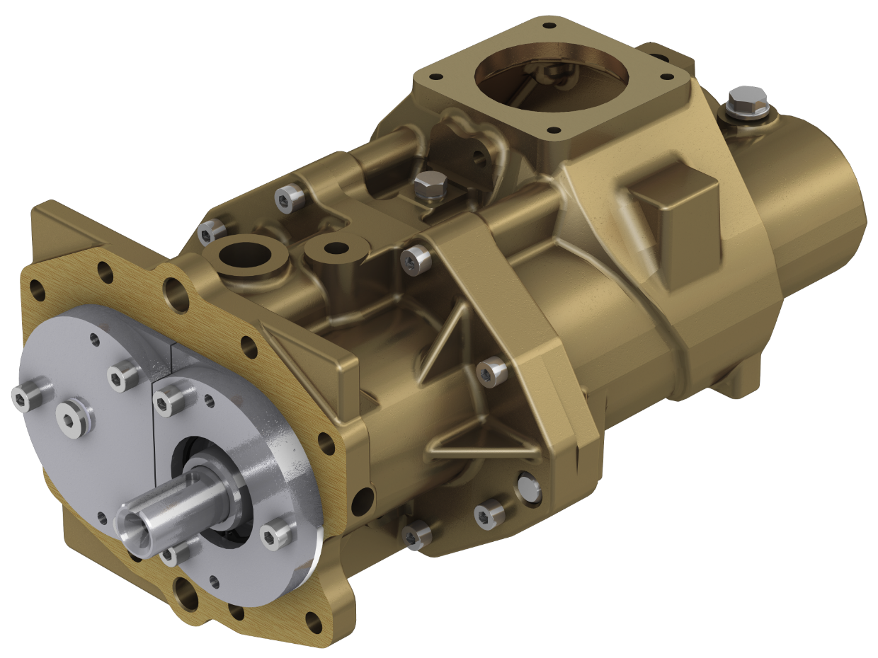

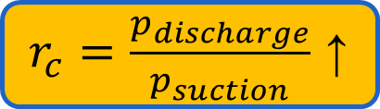



Main Refrigerant Circuit
$r_{c}=\frac{p_{discharge}}{p_{suction}}$ ↑
$$r_{c,turbo}<r_{c,TSC}<r_{c,piston}$$
$ρ_{suction}$↓
$${{\dot{V}}_{piston}<{\dot{V}}_{TSC}<\dot{V}}_{turbo}$$
Twin screw compressor (TSC)?
Liquid injection
liquid carryover tolerance ↑
Oil-free
Hydrodynamic bearings ✔
Twin screw compressor (TSC)!
Vieren et al., Design of a high-temperature heat pump providing heat up to 200 °C, 2024

Slide 17
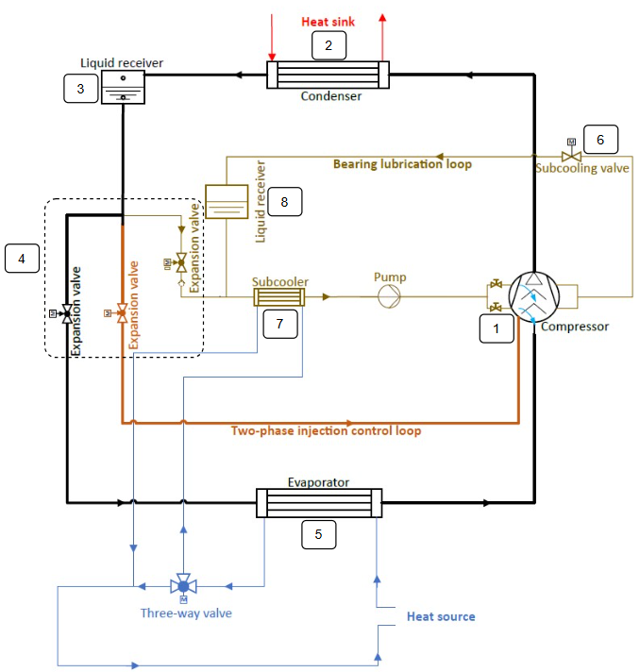
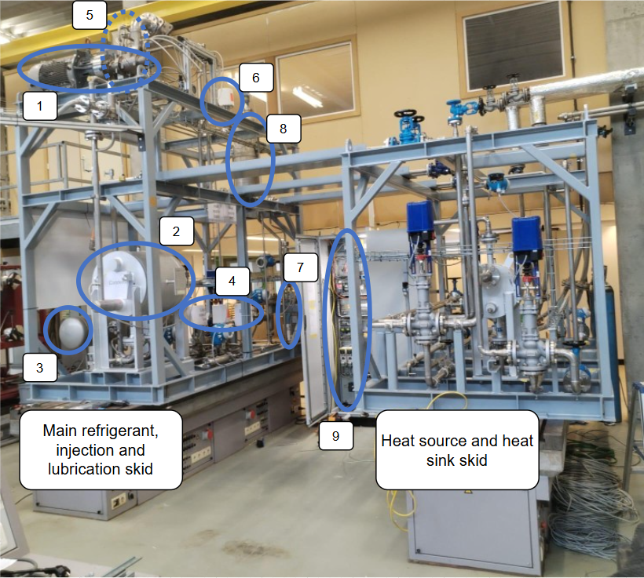
Heat Pump Setup

Slide 18
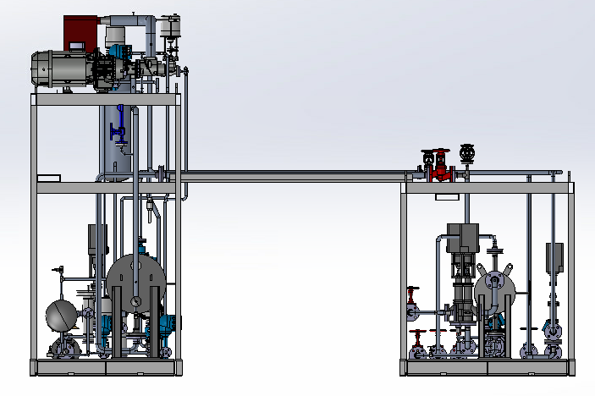
Dimensions demonstrator
Front view
3119 mm
2002 mm
1677 mm
1320 mm
1880 mm
1520 mm

Slide 19
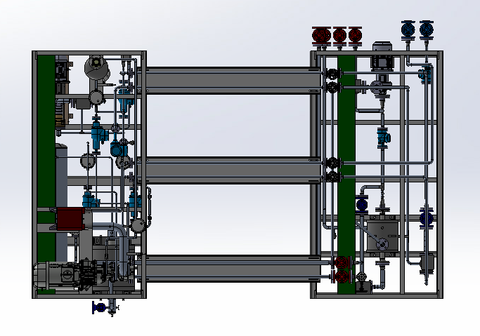
Dimensions demonstrator
Top down view
valves
2850 mm
3194 mm
Evaporator
Compressor
+motor
4720 mm

Slide 20
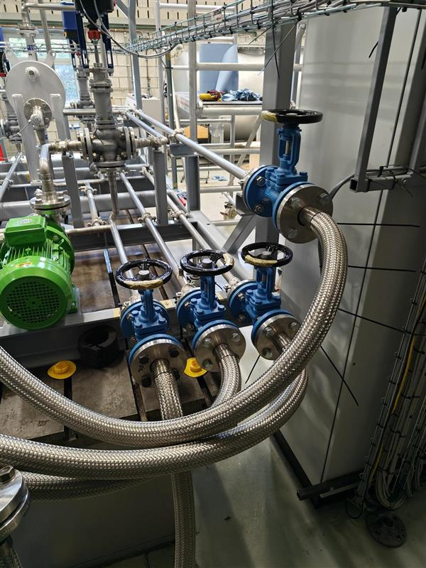
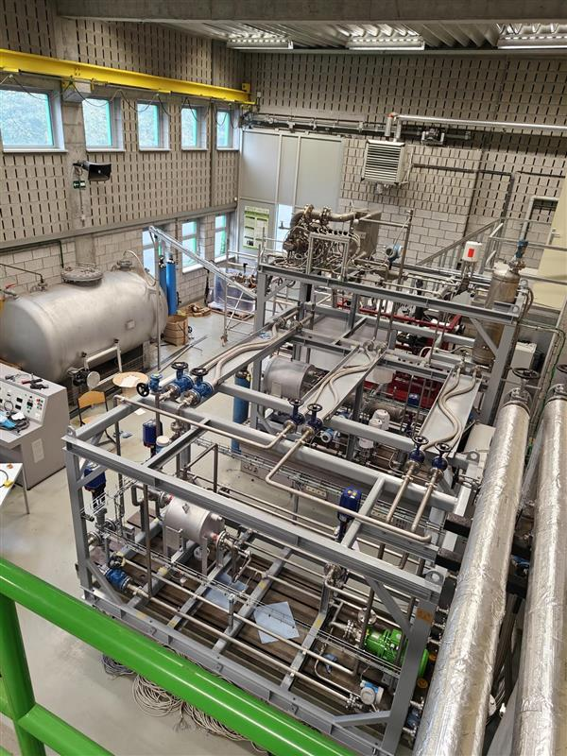
Demonstrator images
Spilling tank

Slide 21
Planning
Short term | 2026 |  |  | 2027
 | 10 | 11 | 12 | 1 | 2 | 3 | 4 | 5 | 6 | 7 | 8 | 9
Commissioning lubrication circuit
Startup procedure
Lubrication circuit tests
Operation range test
…
Long term | 2028 |  |  |  |  |  |  |  |  | 2029
 | 4 | 5 | 6 | 7 | 8 | 9 | 10 | 11 | 12 | 1 | 2 | 3
Upheat-B2I project
Water
Water
+Ammonia
Water
Water
+Ammonia

Slide 22

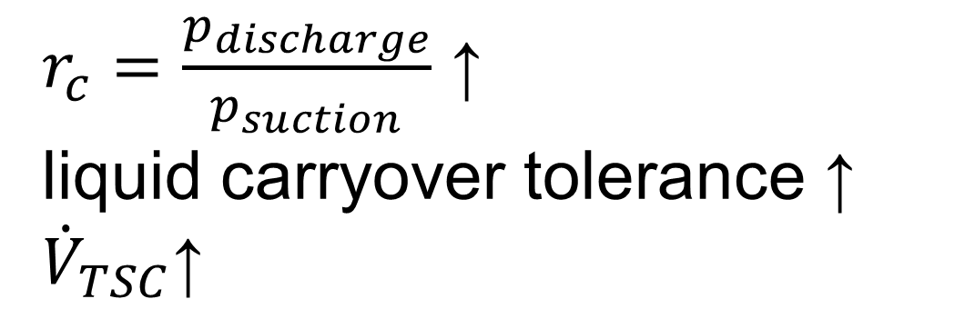
Conclusion
200°C supply
100°C lift
single stage
Target
p↓: ammonia (R717)
T_{discharge} ↑: liquid / 2-phase injection
Water (R718)
$r_{c}=\frac{p_{discharge}}{p_{suction}}$ ↑
liquid carryover tolerance ↑
$${\dot{V}}_{TSC}\text{↑}$$
Twin-screw
Main refrigerant
Liquid/2-phase injection
Lubrication circuit
Loops

Slide 23


Tim Van Craeynest
Department of ElectroMechanical, Systems and Metal Engineering
Sustainable Thermo-Fluid Energy Systems (STFES)
E tim.vancraeynest@ugent.be
Water-Ammonia HTHP with liquid injected and refrigerant lubricated twin-screw compressor
Universiteit Gent
@ugent
@ugent
Ghent University

Slide 24
Heat Upgrading in Energy Intensive Industry
200°C
~100kWth
Max lift:
100°C
Notes:
Therefor the upheat project from the moonshot initiative were started up.
The goal was to achieve 200°C with a HTHP, reaching a maximum lift of 100°C.

Slide 25
HTHP Design Demonstrator
200°C
170°C
Max: 250°C
25bar
Single stage
100°C
120°C
Notes:
This was translated into the following design:
170°C inlet temperature at the sink.
120°C inlet and 100°C outlet at the source
Maximum 250°C and 25bar mostly for material compliance.
And all of this in a single stage

Slide 26
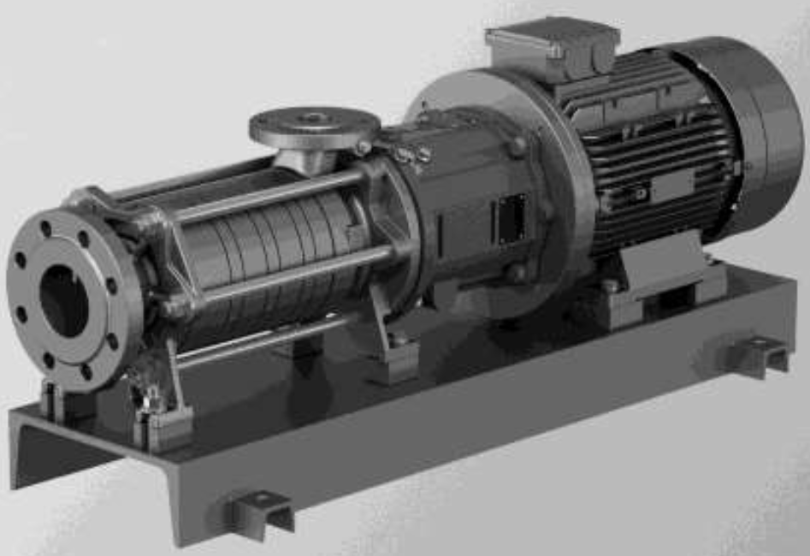

Bearing Lubrication Circuit
Liquid receiver
provides temporary refrigerant supply during start‑up
accommodates charge variations
Saturated Liquid
Potential cavitation
4-step channel pumps
Liquid
Liquid

Slide 27
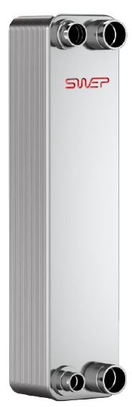
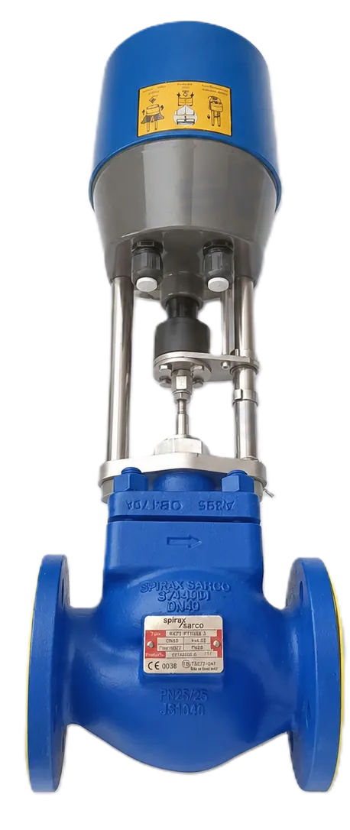

Bearing Lubrication Circuit
Liquid receiver
provides temporary refrigerant supply during start‑up
accommodates charge variations
Saturated Liquid
Potential cavitation
4-step channel pumps
Liquid
Liquid
Prevent evaporation when p↓
Subcooling with source fluid
Prevent evaporation↓
Increase backpressure

Slide 28
Bearing Lubrication Circuit
Leakage to main flow in compressor
Refilling valve

Slide 29
Water-Ammonia HTHP with liquid injected and refrigerant lubricated twin-screw compressor

Slide 30
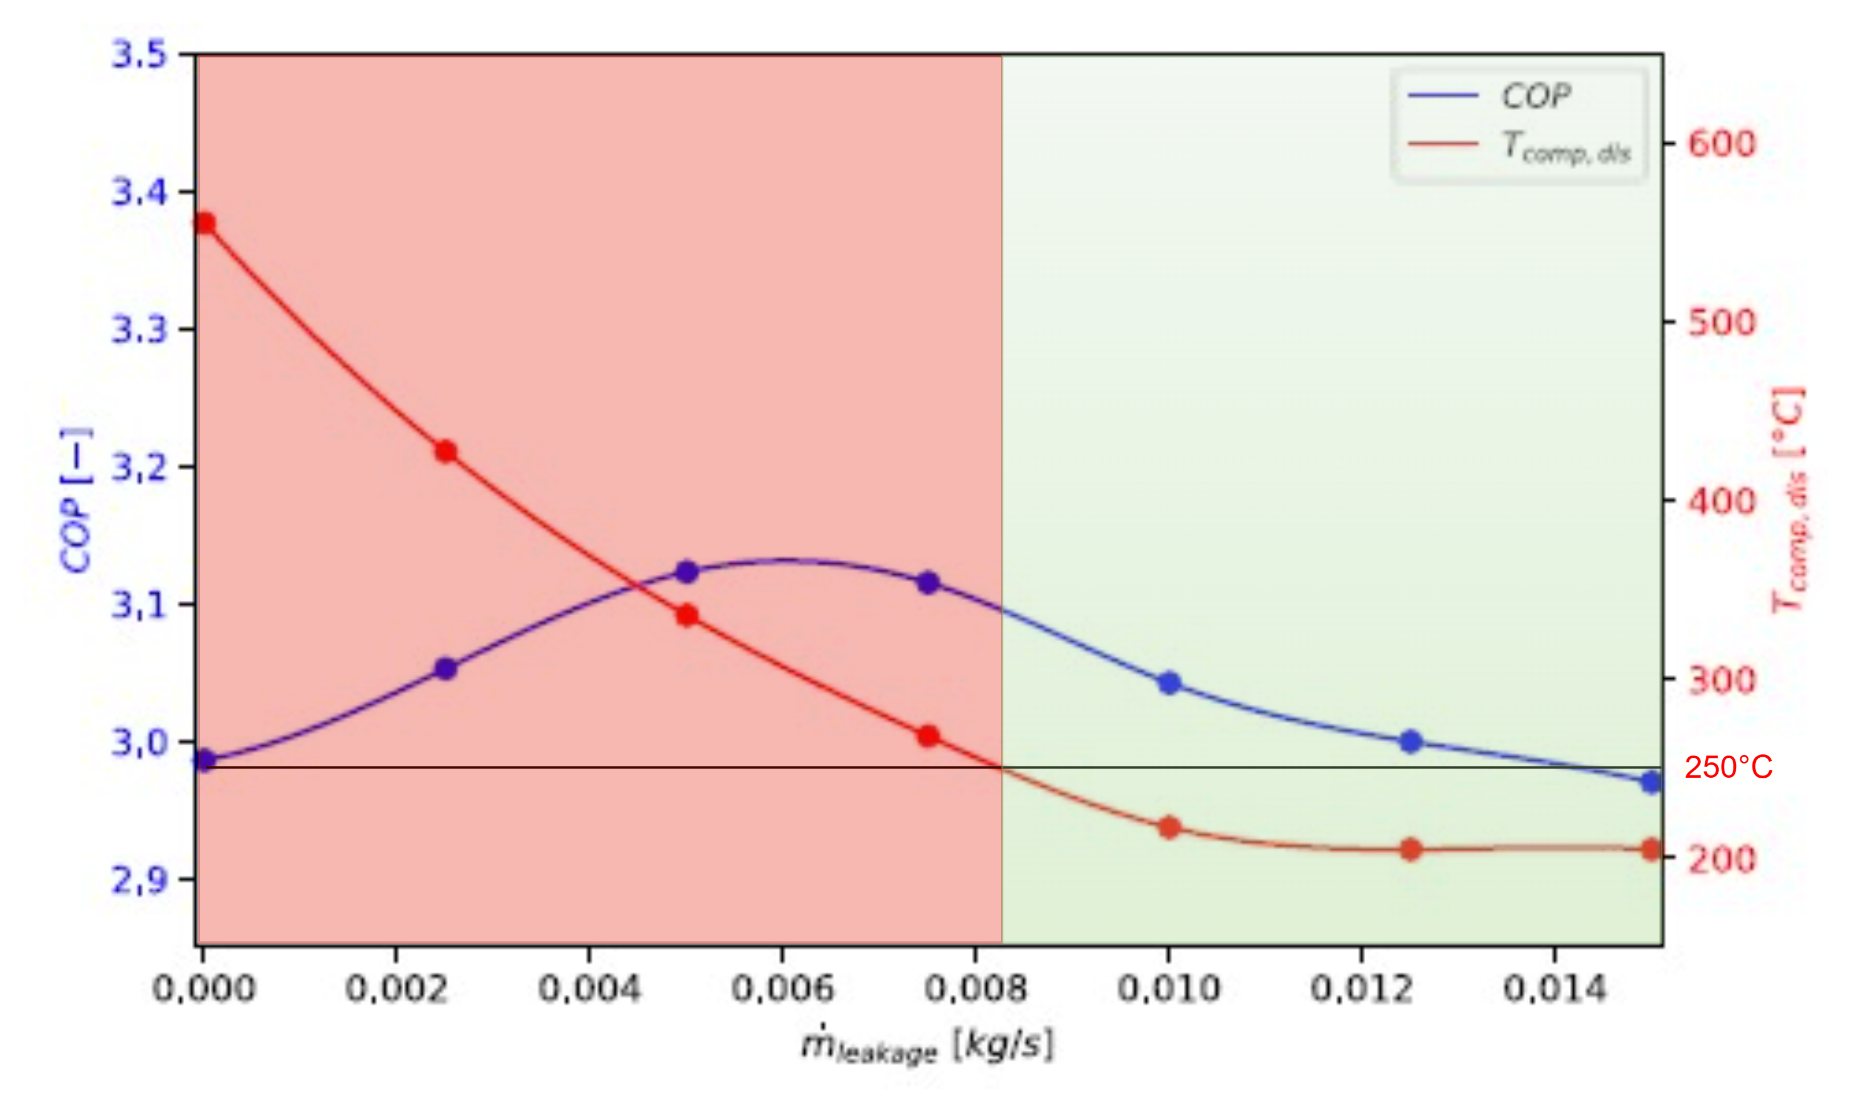
Optimal Ammonia Concentration
Boundary
conditions
PPTD = fixed
Condenser out = saturated (liquid receiver)
Sink temperatures = fixed
$$T_{max}=250°C$$
Optimal ammonia concentration
Optimal discharge temperature
T
250°C
Sink
86,5 mol % water
13,5 mol % ammonia
s
Vieren et al., Design of a high-temperature heat pump providing heat up to 200 °C, 2024
Vieren et el., Advancing Industrial High-Temperature Heat Pumps through Financial, Thermodynamic and Technological Evaluation, 2025
Notes:
How was the optimal ammonia concentration decided
The boundery conditions are the following:
The PPTD is Fixed
The condenser outlet state is saturated (a little spoiler here but this is because there will be a liquid receiver after the condenser)
The sink temperatures are known
And the maximum temperature is 250°C
Furthermore, Vieren et al. found that the maximum allowable COP is found when the discharge temperature is at the limit. (trade-off more isothermal compression vs higher condensing pressures)
And lastly by adding ammonia the temperature glide will change. For small fractions of ammonia this result in an increased glide temperature difference when the ammonia fraction increases.

Slide 31
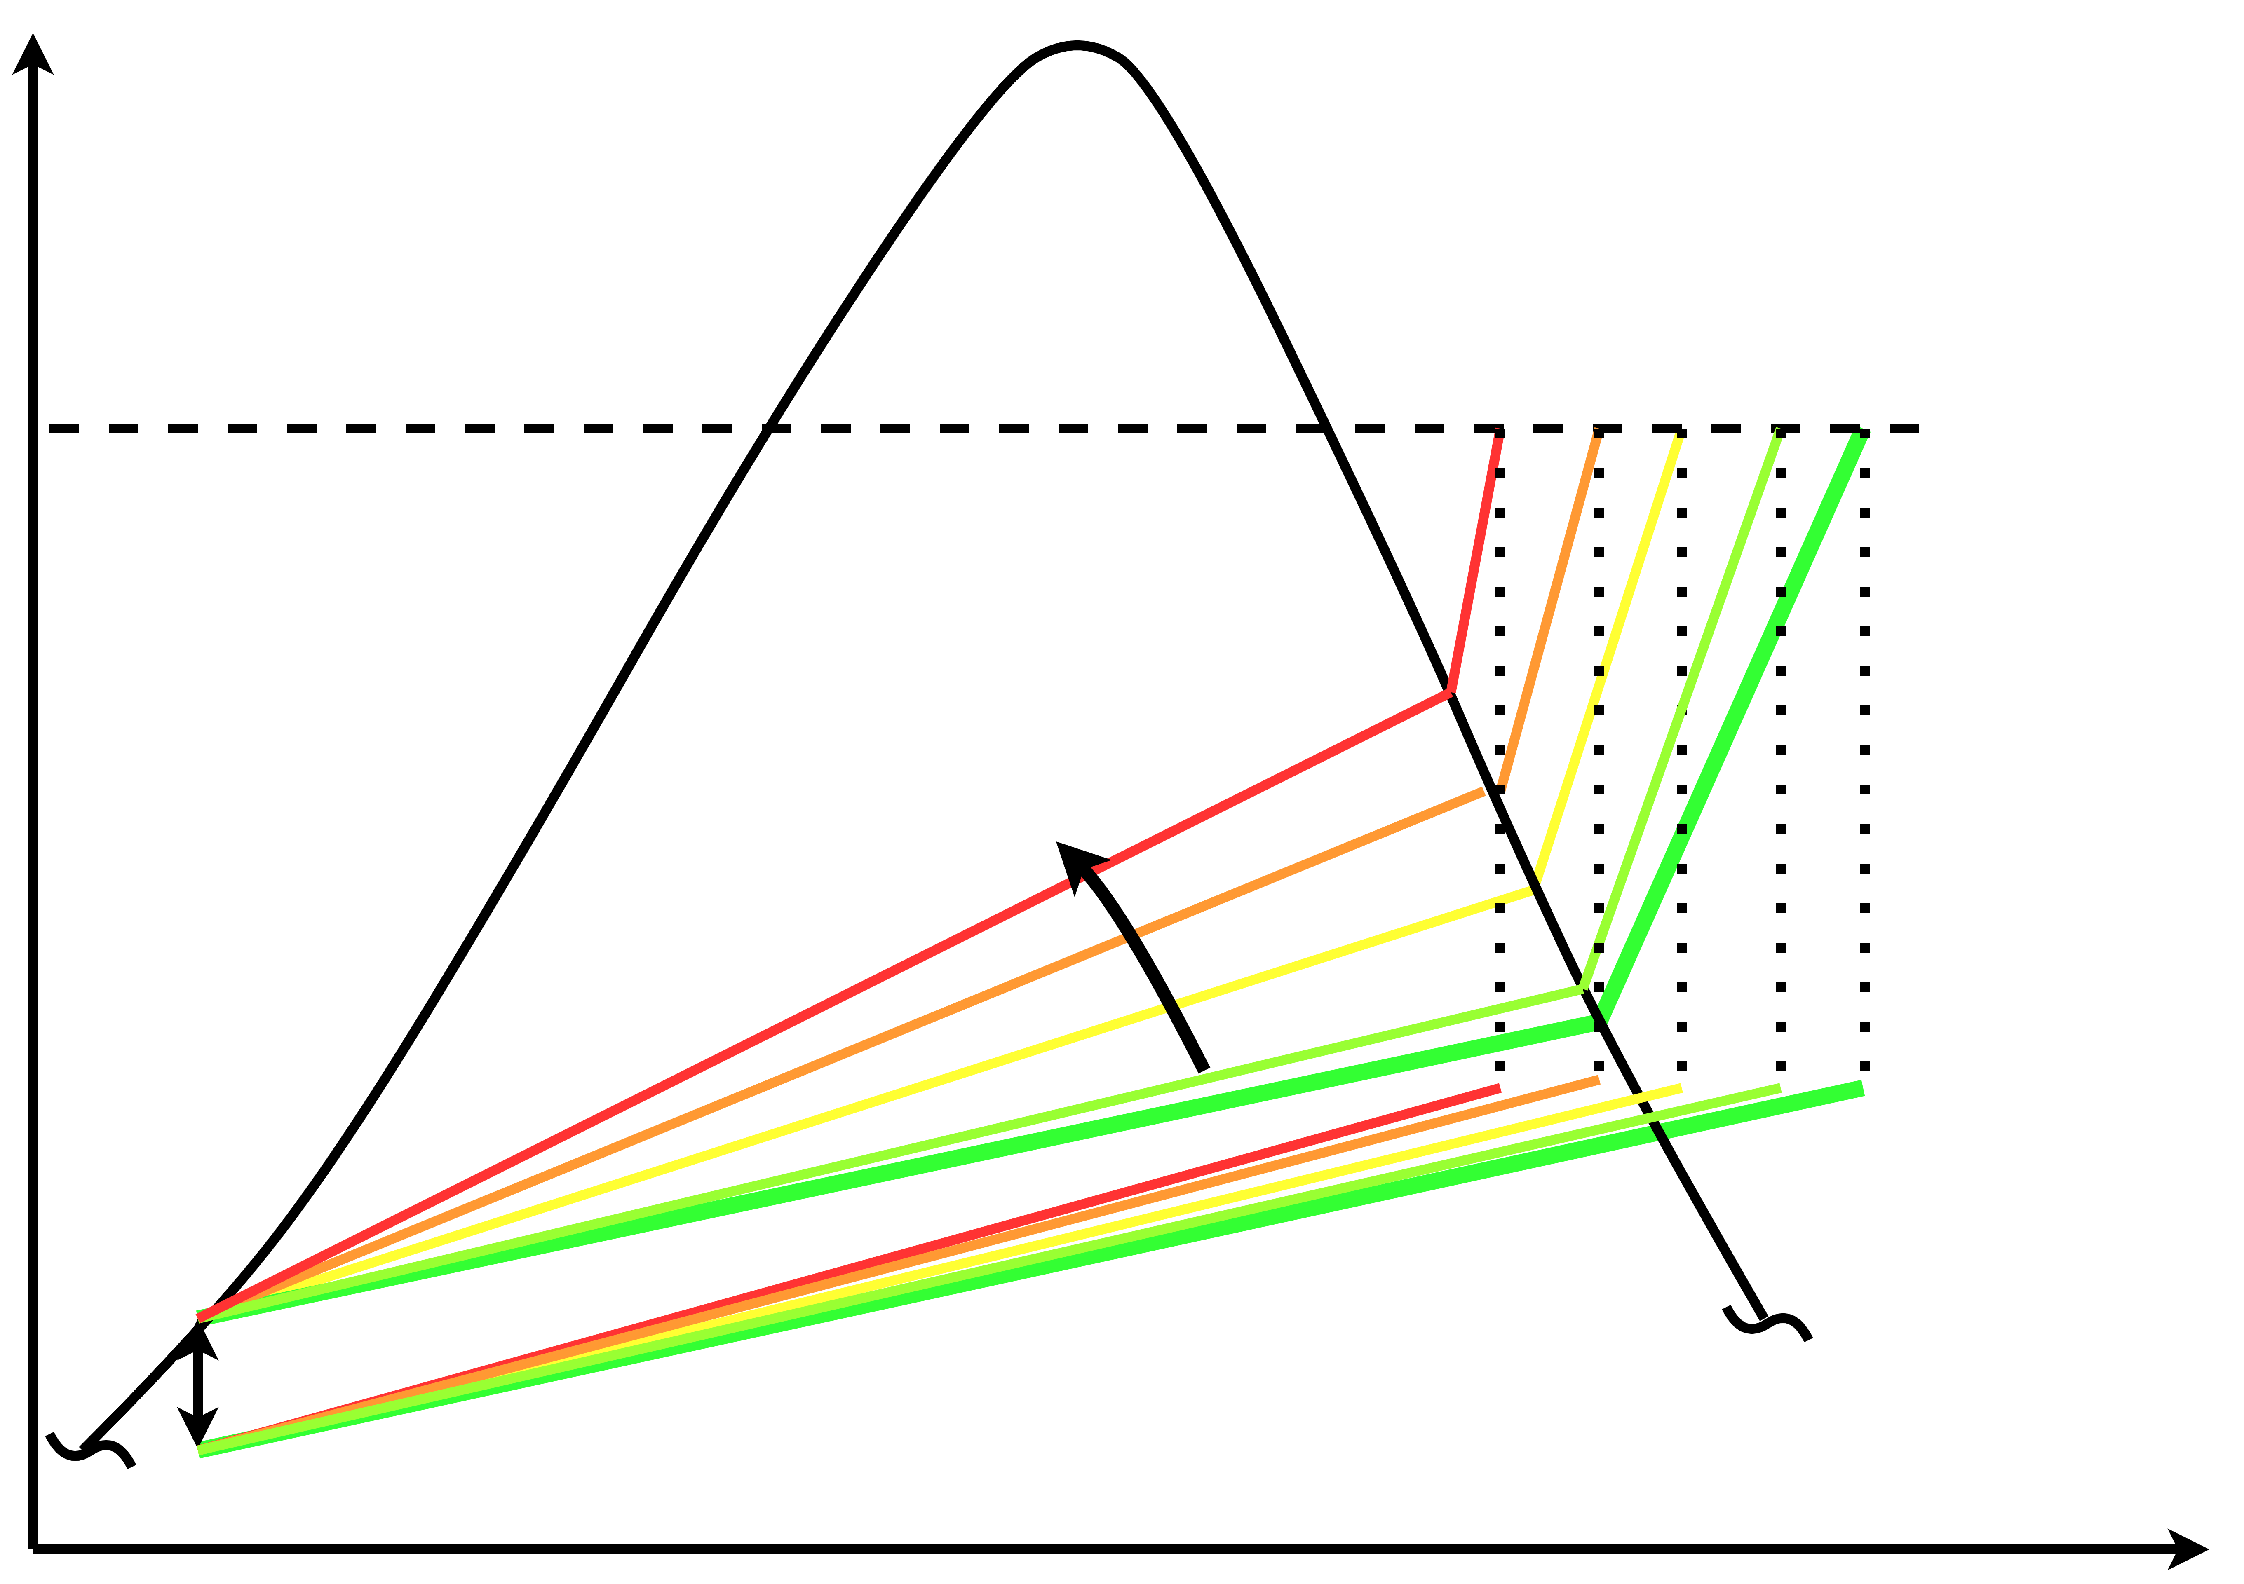
Water And Optimal Ammonia concentration
T
250°C
86,5 mol % water
13,5 mol % ammonia
Increased ammonia fraction
Sink
s
Notes:
Going to higher concentrations, the matching is again lost and the PP is now at the sink inlet.

Slide 32

Bearing Lubrication Circuit
Leakage to main flow in compressor
Refilling valve
Only open when compressor ON:
$$p_{main}>p_{lubrication}$$
Cv = 0.1

Slide 33
Demonstrator images

Slide 34
Demonstrator images

