Slide 1
industriële warmtepompen
Steven Lecompte

Slide 2


Slide 3

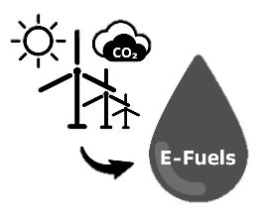



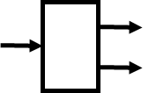
Renewable heating options
Solar energy and thermal storage
Hydrogen
E-fuels
< 200°C & > 200°C
Electrical boilers
Biofuels
Heat pumps
< 200°C
Heat recuperation
Heat transformers

Slide 4
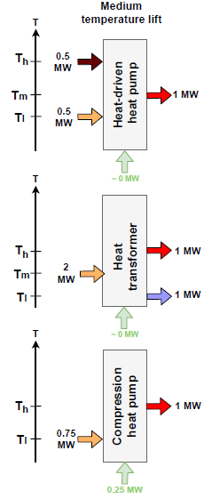
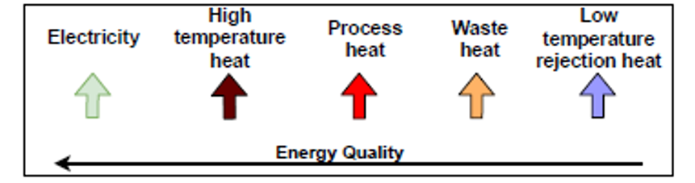
Heat pumps
COP = 2
Type 1
Type 2, warmteomvormer
COP = 1/2
COP = 4
Dampcompressie

Slide 5
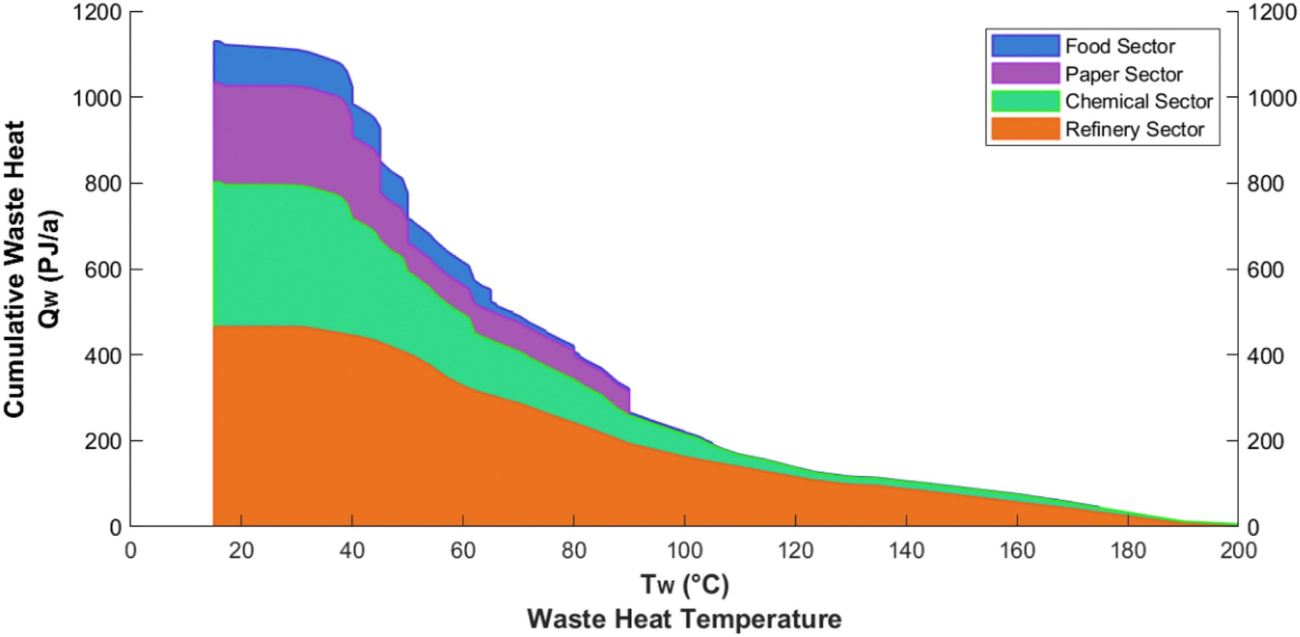
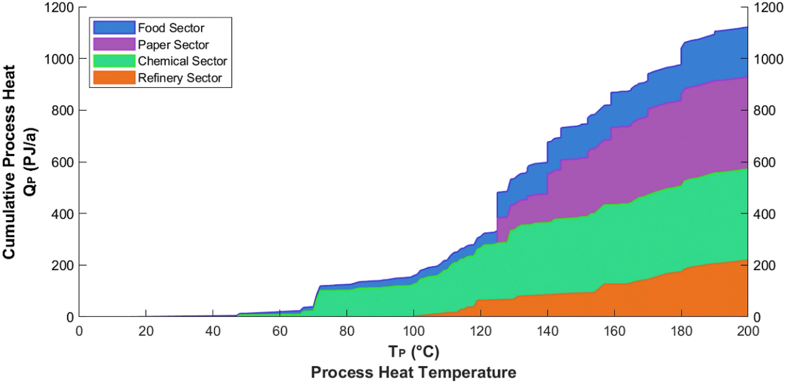
Heat pumps = upgrading heat
Heat pump technologie
1200
1200
Cumulative Process heat
(PJ\a)
Cumulative Process heat
(PJ\a)
0
0
0 20 40 60 80 100 120 140 160 180 200
0 20 40 60 80 100 120 140 160 180 200
Waste heat temperature (°C)
Demand heat temperature (°C)
Marina et al. (2021)
Notes:
Uitleggen dat lucht niet echt altijd een optie is door te hoge deltaT.

Slide 6
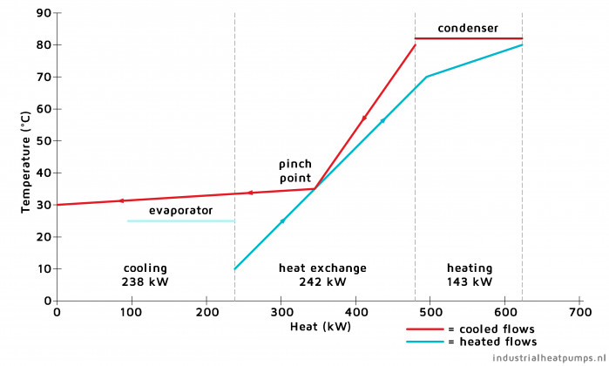
Heat pump integration
PINCH ANALYSIS

Slide 7
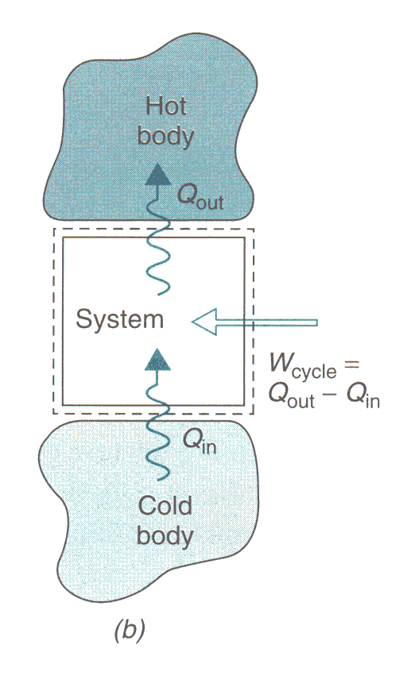
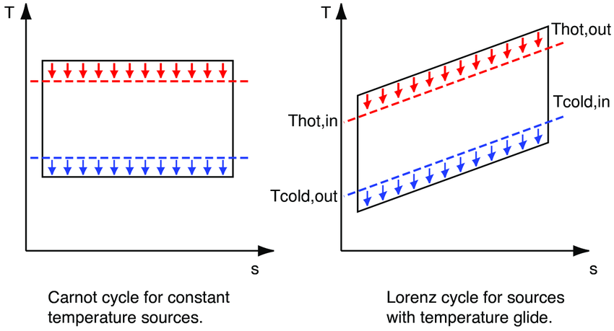
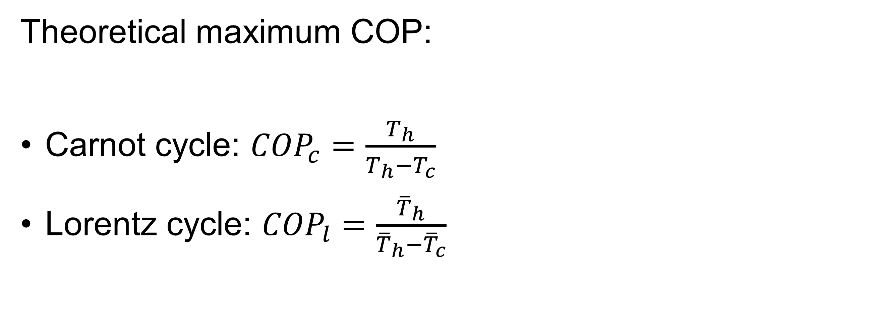
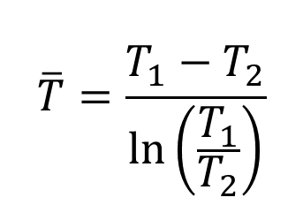
Coefficient of performance (COP)
Theoretical maximum COP:
Carnot cycle: ${COP}_{c}=\frac{T_{h}}{T_{h}−T_{c}}$
Lorentz cycle: ${COP}_{l}=\frac{{\overline{T}}_{h}}{{\overline{T}}_{h}−{\overline{T}}_{c}}$
$$\overline{T}=\frac{T_{1}−T_{2}}{ln⁡\left(\frac{T_{1}}{T_{2}}\right)}$$

Slide 8
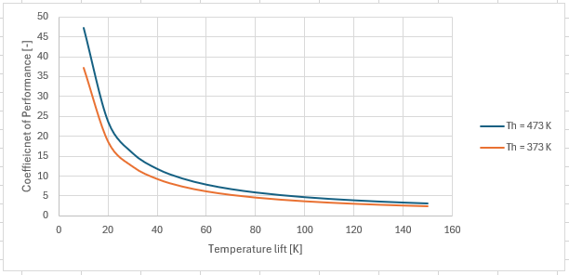
Max. Coefficient of performance
Illustration of Carnot COP
High-temperature heat pumps: higher theoretical COPs (considering the same temperature lift)
High temperature heat pumps however often have higher lifts.
  → In practice lower COPs
Typical heat pump COP < 0.5 COP_{c}
Temperatures in Kelvin!

Slide 9
In practice

Slide 10
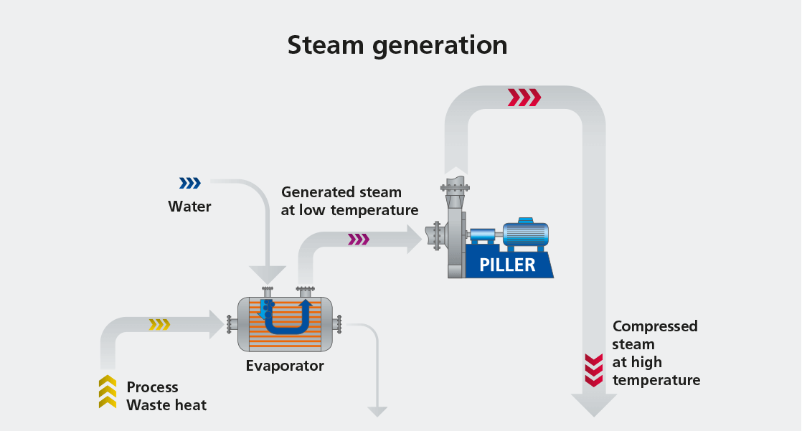
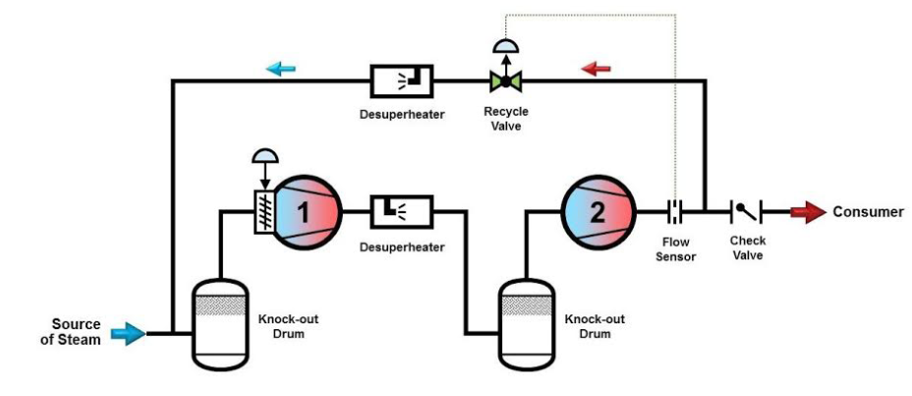
High T
Mechanical vapour recompression (MVR)
Atlas Copco

Slide 11
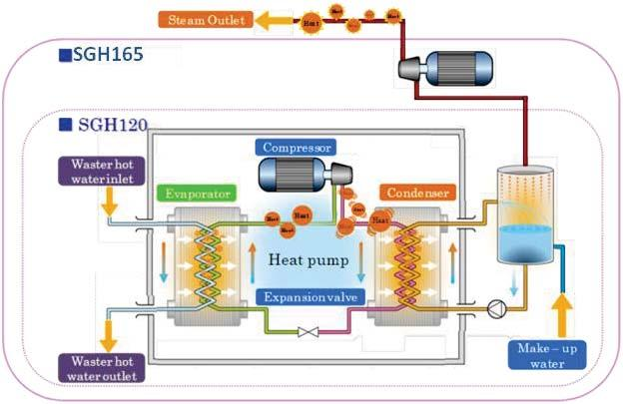
Versus Large ΔT
Vapour compression heat pump + MVR

Slide 12
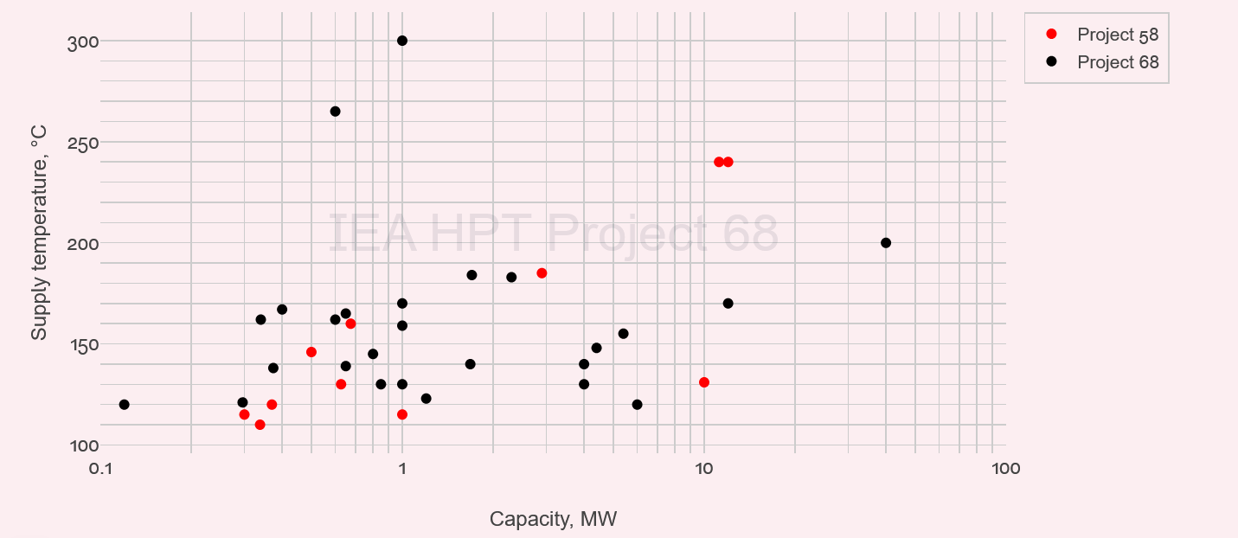
Trends (T) 2021-2023 & 2023-2025

Slide 13
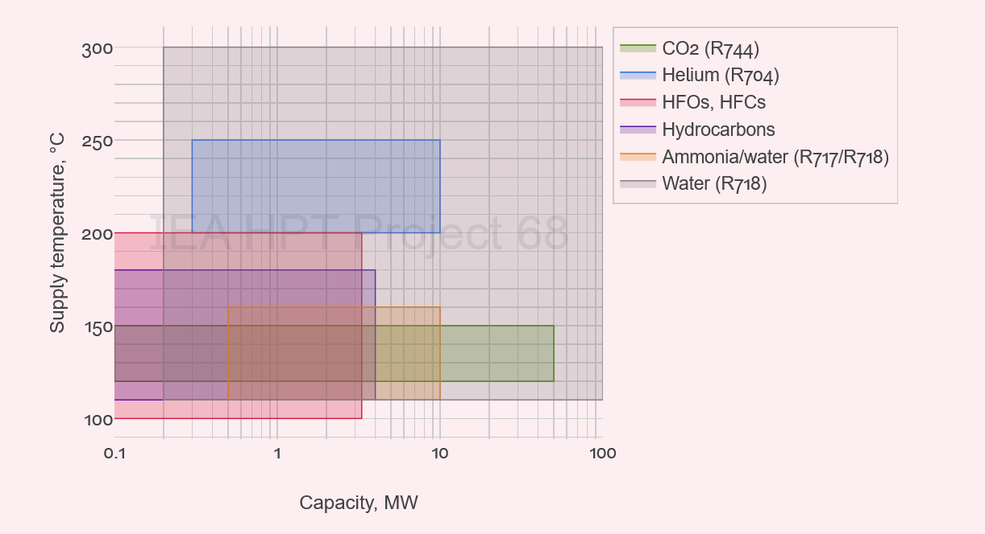
Refrigerants (T)

Slide 14
Refrigerants historical overview
Nieuwe EU F-gas
Kyoto protocol (1997)
Montreal protocol (1987)
1ste EU F-gas regelgeving (2006)
CO₂, NH₃, HC
HFO, etc.e
HFC, etc.e
CFC, HCFC, etc.e
HC, NH₃, etc.e
CO₂, NH₃, SO₂, etc.e
HC: Hydorcarbons
CFK: Chlorofluorocarbons
HCFK: Hydrochlorofluorocarbons
HFC: Hydrofluorocarbon
HFO: Hydrofluoroolefin
1830
1930
1950
1990
2010
2024
…

Slide 15
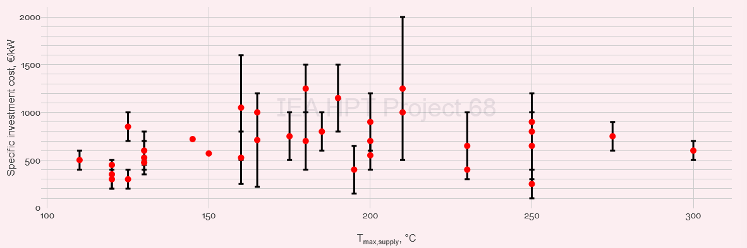
Cost (T)

Slide 16
Availability
Dampcompressie
TRL 6+
> 1MW
< 8MW
T_{supply} >=140 °C
T [°C]
280
Spilling
250
Enerin
212
Piller
200
Heaten
Heat Lift
Turboden
180
160
Sustainable process heat
Ago Caldora
Futraheat
Aneo industry
Epcon
140
Rank
120
100
0
1
2
3
4
5
6
7
8
10
15
30
70
100
Q [MW]

Slide 17
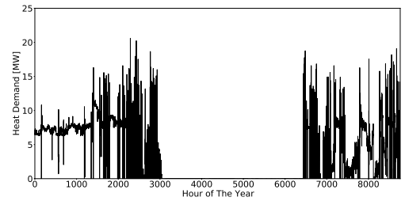
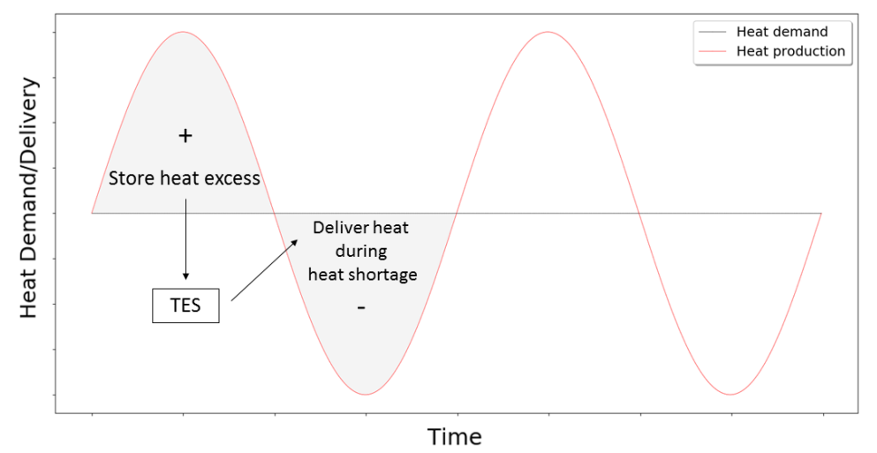

Synergy with thermal energy storage
Three main synergies:
Smaller/better sizing of heat pump
Can optimally handle dynamic energy prices:
  Low electricity prices: Charge storage
  High electricity prices: Discharge storage
More continuous operation of heat pump
Discharge storage
Charge storage
TES
Heat
HP
Process
El.
Heat

Slide 18
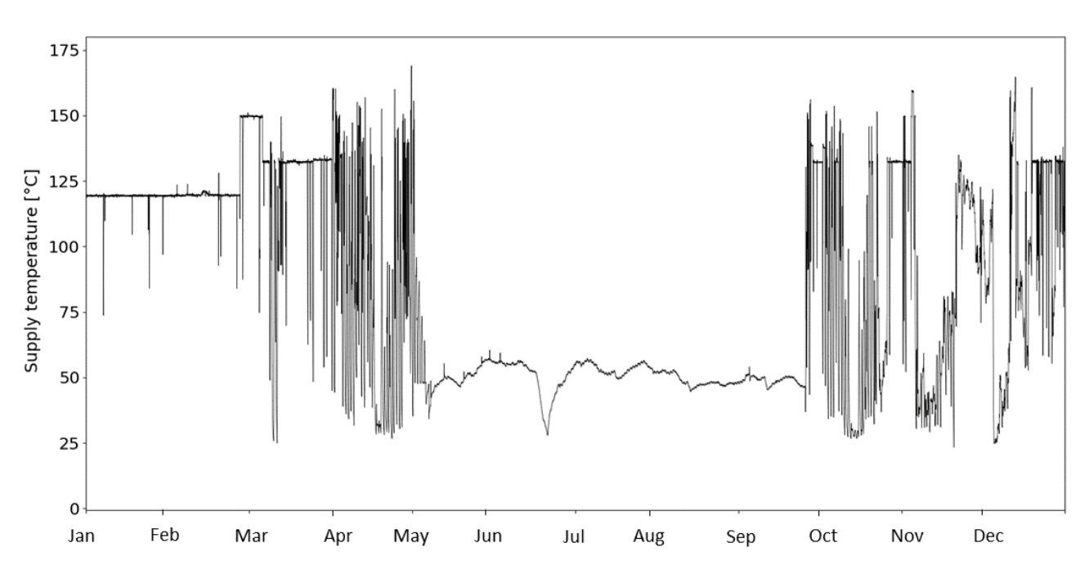
Synergies with electric boiler
Smaller sizing of heat pump
Boost temperatures
Electrical heater
Electrical heater

Slide 19
Synergy With natural gas boilers
Smaller/better sizing of heat pump
Boost temperatures
Handle dynamic energy prices
  Low electricity prices
  High electricity prices
El.
Heat.
HP
Process
Heat.
Gas boiler
Notes:
Oké resultaten toevoegen SDR.

Slide 20

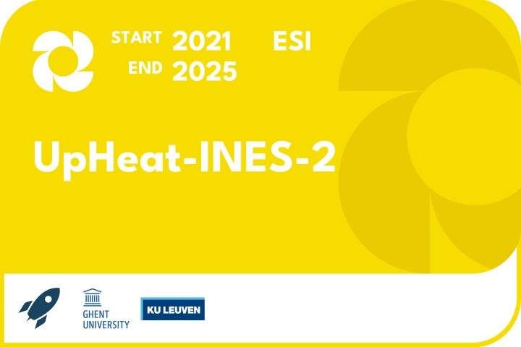

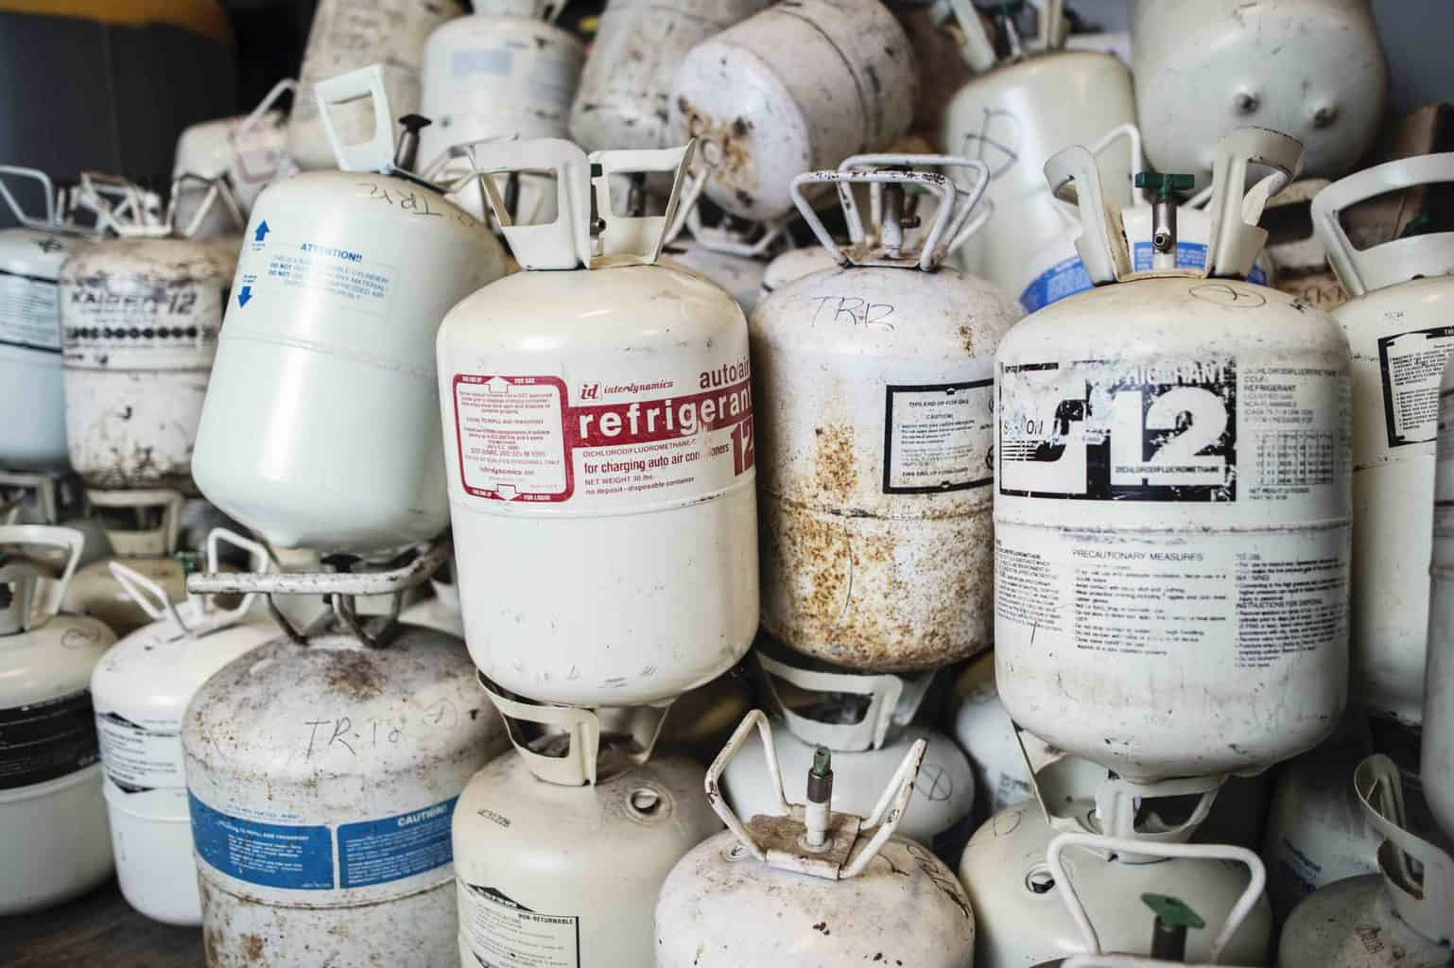




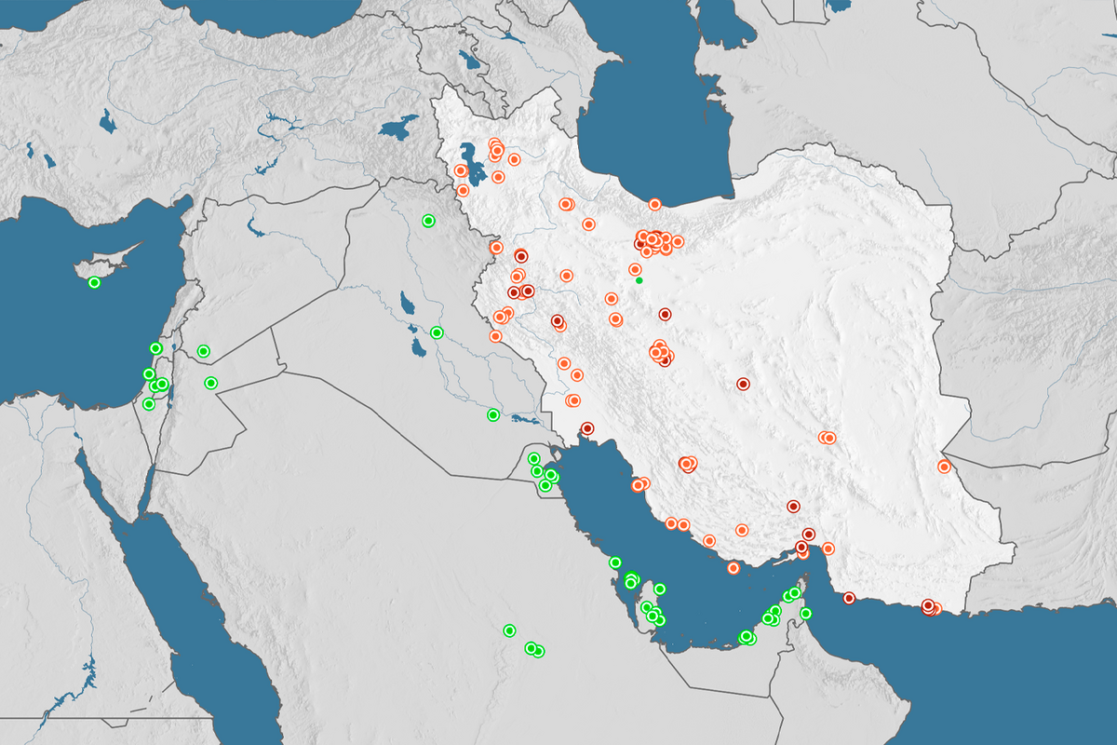
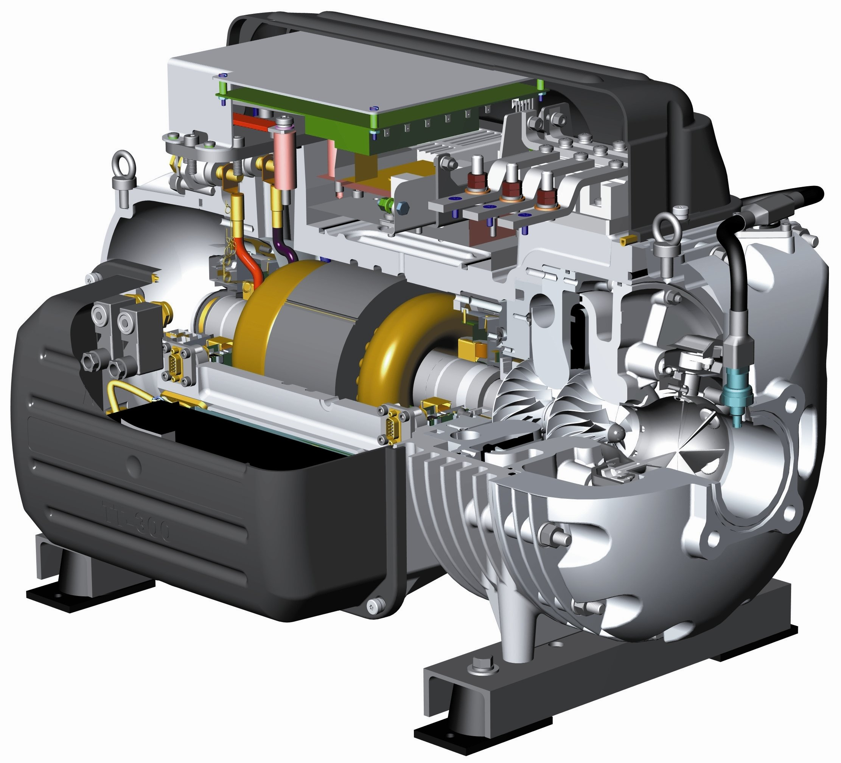
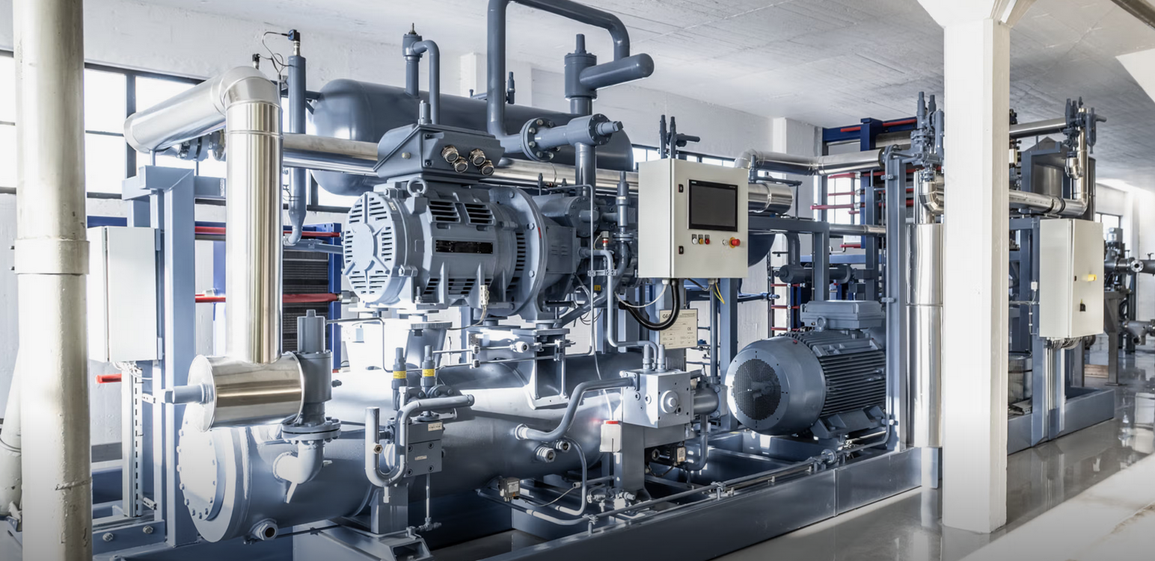


context
2010-2020
Derivative products refrigeration technology
2020-2023
Scaling up, research into higher temperatures, and initial demonstrators
2023-2024
Efficiency, materials, steam, EaaS
2025
Rethinking industrial processes, flexibility
2026
Commercialization, demonstration of high temperatures (>200°C)

Slide 21
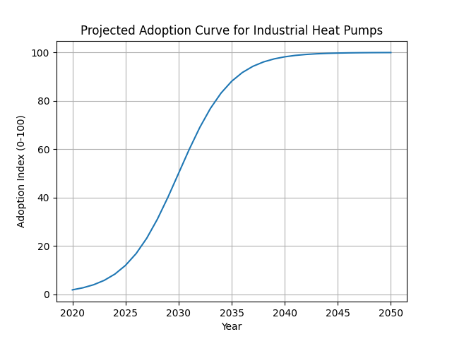
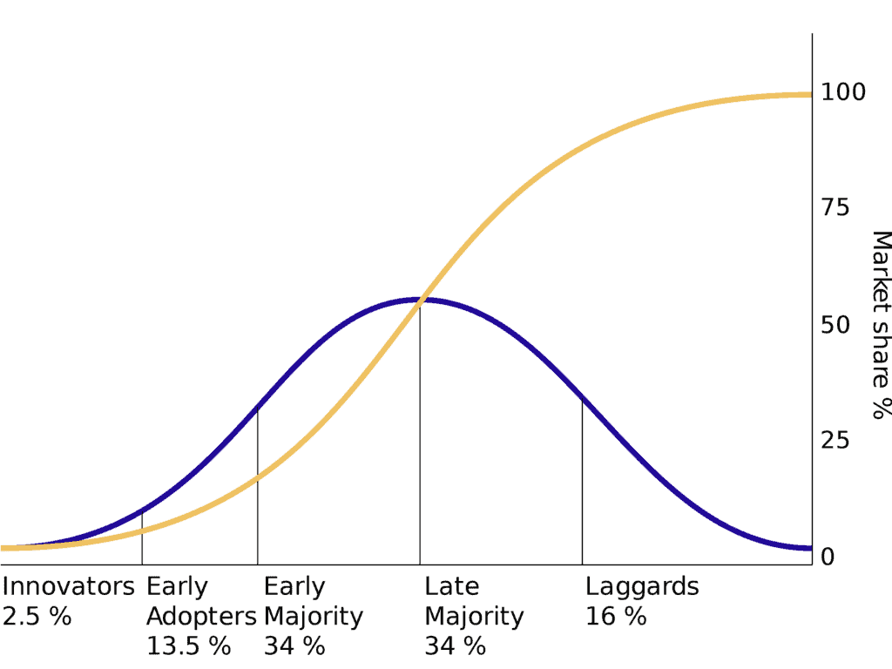
Adoption curve
Projected from EHPA data 2025
Copilot

Slide 22
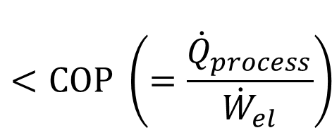
Decision factors
  Energy cost
    Cost ratio Elek/Gas
    Absolute cost values
  CO₂ cost
  Residual heat availability
  Cost heat recuperation
  Combination with cooling
Positive for HP
$$<COP \left(=\frac{{\dot{Q}}_{process}}{{\dot{W}}_{el}}\right)$$
Low
High
Variabel
High
High
Low
+
Notes:
Rekening mee te houden in een haalbaarheidsstudie

Slide 23
Wat zijn de uitdagingen 2026
  Geen of weinig stimulans
    Beleid EU (ETS-(2))
    CfD, …
    Energiezekerheid
  Elektriciteit versus gasprijs onvoordelig
    Grote variabiliteit!
    Toekomst?
    Situatie Midden-Oosten
  Lage TRL
    Zie tijdslijn hiervoor en demonstrators
  Netcapaciteit onvoldoende
    Opslag
    Verdubbeling investering vanaf 2025 (naar ~0,5% EU-BBP ~ 100 miljard/j) [Eurelectric]
    [EU defensie: 2022: 1,5%, 2025: 2,1% -> 0,6pp (<->0.25pp)]

