Slide 1


25 September 2026
Energik: Industriële warmtepompen
1 October 2026

Slide 2

25 September 2026
Version 1.1
2-stage NH3 Heat Pump
Koen Demerie & Thomas De Cuyper
Equans Belux - Industry North
Notes:
imachs: Integrated maintenance automation cooling & hvac solutions

Slide 3

Agenda
01
02
03
AGFA Gevaert: customer information
Problem statement
Solution & technical details

Slide 4

01
Agfa Gevaert

Slide 5
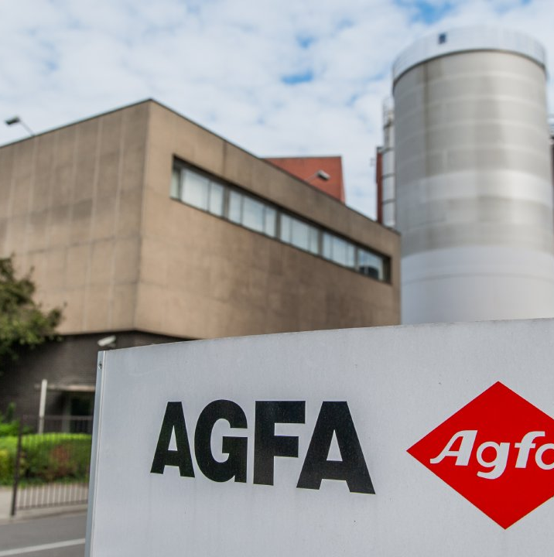


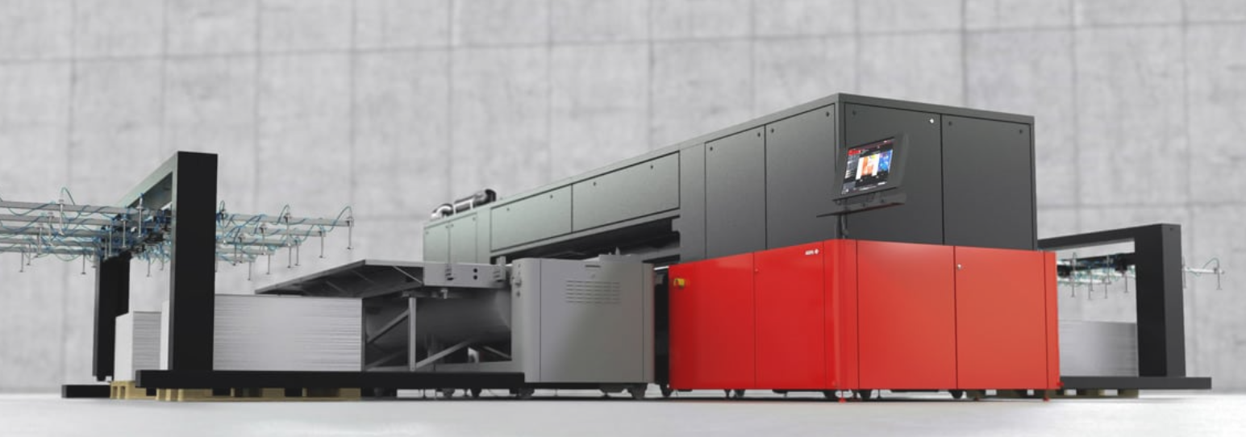
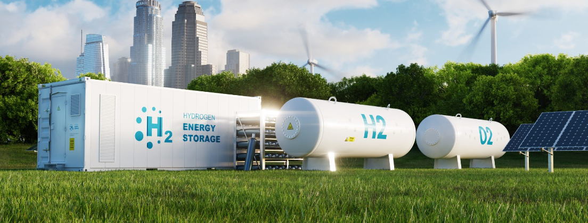

Notes:
Printing: developments of inks,
H2: development of zircon membranes for elektrolysis
Medical: emulsions for medical imaging
Resulting a state-of-the-art chemical plants with 70 reactors, filters and drying equipment

Slide 6

02
Problem statement

Slide 7

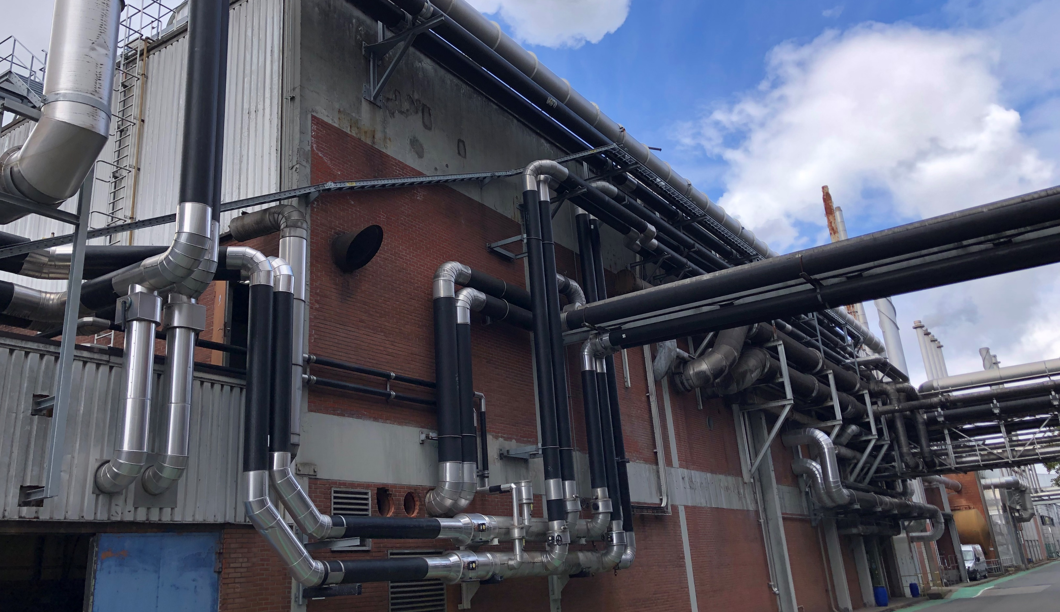
Complex and high utility demand

Slide 8

Complex and high utility demand
LOW TEMPERATURE
10/4°C circuit
HVAC buildings cooling
Process cooling
  Reactor jackets
  Adsorption dryers
CTW
30/25°C circuit
Condensor cooling
MEDIUM TEMPERATURE
30/55°C circuit
HVAC buildings heating
(process)
HIGH TEMPERATURE
70/90/110°C circuit
Process heating
  Reactors
  Dryers
water cooled chillers
Cooling towers
CHP/chillers
CHP/boilers

Slide 9
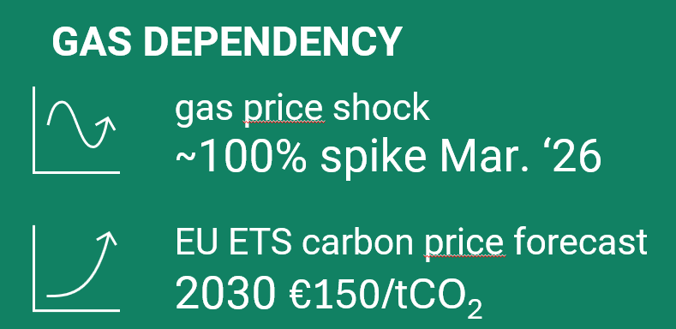
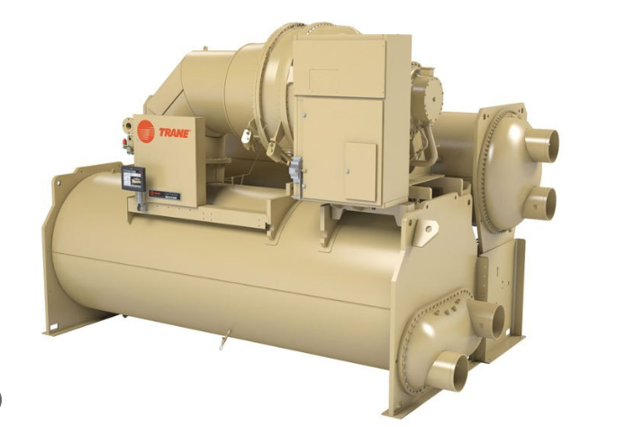
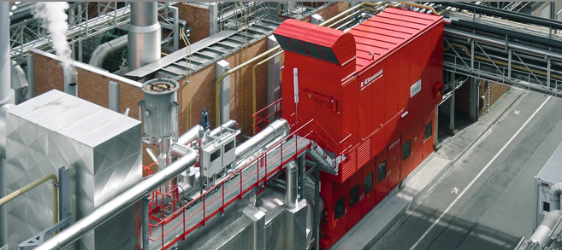
Problem statement
CHP no more certificates
Some of the water cooled chillers are EOL
Phasing out freon gases
Gas dependency
Thermodynamic integration (coupling of the T-levels)
    Lots of waste heat on the MT
        Condensation heat of chillers
        MT circuit in summer!
Electrification

Slide 10

03
Technical solution
Two-stage ammonia hybrid cooling & heat pump

Slide 11
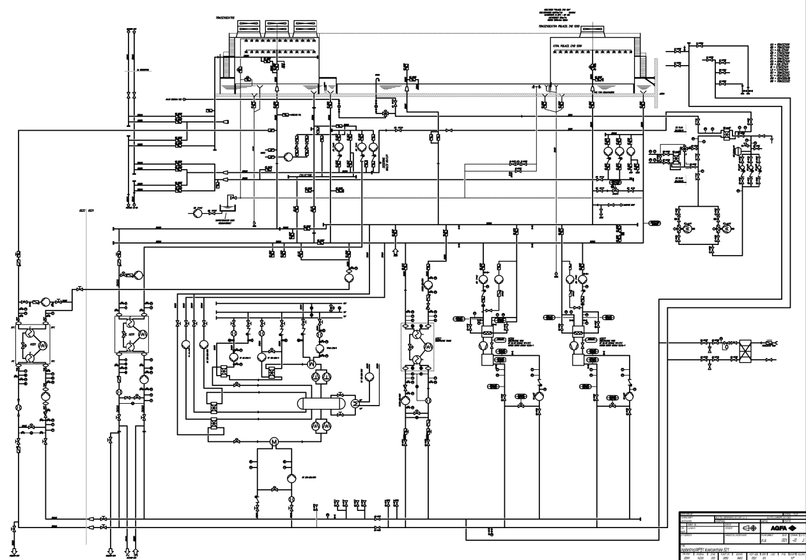
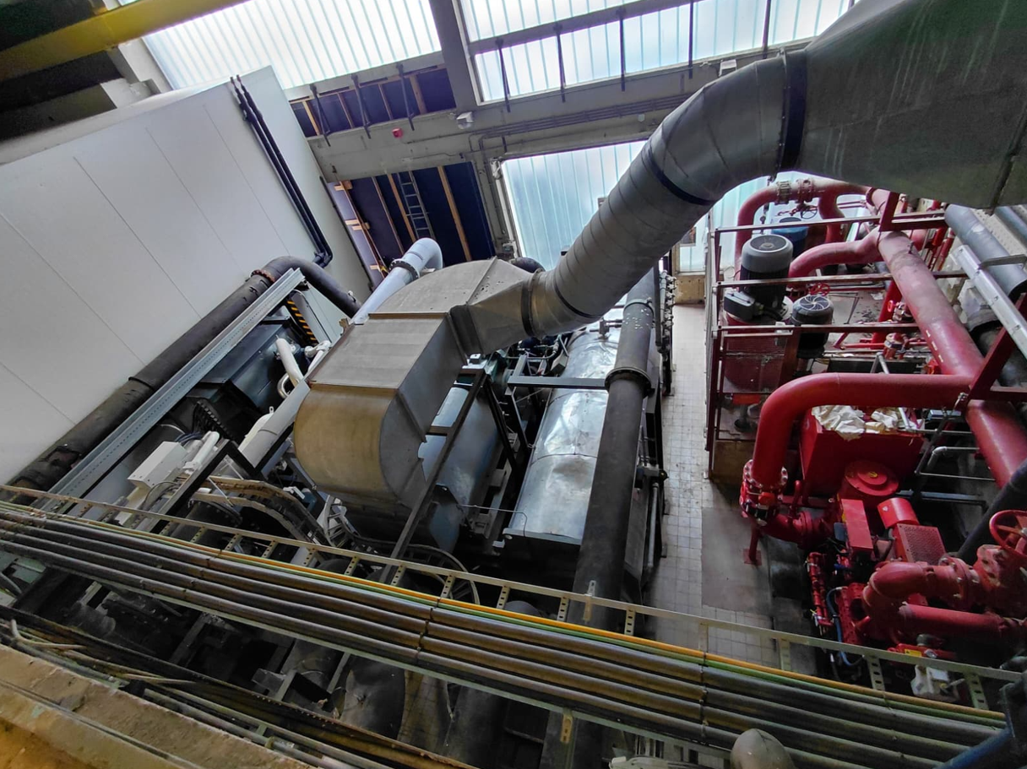
Title comes here
Installation to improve overall efficiency and flexibility by intergrating different temperature flows on a given footprint, no limitation regarding capacities

Slide 12
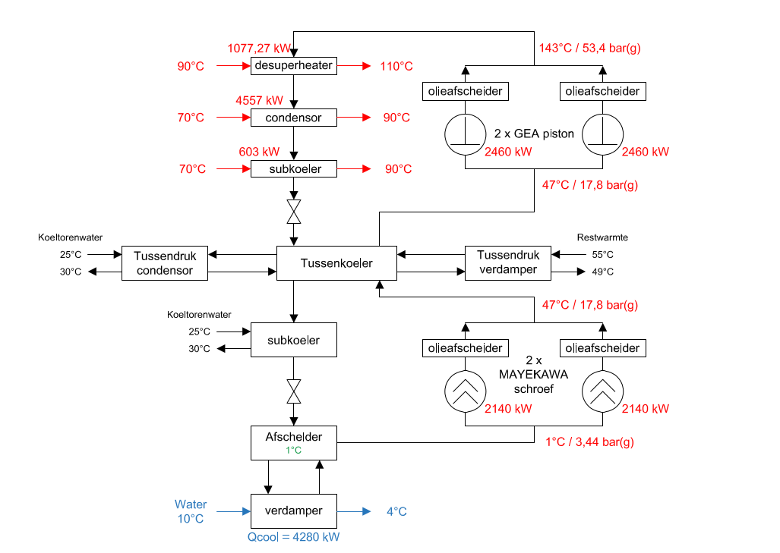
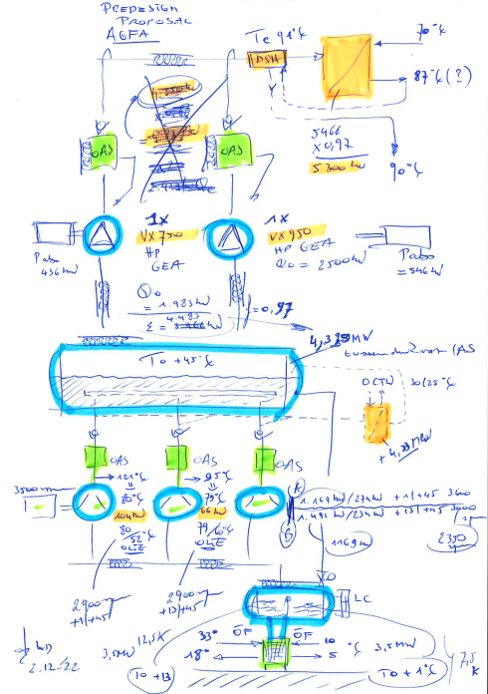
Solution: 2-stage NH3 hybrid heat pump
HD C

Slide 13
Solution: 2-stage NH3 hybrid heat pump
Concept design
2-stage NH3 heat pump
  LD CU (screw compressors)
  HD CU (piston compressors)
Open intercooler design
  Thermosiphon condensor
  Thermosiphon evaporator
2x subcooler (HT and MT)
Intermediate temperature design!
HD wisselaars
HD CU
TD koeler
LD CU
LD wisselaar

Slide 14
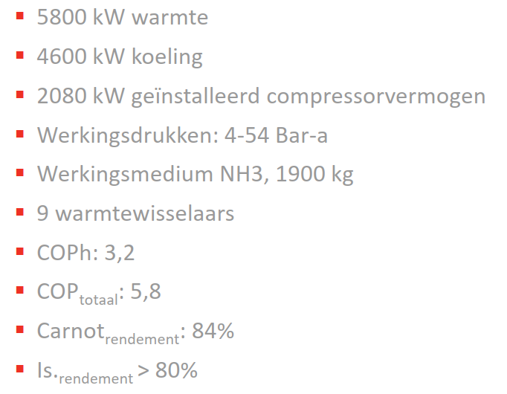
Solution: 2-stage NH3 hybrid heat pump

Slide 15
Solution: 2-stage NH3 heat “integrator”
CTW
LT 10/4°C

Slide 16
Solution: 2-stage NH3 hybrid heat pump
Flexibility:
Modus 1: 100% chiller, max LT demand
Modus 2: full LT demand, partload HT demand → MT cond
Modus 3: LT and HT in balance
Modus 4: LT demand too low, heat input using MT evap (CHP)
Modus 5: LT demand too low, heat input using MT evap (condensation heat of the chillers)
Modus 6: LT demand too low, heat input in LT evap
Modus 7: only heat input using MT evap
Design of TD = temperature of intercooler = f(modi)
modus 1: TD = 33°C (COP chiller = 6,31)
modus 3: TD = 47°C (COP chilling/heating = 5,35)
modus 7: TD = 36°C (COP heating = 4,9)

Slide 17
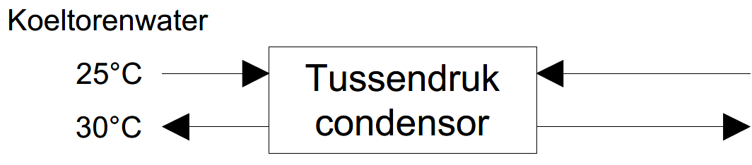

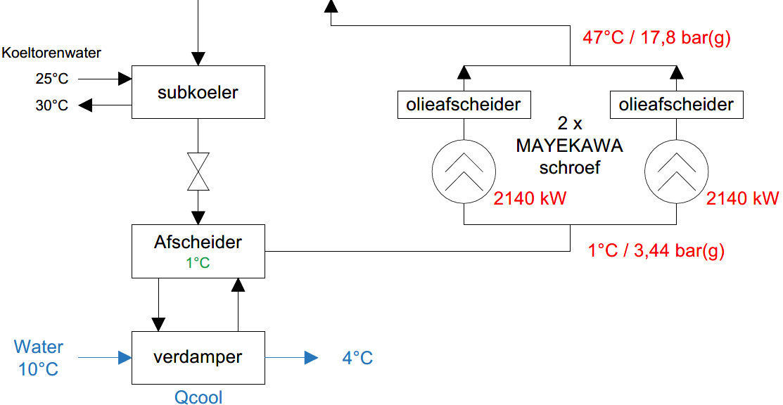
Solution: 2-stage NH3 hybrid heat pump
3 modi:
- Enkel koelen

Slide 18
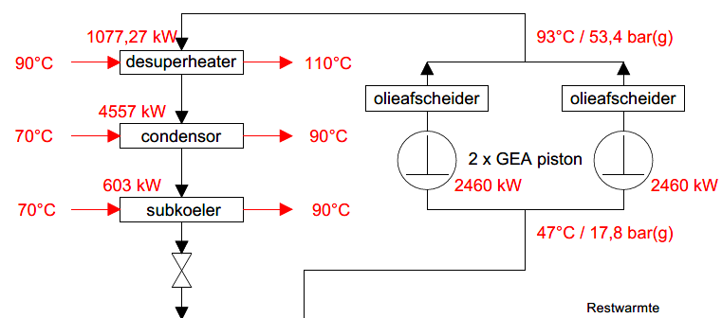
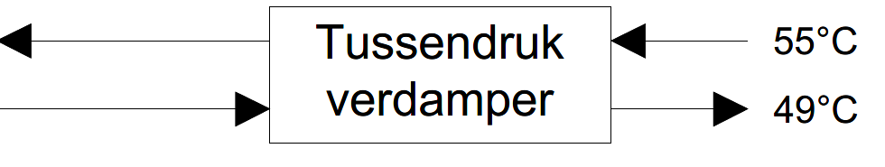
Solution: 2-stage NH3 hybrid heat pump
3 modi:
- Enkel oppompen restwarmte

Slide 19
Solution: 2-stage NH3 hybrid heat pump
3 modi:
- Evenwicht koelen en verwarmen

Slide 20
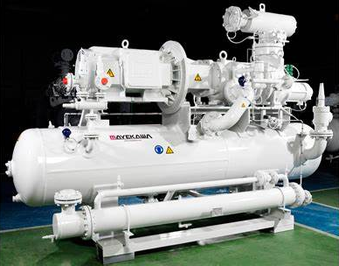
Main component selection
LP compression
2x SCV250M-L
1/47 °C
Qc = 4.2 MW (modus 3)
speed = 3050 rpm
Thermosiphon oil cooler
560 kW Siemens motor IE4, VSD
Notes:
We compared to GEA screws en Bitzer screw units (4xOSKA95)
At the end client opted for mycom

Slide 21
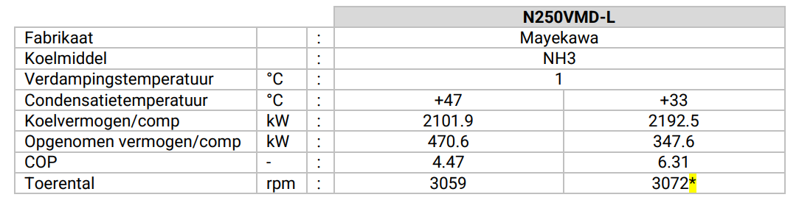
Main component selection
*Modus 1: chiller operation, speed is limited due to LT evap design

Slide 22
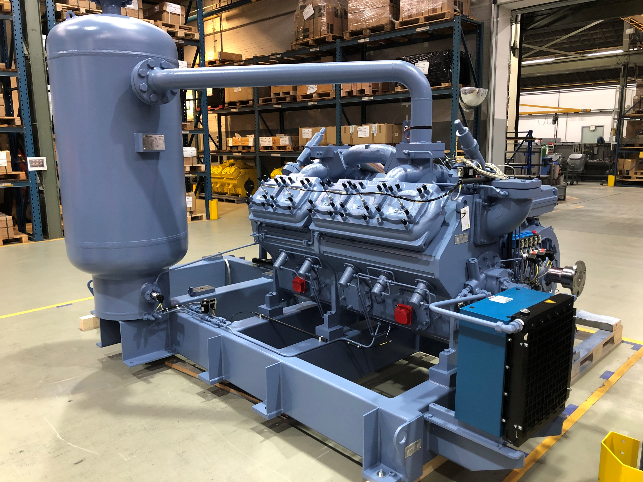
Main component selection
HP compression
2x V750XHP NH3 heat pump
47/93 °C
Qh = 5.7 MW (modus 3)
Speed = 1500 rpm
630 kW ABB motor IE4, VSD
Notes:
Comparison between gea and sabroe, the >90°C condensation temperature → GEA, now Sabroe is also able to reach these condensation temperatures

Slide 23
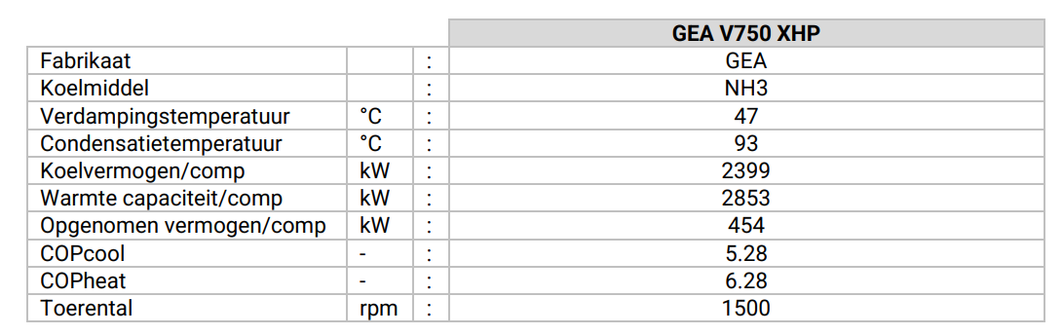
Main component selection

Slide 24
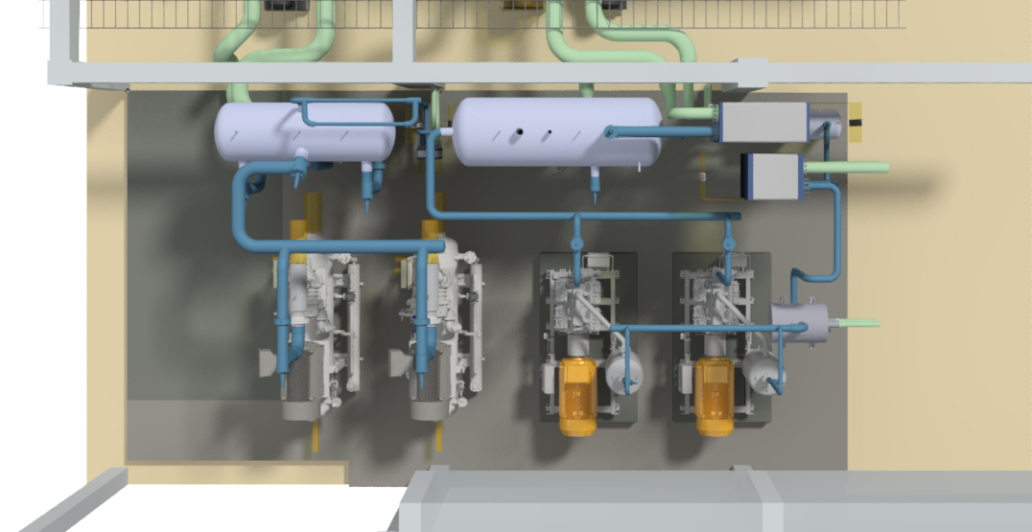
2-stage NH3 hybrid heat pump (modus 3)
CONDENSOR
LT EVAPORATOR
4.2 MW 10/4°C
5.7 MW 70/90/110°C
DESUPERHEATER
COP global= 5.35

Slide 25
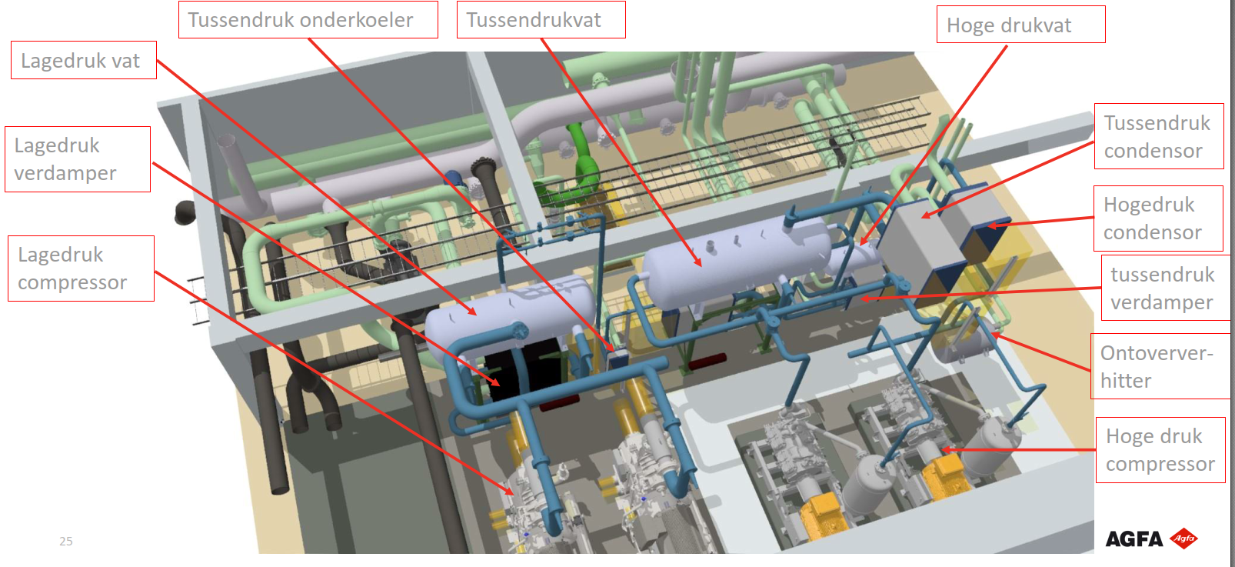
2-stage NH3 hybrid heat pump (modus 3)
CONDENSOR
LT EVAPORATOR
4.2 MW 10/4°C
5.7 MW 70/90/110°C
DESUPERHEATER
COP global= 5.35

Slide 26
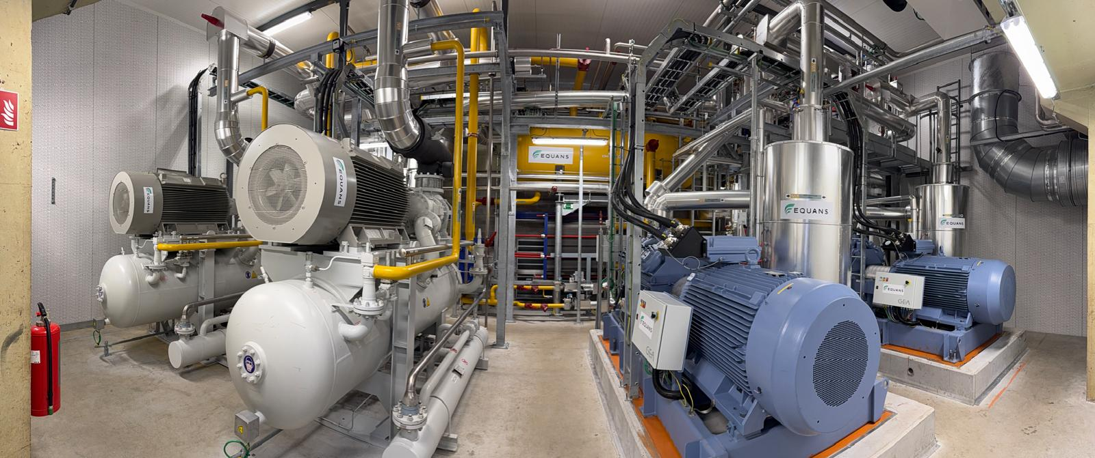
2-stage NH3 hybrid heat pump

Slide 27
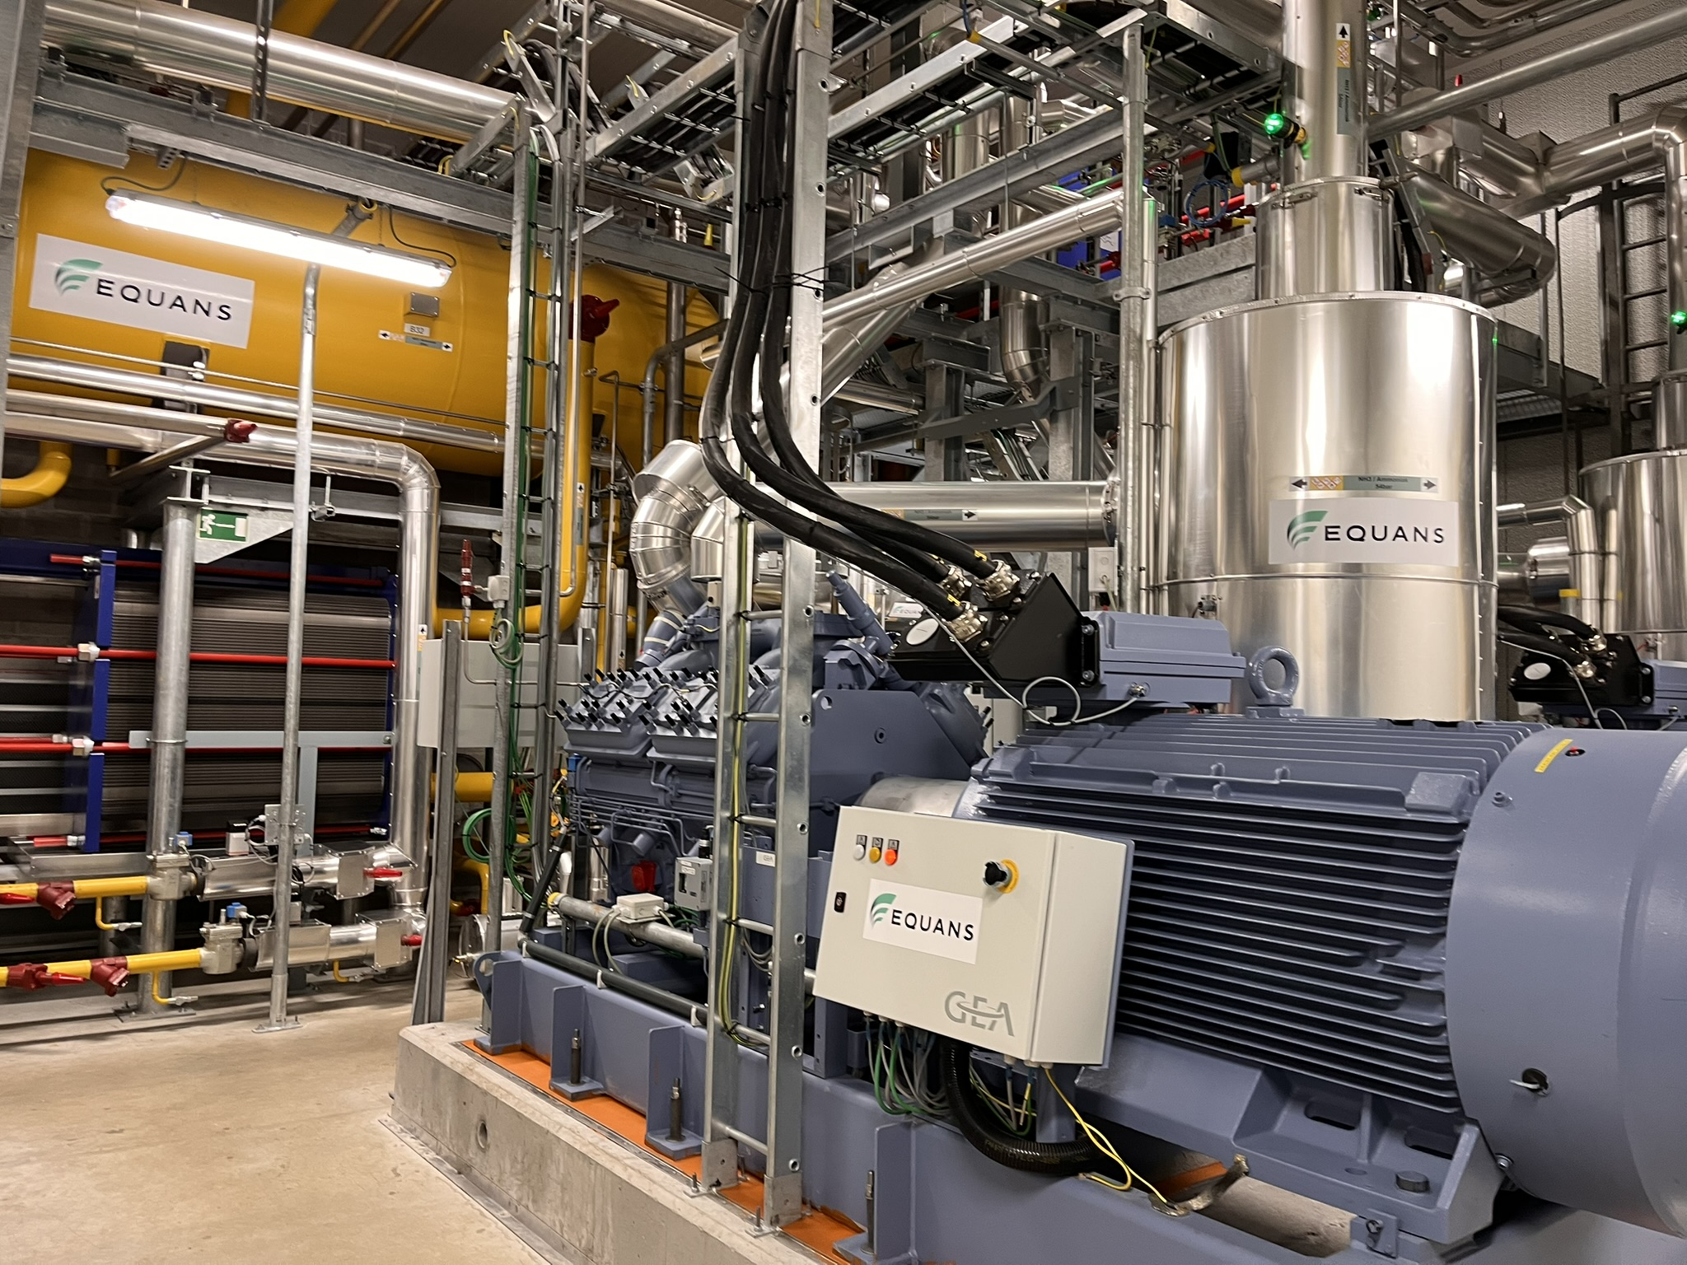
2-stage NH3 hybrid heat pump

Slide 28
Return on technical experiences
Stability of hydraulics connections (hardware & software)
Extra attention to the oil return system due to the open system
Vibration of both the LP & HP compressors
Condensation of NH3 during operation, stillstand and the different modi
Temperature of the machineroom

Slide 29
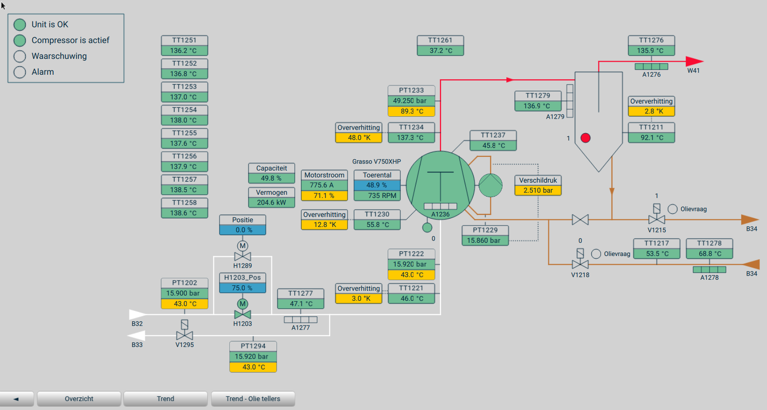
Results

Slide 30
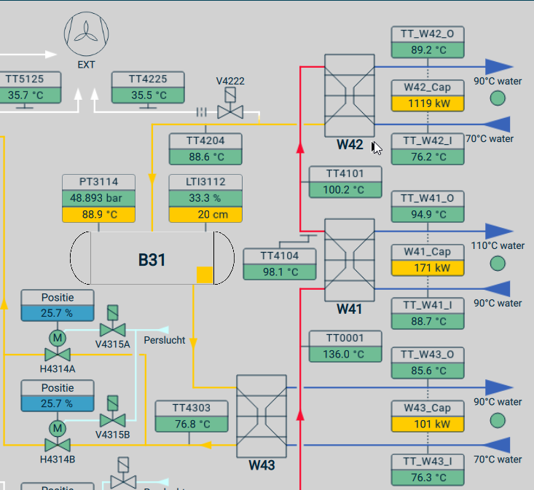
Results

Slide 31
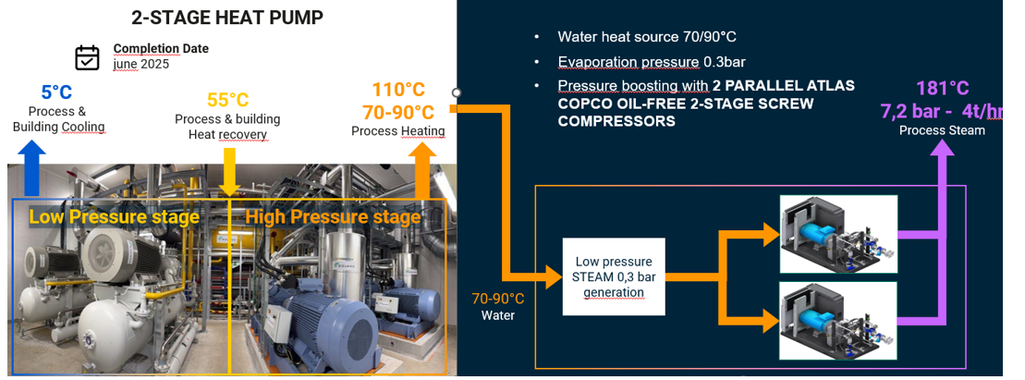
Next step: MVC

Slide 32
Thank you for your attention!

