Slide 1
Jean-Pierre Perron
Jeanpierre.1.perron@jci.com
0499/56 57 64
Johnson Controls
York 2023 voor Celanese

Slide 2
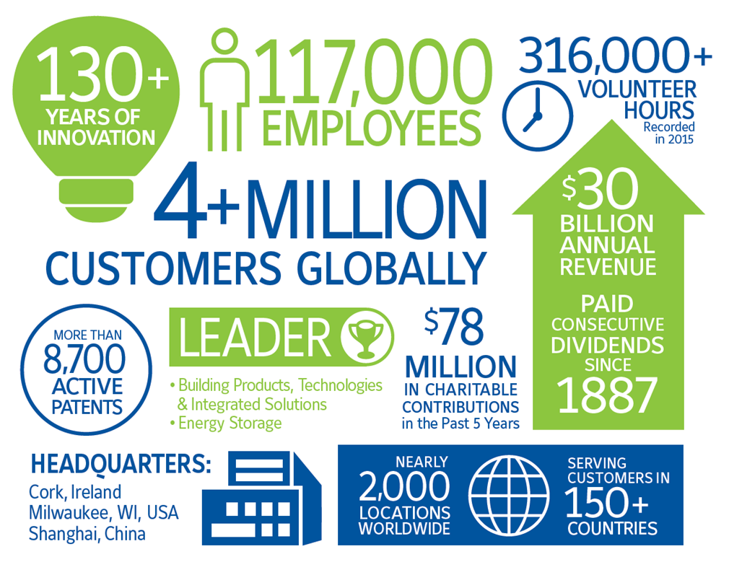

Slide 3
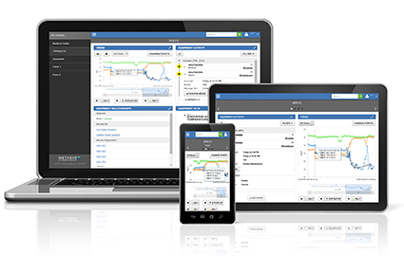
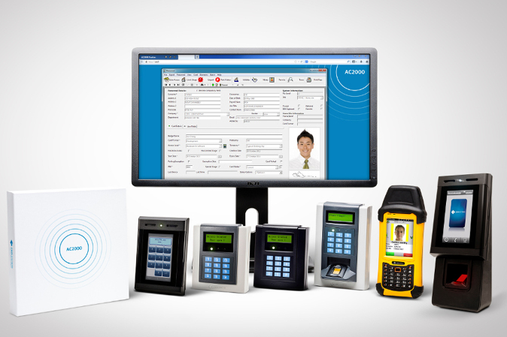
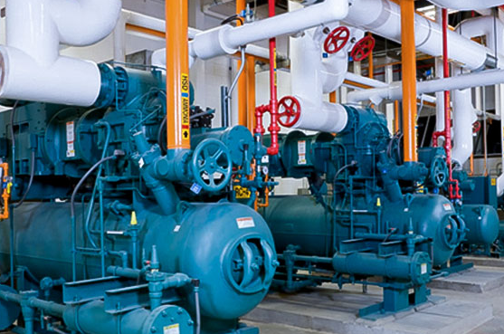
Activiteiten België - Luxemburg
Building Systems
TYCO
Iref –Sabroe & HVAC York
Power solution Varta
Gebouwbeheersystemen
Digitale regeling
Integraties
Onderhoudsdiensten
Branddetectie
Blussing
CCTV
Toegangscontrole
Inbraakdetectie
Perimeter detectie
Onderhoudsdiensten
Industriële koeling + HVAC
Compressor Remanufacturing
Small tonnage chillers
Large tonnage chillers
Onderhoudsdiensten

Slide 4
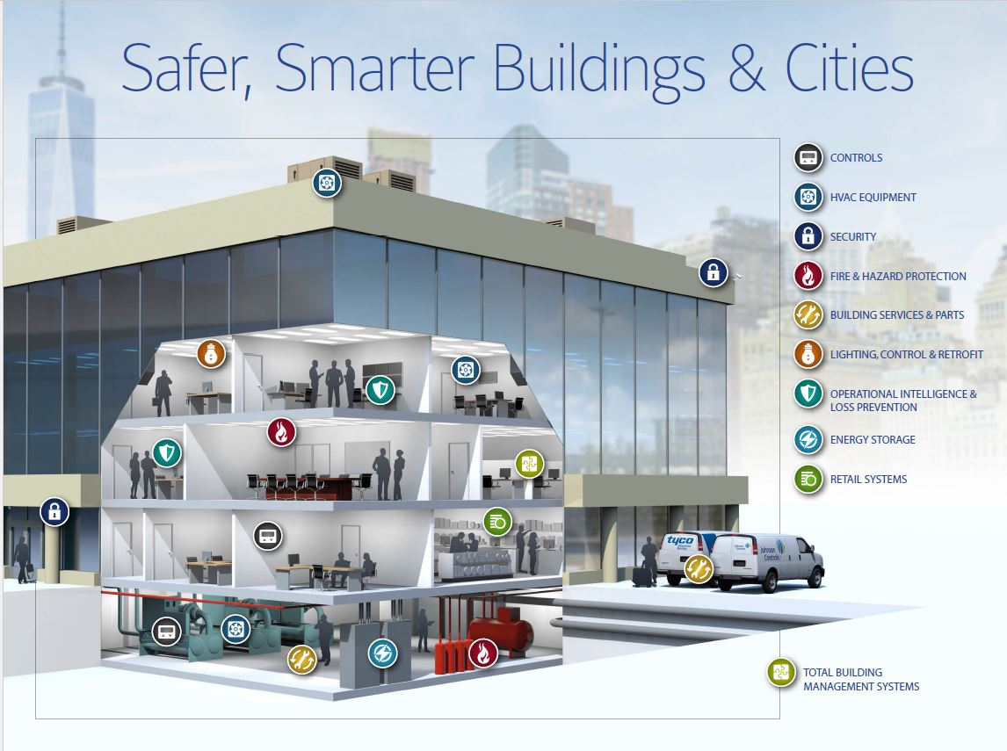

Slide 5
HVAC digitale regeling
Gebouw Beheer Systeem
November 2017
Notes:
Good Morning to you all…….

Slide 6



Wat is een gebouwbeheersysteem?
Een gebouwbeheersysteem (GBS of BMS) wordt gebruikt om alle binnen het gebouw aanwezige installaties, met name de HVAC en electrische installaties, centraal aan te kunnen sturen, te bedienen en te laten samenwerken.
In een gebouwbeheersysteem zijn in regel volgende functies ondergebracht:
  Procesbeelden met de grafische weergave van installatiedelen
  De samenhang tussen installatiedelen
  Een alarmlijst met de aanwezige en de geaccepteerde alarmen
  Grafieken van belangrijke metingen (trends)
  Klok- en kalenderfuncties
  Routeringsfuncties voor alarmen en meldingen
Meer en meer wordt ook het aspect energiemonitoring geïntegreerd in het BMS (BEMS).

Slide 7
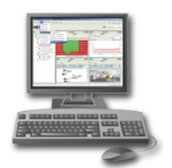



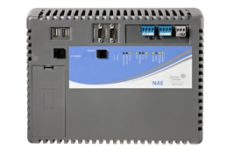

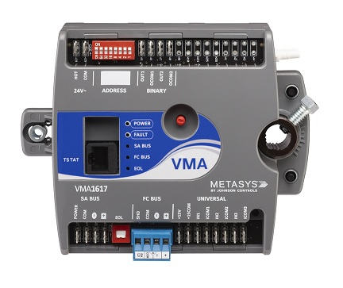

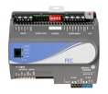
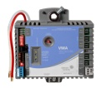

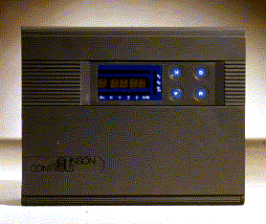
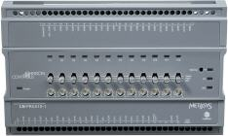


Hoe is een gebouwbeheersysteem opgebouwd?
Browsers
Gebruikersinterface
Raadpleeg systeem vanop elke PC / mobiel via standard web browser
Data Servers
Voor data opslag(kalenders, alarmen, trends)
Rapporteringsfunctionaliteit (Advanced Reporting System)
BEHEER
ETHERNET TCP/IP
Network Engines
Beheer toestellen – controle & coördinatie van de veldregelaars
Scheduling, Alarmmonitoring, Trending
Gebruikersinterface via web browser
Network Engines
BACnet MS/TP
AUTOMATISERING
N2
LonTalk
Veld Regelaars
Intelligente, stand-alone digitale regelaars
Locale sturing van HVAC & electrische systemen
FIELD
Veld Componenten
Temperatuursensoren
Regelafsluiters
…

Slide 8





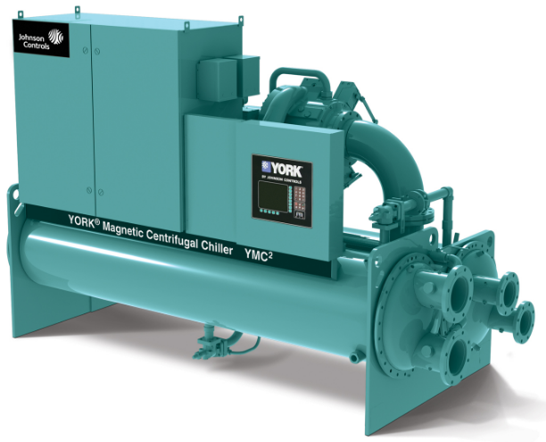
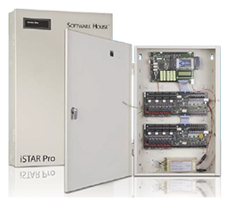
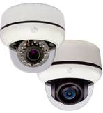
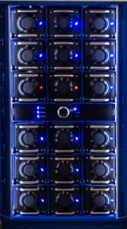
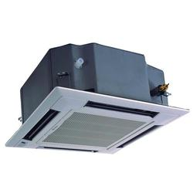
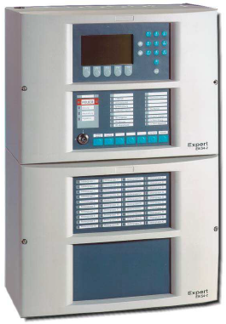
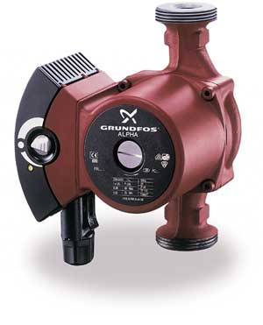
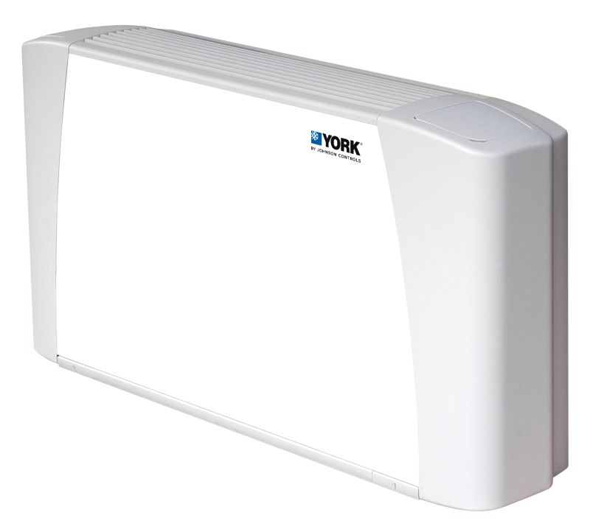
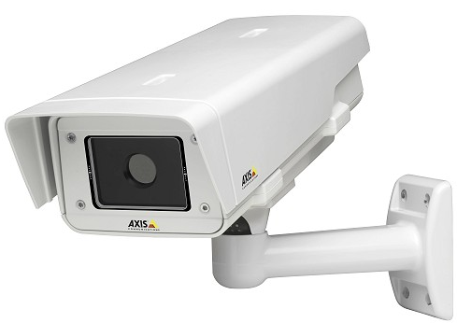





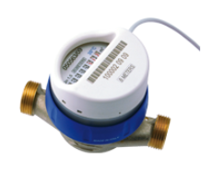
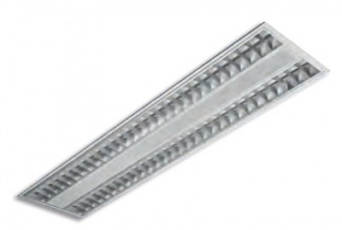
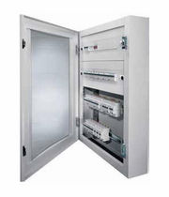
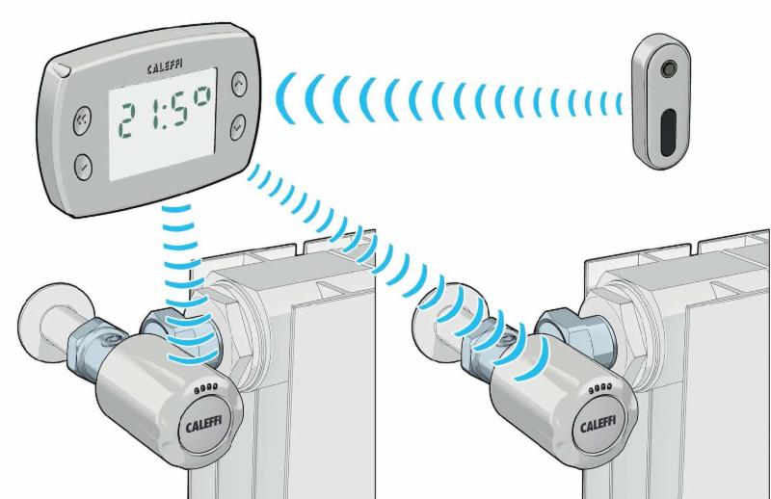
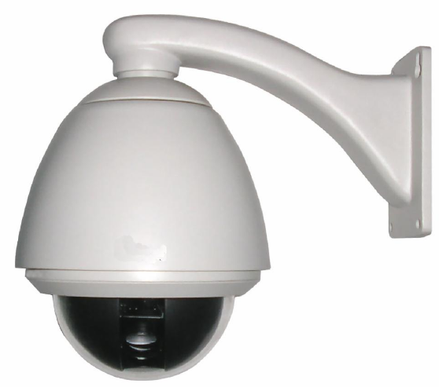
Hoe is een gebouwbeheersysteem opgebouwd?
Browsers
Gebruikersinterface
Raadpleeg systeem vanop elke PC / mobiel via standard web browser
C-CURE
Network Integration Engine
L1000
Energy Storage
Zettler
Fire Detection
C-Cure
Acess Control
CCTV

Slide 9
Integrated Fire and Security Solutions
Tyco Integrated Fire & Security
Diegem - 2017
Notes:
Good Morning to you all…….

Slide 10









Integrated Fire and Security Solutions
Fire Detection
// Fire detection and alarm systems
// Fire risk assessment
// Aspirating fire detection
// Hazardous area detection // Signalling
// Public Address and Voice Alarm (PAVA)
// Emergency Voice Communication (EVC)
Intruder
// Intrusion detection // Panic devices
// Perimeter protection // Wireless solutions
// Alarm receiving centre
// Fog dispensing systems
Fire Suppression
// Gaseous suppression // Kitchen suppression
// Special hazard suppression
// Deluge and water spray
// Watermist
Fire, Security
// Access doors // Fire doors
// Smoke curtains
// Security doors
// Industrial & warehousing doors
Video Surveillance
// High Definition (HD) cameras
// Internet Protocol (IP) based systems
// Video Analytics (VA)
// CCTV monitoring centre
Specialist Solutions
// Care communications systems
// Retail solutions
Access Control
// Simple entry systems
// Standalone systems
// Networked systems
// Smartcards
// Wireless and off-line solutions
Systems Integration
// Systems integration
// Building command & control solutions
// Enterprise solutions
// Alarm & process management
// Physical security management
Notes:
If we break down each product area, you can see there are a large number of systems within each family.

Slide 11








Our capabilities
System Design
Service & Maintenance
Installation
& Project Management
Alarm & Event Monitoring
Professional Services
Remote Engineering
Notes:
This slide shows the wider capabilities Tyco brings to the table, as a system integrator we are product agnostic. This enables Tyco to tackle customer problems with the “Right Solution” regardless of who the manufacturer is. Our strength in this agnostic approach is further enhanced by our ability to take a range of products from manufacturers, who normally would not combine or integrate with each other and provide you the customer with a Turn-Key Integrated Solution.
One example of this kind of integration would be our works at Heathrow Airport in London. Tyco developed and deployed the integration between Access Control, CCTV, Gate Control and Baggage Handling. Giving Heathrow the ability to change the flow of passengers dependant on whether the flight is domestic or international at the click of a mouse.
Our Professional Services Team, is becoming a powerful resource for customers across the globe… this teams primary function is to work through the common issues a customer has with their buildings or sites and use existing market technologies and products to provide a solution. A good example of this will come up later, when we discuss this process at P&G Manchester.

Slide 12
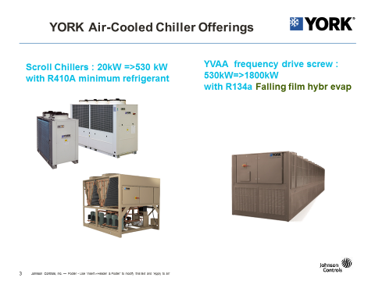
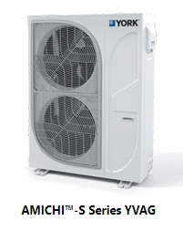
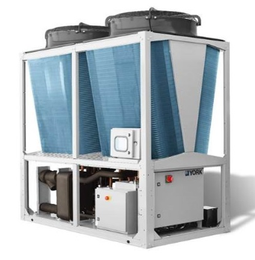
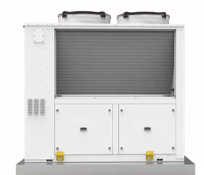
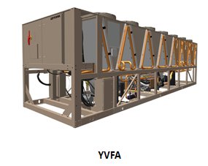
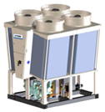

Slide 13
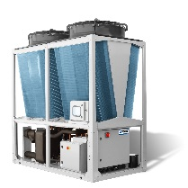



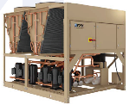
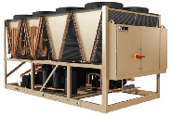
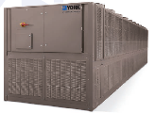
YORK® EUROPEAN AIR COOLED
CHILLERS & HEAT PUMPS PORTFOLIO
0
100
200
300
400
500
600
700
800
900
1000
1100
1200
1300
kW
AmichiTM YMAA/YMPA
DC Inverter Scroll
CO & HP
45 - 260 kW
YAS – 32-355 KW
YCME/YHME Series 2 (Modular)
Screw
CO & HP
160 - 525 kW
TempoTM YLAA
Scroll
CO
190 - 650 kW
TempoTM Heat Pump YLPB
Scroll
HP
180 - 632 kW
YVAA-YVAF
VSD Screw
CO
435 - 1730 kW

Slide 14
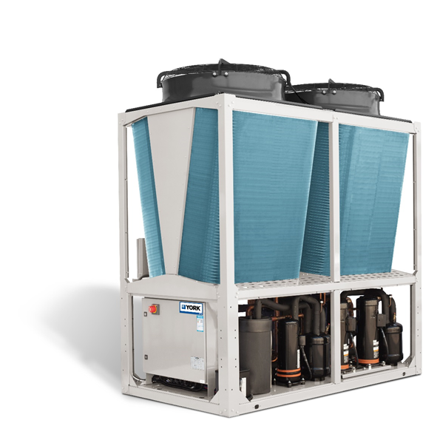
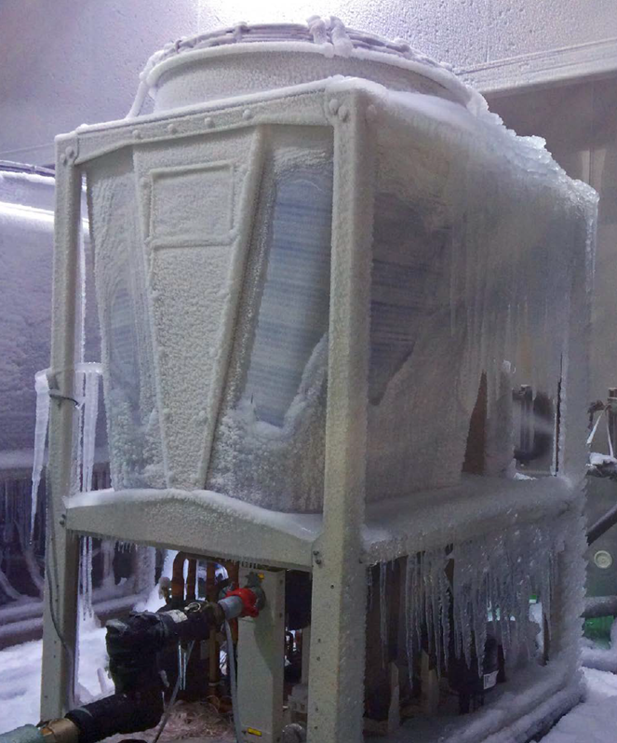
Model |  |  | YMAA / YMPA
 |  |  | 45 | 65 | 80 | 100 | 130 | 160 | 200 | 230 | 260
Performance | Cooling capacity c/o units | kW | 44 | 57 | 78 | 97 | 121 | 155 | 190 | 225 | 255
 | SEER / ηs,c |  | Ecodesign Comfort Cooling Tier 2 (2021)
 | SEPR Process High Temperature |  | Ecodesign Process High Temperature Tier 2 (2021)
 | SEPR Process Medium Temperature |  | Ecodesign Process Medium Temperature Tier 2 (2018)
 | Cooling capacity h/p units | kW | 44 | 57 | 78 | 97 | 121 | 155 | 190 | 225 | 255
 | Heating capacity h/p units | kW | 48 | 59 | 82 | 97 | 130 | 155 | 190 | 225 | 255
 | SCOP / ηs,h |  | Ecodesign Comfort Heating Tier 2 (2017)
 | Capacity steps |  | Stepless (Inverter)
 | Sound power level LN / Ultra Quiet | dB(A) | 80/75 | 83/77 | 81/77 | 86/77 | 86/79 | 87/81 | 89/82 | 91/84 | 92/85
Refrigerant | Refrigerant ciruits | # | 1 | 1 | 2 | 2 | 2 | 3 | 3 | 4 | 4
 | Refrigerant (R410A) charge / circuit | kg | 9.5 | 12.3 | 8.5 | 9.5 | 11.4 | 9.5 | 11 | 9.5 | 11
 |  |  | - | - | 9.7 | 11 | 11.4 | 11 | 11 | 11 | 11
 |  |  | - | - | - | - | - | 11 | 11 | 11 | 11
 |  |  | - | - | - | - | - | - | - | 11 | 11
Compressor | Compressor type |  | DC Scroll Inverter + Scroll
 | Quantity | # | 2 | 2 | 3 | 3 | 4 | 5 | 6 | 7 | 8
Air side heat exchanger | Fan Motor type |  | EC motor
 | Fans quantity | # | 1 | 1 | 2 | 2 | 2 | 3 | 3 | 4 | 4
Water side heat exchanger | Type |  | Plate Heat Exchanger
 | Unit water volume | l | 7 | 10 | 14 | 16 | 16 | 26 | 26 | 30 | 32
 | Nominal water flow | l/s | 2.2 | 2.9 | 3.8 | 4.8 | 5.9 | 7 | 8.2 | 9 | 10.4
 | Pressure drop | kPa | 30 | 30 | 28 | 32 | 36 | 45 | 45 | 45 | 45
 | Water connections type |  | Victaulic
Dimensions & Weight | Height | mm | 2440 |  |  |  |  | 2495
 | Width | mm | 1200 |  |  |  |  | 2842
 | Depth | mm | 1500 |  | 2250
 | Operating weight | kg | 587 | 610 | 892 | 920 | 998 | 1600 | 1700 | 1850 | 1950

Slide 15
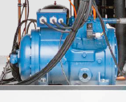

Aircooled RAS MC with R290
RAS MC Kp : reciprocating compressors and axiaal fans (-2=>15°C)
RAS MC Vp: low temperature ( -2=>-14°C)
RAS MC F (-5°C=>+15°C)
RAS F Kp : reciprocating compressors and axiaal fans (-2=>15°C)
Stainless plate, Partwinding, oil control, valves, microchannel, electrical bord IP 66

Slide 16
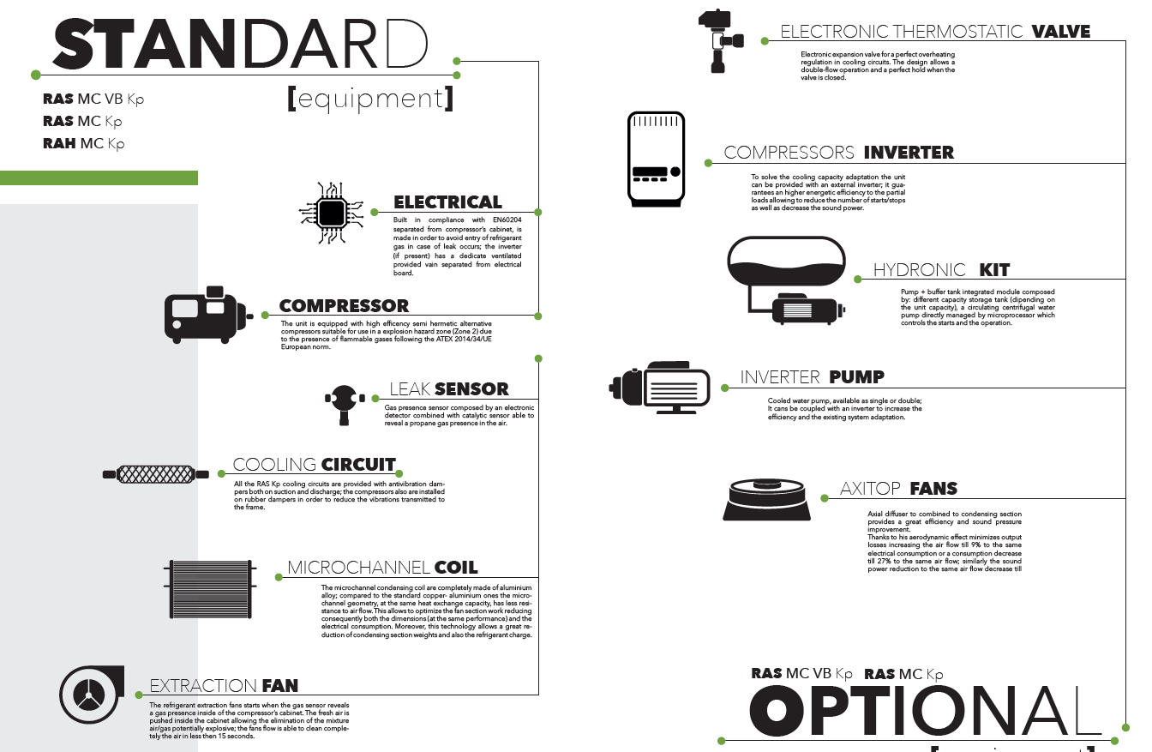

Slide 17
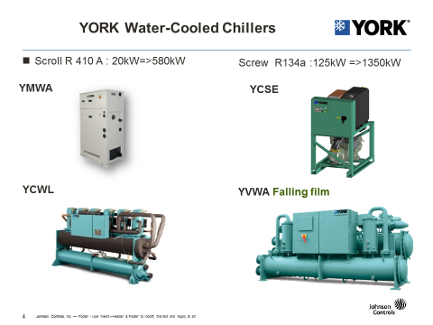
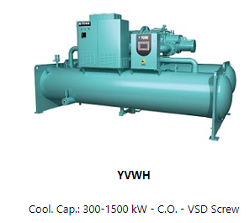

Slide 18
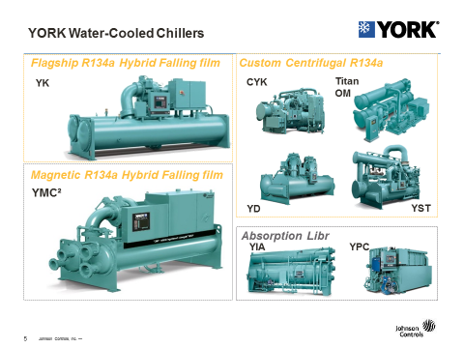
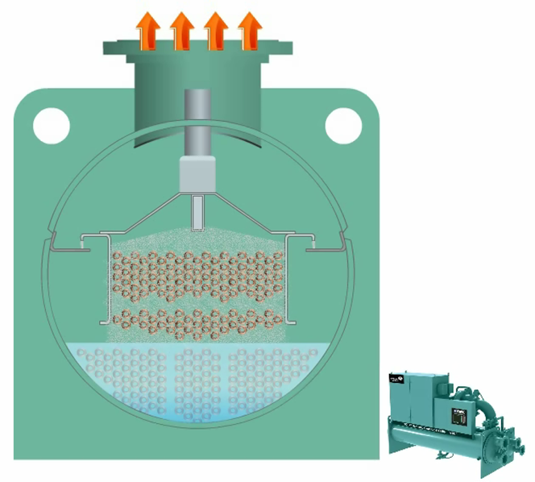
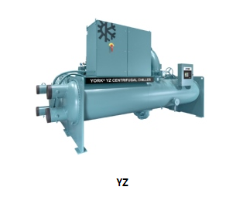
De grote centri-koelmachines >650kW

Slide 19
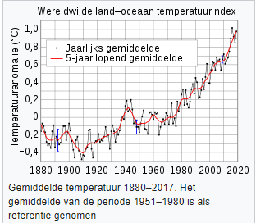
R…. ?
What exactly are we offering today? Ozone depletion Potential( ODP) & Global warming potential( GWP)
ODP:Het ozonafbrekend vermogen van een chemische stof, is een getal dat het relatief vermogen aangeeft van die stof om de ozonlaag af te breken, ten opzichte van trichloorfluormethaan (CFC-11), waarvan het ozonafbrekend vermogen per definitie vastgesteld is op 1,0. Het is dus het globale verlies aan stratosferische ozon door een bepaalde hoeveelheid van de chemische stof, gedeeld door het globale ozonverlies door eenzelfde hoeveelheid CFC-11.
GWP:Het is een relatieve maat, die het aardopwarmingsvermogen van een broeikasgas aangeeft vergeleken met dat van koolstofdioxide (CO₂); meer bepaald, het opwarmingsvermogen in een periode van 100 jaar van 1 kg van het gas ten opzichte van 1 kg CO₂.

Slide 20
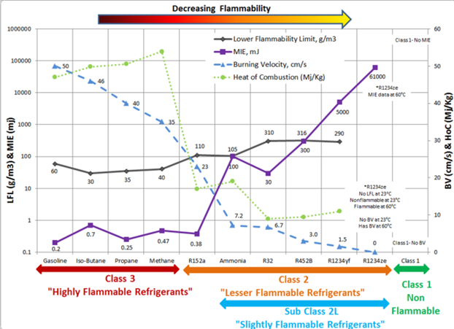

Slide 21
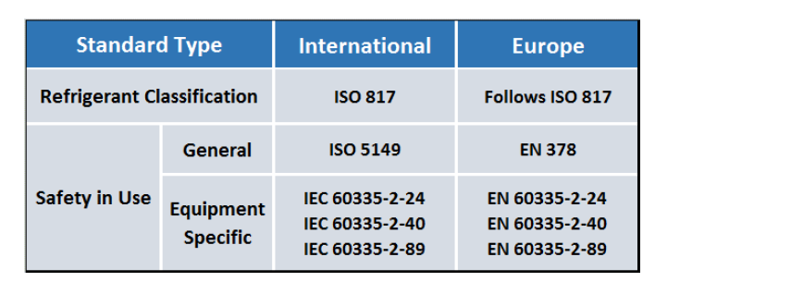
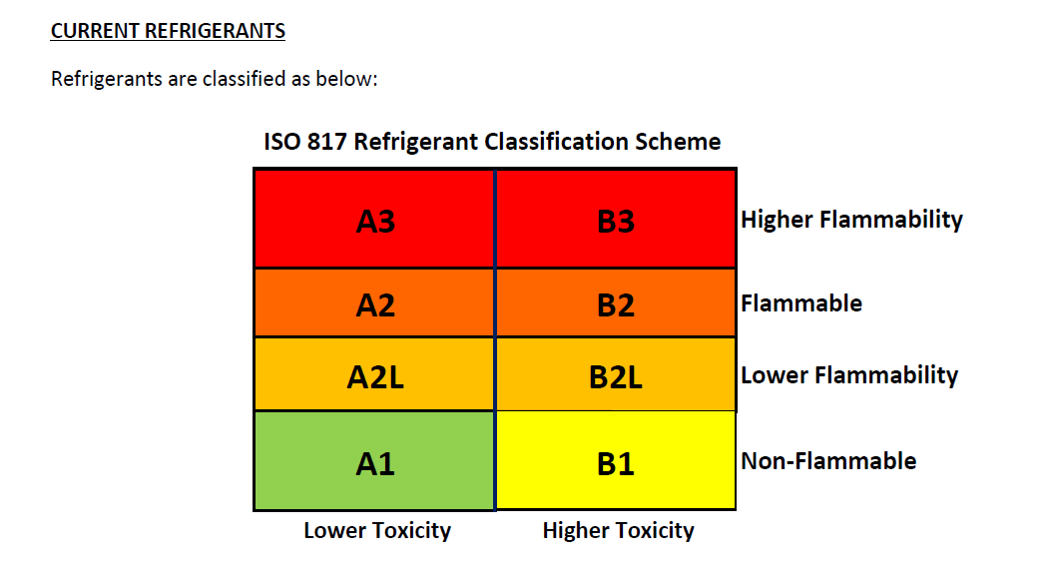

Slide 22
En nu welk koelmiddel ?
Customers can purchase R-134a (GWP 1450) centrifugal and screw chillers ranging from 440 to 21100 kW that can be easy converted to R-513A (GWP 631) if/when necessary at any time during the chiller’s life. ( ASC Class A1)
R410A ( GWP 2088) and A1 with possibility R454B ( XL41) GWP 466 and A2L
Lithium bromide & Water (absorption). GWP 0
R290 (propane) GWP 3.3(ASC Class A 3)
R717 (Ammonia) GWP 0 ( ASC Class B 2)
CO² or R744 for low temp, GWP 1
HFO For large water Centrifugaal chillers between 700kW and 4000 kW=> R1233zd, GWP 4,5 ( ASC Class A1), R1234ze alleen voor YVWH en voor nieuwe aangepaste ruimtes GWP 7 en A2L
De fluor waterstof Olefines (HFO) zijn onverzadigde molecules met minstens één dubbele koolstof-koolstof verbinding. Deze molecules zijn bijzonder reactief in de atmosfeer en hebben daarom een relatief korte levensduur. Deze korte levensduur draagt gedeeltelijk bij tot de lage GWP.

Slide 23
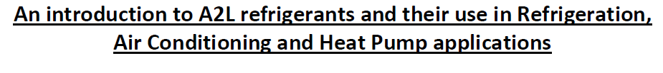


Slide 24



Slide 25
Wat kiezen we ?

Slide 26


Schroeven op R1234ze ?
Refrigeration system
Low chilled water temperature protection
High discharge pressure / temperature protection
High / Low oil pressure difference protection
Oil level switch protection
Low suction pressure protection
Flow switch off protection
Compressor motor
  Overcurrent protection
  Low current protection
  Reverse-phase protection
  3-phase imbalance protection
  Low voltage protection
  Winding overheating protection

Slide 27

NH3 or R290

Slide 28




Slide 29


Slide 30

Free cooling !?

Slide 32


Slide 33


Slide 34


Slide 35


Motor
Driveline selection starts with required compressor speed
R134a: Higher compressor speeds – direct drive requires permanent magnet (PM) motors
R1233zd: Lower compressor speeds overlap capability range of the latest high speed induction motors
YZ Technology: Hermetic, direct drive, induction motor
YZ Customer Benefit:
  High speed induction motors are compact and deliver similar efficiency to permanent magnet motors
  YZ motors are custom matched to the compressor design
  VSDs for high speed direct drive induction motors are higher efficiency and less complex (vs PM motor VSD’s)

Slide 36

Compressor
YZ Builds on our legacy of leadership in Real World Energy Efficiency
YZ Technology:
  Same patented combination of single stage compressor, VSD and Variable Geometry Diffuser (VGD) used on YMC²
  Plus an aerodynamically optimized suction line to minimize suction losses

Slide 37


Evaporator
Low pressure refrigerant challenges … are solved by YZ falling film
R134a: Falling film evaporators are common
R1233zd: Multiple evaporator challenges (and opportunities)
  Far less differential pressure to ‘move’ refrigerant
  Refrigerant pump complexity and cost could be needed
  Must be able to operate at real world conditions (low ECWT)
  Submergence effect in evaporator has increased performance impact
YZ Technology: Falling film evaporator (no pump)
YZ Customer Benefit:
  YZ’s design maintains real world operating capabilities and minimizes refrigerant charge / vessel diameter
  YZ’s refrigerant distribution system solved the low pressure ‘moving’ challenge without a refrigerant pump (reducing complexity)

Slide 38



Slide 39

ESEER

Slide 40

YZ magn centrifugaal

Slide 41


Slide 42

EER vergelijking YZ-NH³

Slide 43
Kan je de warmte gebruiken die je afgeeft via condensor naar de waterloop-koeltoren, Albert kanaal ?
En wat zou het rendement zijn ?

Slide 44


Slide 45


Slide 46



Slide 47


Slide 48


