Slide 2
koelcursus
DEPARTMENT OF electromechanical, systems and metal engineering
research group sustainable thermo-fluid Energy systems
Steven Lecompte

Slide 3
Basics

Slide 4
Basics of refrigeration
Market overview
Thermodynamics
Applications and refrigeration systems
Heat driven cooling
Auxillary components
C02 installations
Compressors

Slide 5
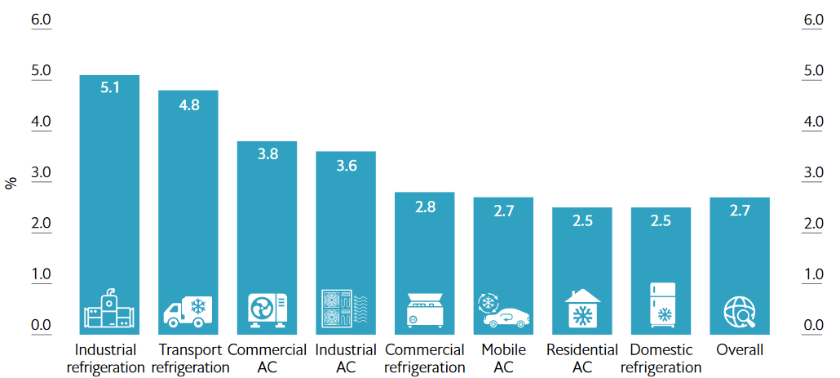
Refrigeration and its impact
Share electricity use
Yearly growth (2018-2030)
Refrigeration
Industry
Residential
Tertiary
Agriculture
Transport
Other
%
Residentieel AC
Industriële koeling
Industriële koeling
Tertair
AC
Industriële AC
Tertair koeling
Transport AC
Residentiële
AC
Residentiëlekoeling
Totaal
Bron: IIR
Bron: EIU analyse

Slide 6
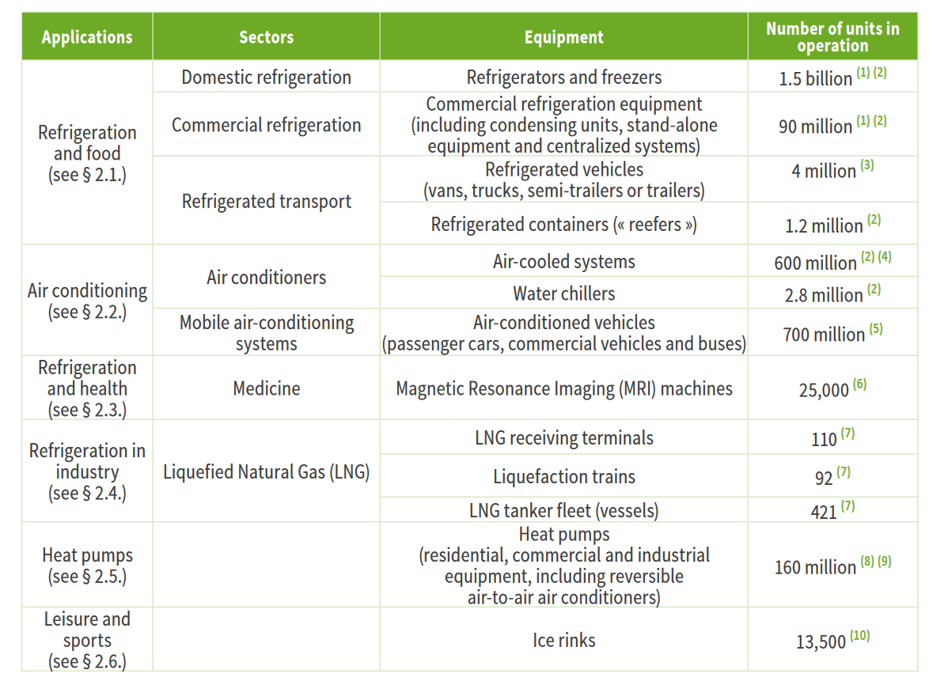
context
Challenges:
  Integration of renewable energy
  Climate and environment (ODP & GWP)
  Energy efficiency

Slide 7
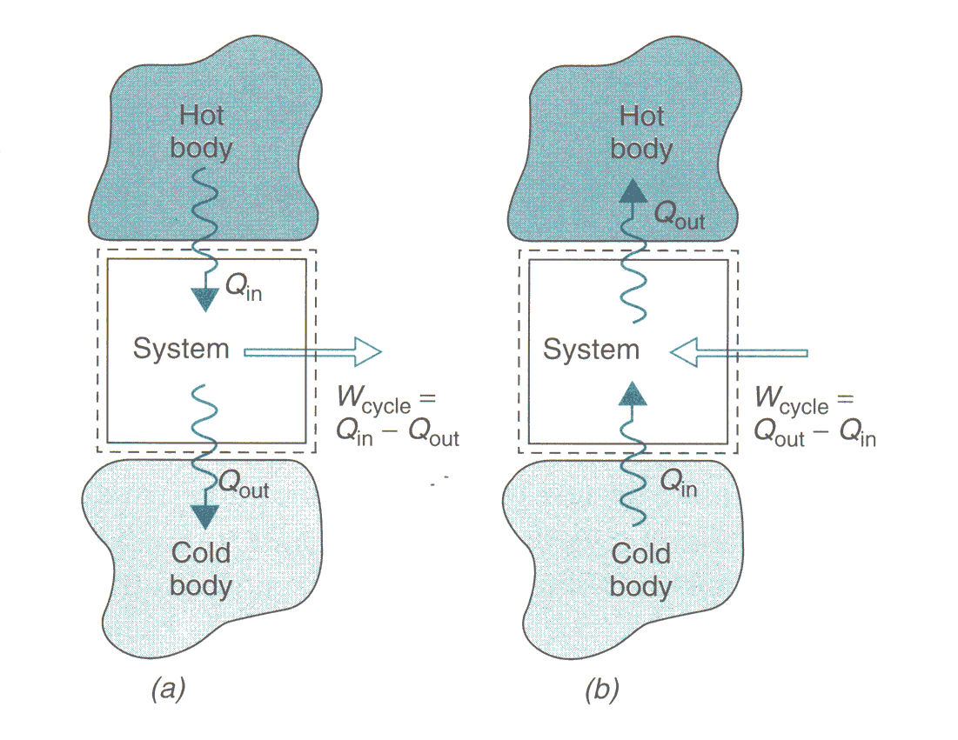
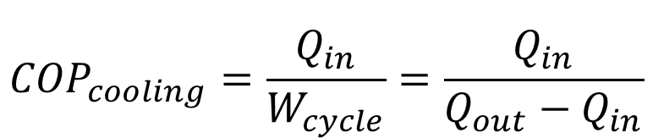
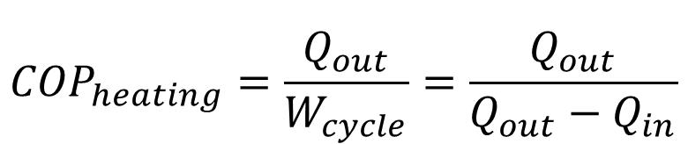
Vapour compression chiller
Heat absorption from cold body
Heat rejection to hot body
Not spontaneous, need work
    Clausius theorem
    (2nd law of thermodynamics)
$${COP}_{cooling}=\frac{Q_{in}}{W_{cycle}}=\frac{Q_{in}}{Q_{out}−Q_{in}}$$
$${COP}_{heating}=\frac{Q_{out}}{W_{cycle}}=\frac{Q_{out}}{Q_{out}−Q_{in}}$$

Slide 8
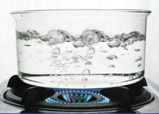
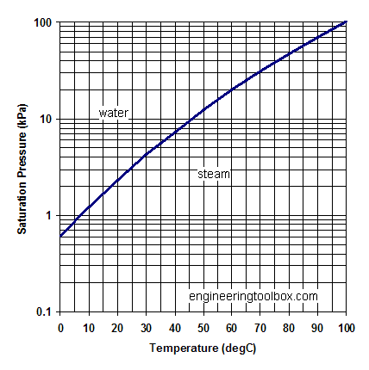
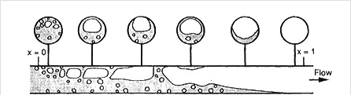
In practice: heat absorption (cold side)
Liquid refrigerant at low temperature
Heat transfer from cold body to refrigerant
Evaporation of refrigerant: at low pressure

Slide 9
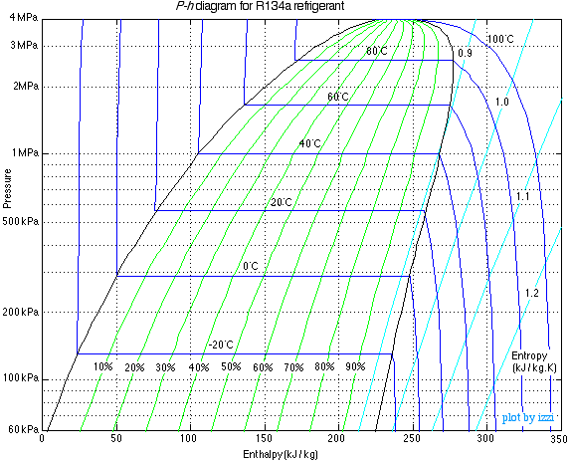
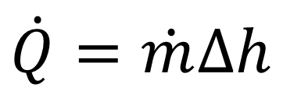
In practice: why evaporation
$$\dot{Q}=\dot{m}∆h$$
Sensible heat: ΔT = 20 °C
  Large enthalpy difference between liquid and vapour
  Large heat absorption per unit of mass
  Large cooling capacity for low mass flow rate
Latent heat: evaporation

Slide 10
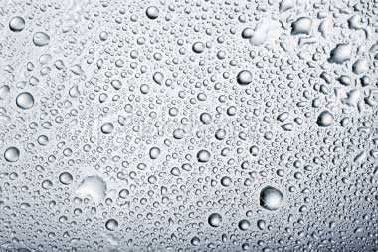
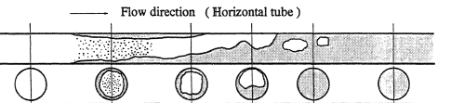
In practice: heat rejection (hot side)
Vapour refrigerant at higher temperature
Heat transfer from refrigerant to hot body
Condensation of refrigerant: at high pressure

Slide 11
In practice: condensation
60° C, 17 bar
20° C, 5 bar
  Refrigerant at high temperature
  Condensaten of refrigerant: heat rejection to hot body

Slide 12
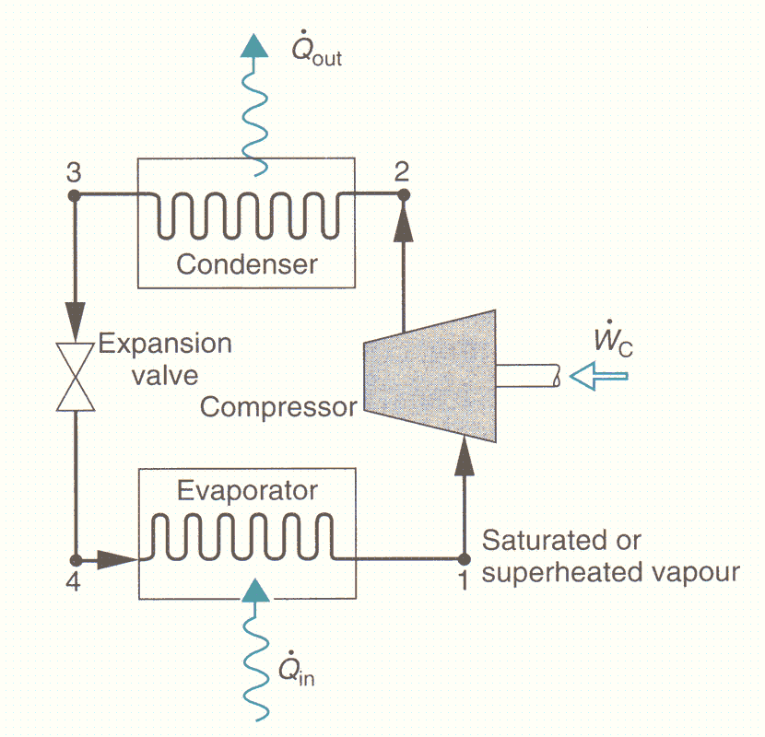
Vapour compression chiller
Low pressure to high pressure transition with compressor
Transition from high pressure to low pressure with expansion valve

Slide 13
Vapour compression chiller: nomenclature
Discharge line (persleiding)
Liquid line
(vloeistofleiding)
Suction line (zuigleiding)

Slide 14
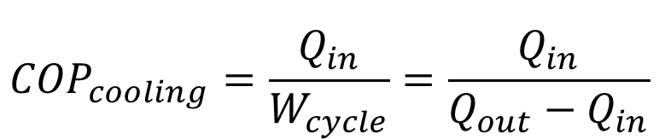
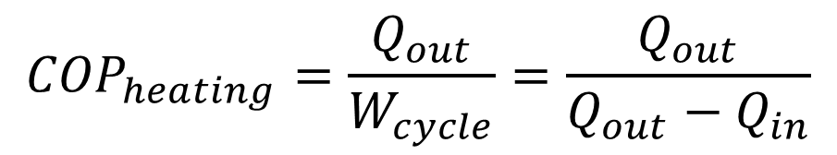
PH diagram of vapour compression chiller (or heat pump)
$${COP}_{heating}=\frac{Q_{out}}{W_{cycle}}=\frac{Q_{out}}{Q_{out}−Q_{in}}$$
$${COP}_{cooling}=\frac{Q_{in}}{W_{cycle}}=\frac{Q_{in}}{Q_{out}−Q_{in}}$$

Slide 15
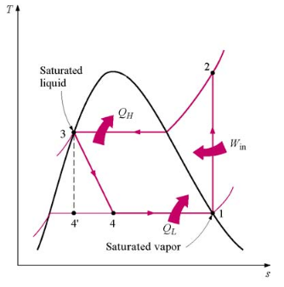
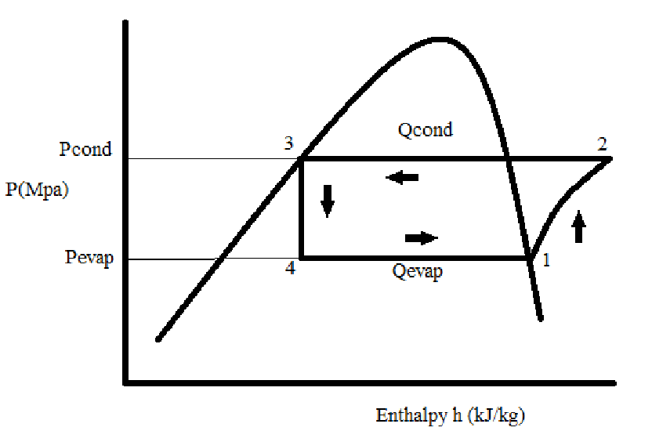
The ideal refrigeration cycle, P-h and t-S diagrams
No pressure drop over the heat exchangers
Saturated vapour at exit of the evaporator
Saturated liquid at exit of the condenser
Isentropic compressor

Slide 16
Effect of subcooling in the condenser
Outlet of condenser is not perfectly saturated
Desuperheating
Condensation
Subcooling
Secondary medium
Capacity
Subcooling
But also: A_{subcooling}
p_{condensation}
_{COP}

Slide 17
Effect of superheating in the evaporator
Outlet of evaporator not perfectly saturated
Secondary medium
Superheating
Evaporation
Capacity
Superheating
But also: A_{superheating}
(ρ )
p_{evaporation}
COP

Slide 18
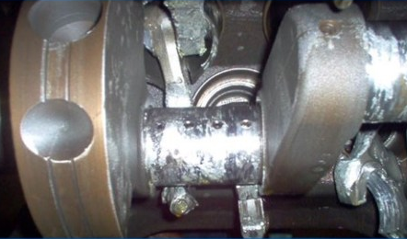
Superheating affects compressor
Small superheating
  Risk of liquid droplets entering the compressor
    Pressure shock in compressor
    Foaming in oil sump
    Lubrication issues
Large superheating
  Limited discharge temperature
  Reduces COP
Superheating typically around 5°C

Slide 19
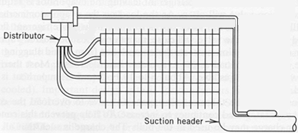
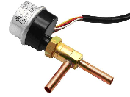
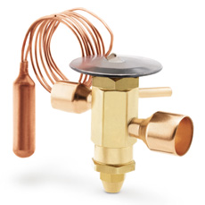
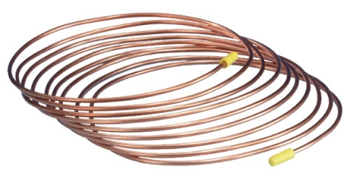
Regulate superheating: expansion valves
At the inlet of the evaporator
Pressure reduction
Control superheat
  By regulating refrigerant flow rate evaporator
Different types
  Capillary
  Thermostatic
  Electronic

Slide 20
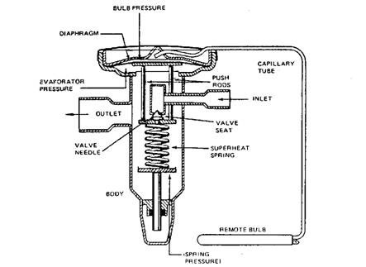
Thermostatic expansion valve
Sensing bulbe: closed volume two phase refrigerant in contact with outlet evaporator
Pressure in sensing bulbe rises with temperature.

Slide 21
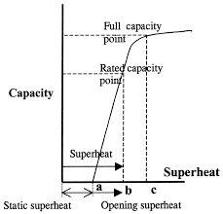
Thermostatic valve characteristic
Valve opening depends on superheating
  When superhreating rises, valve opens
    Mass flow rate refrigrant increases
  When superhreating drops, valve closes
    Mass flow rate refrigerant drops
On average constant superheating
Oversized valve
Instable operation
Lag input sensing bulb
Sizing!

Slide 22
Two stage compression and intercooling
Optimum intercooling pressure

Slide 23
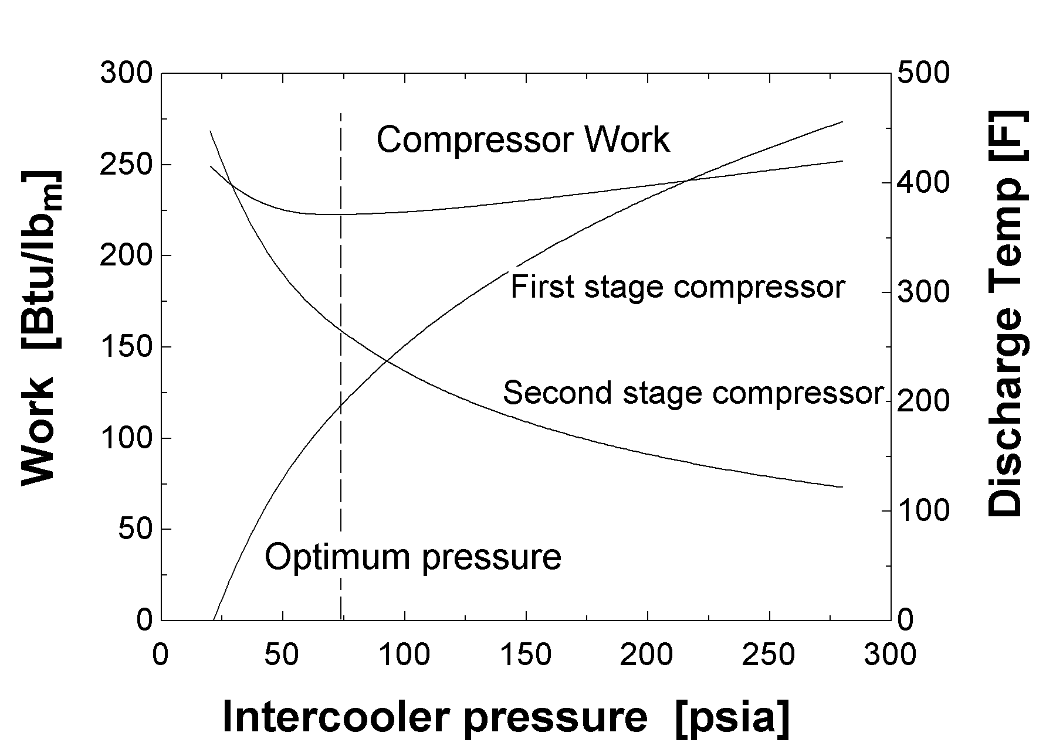
Two stage compression and intercooling

Slide 24
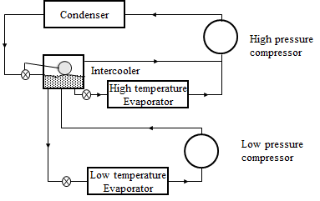
Different temperature levels

Slide 25
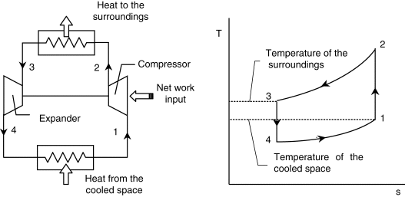
Reverse brayton
Q_{out}
Q_{in}
W_{net}=Q_{out}-Q_{in}

Slide 26
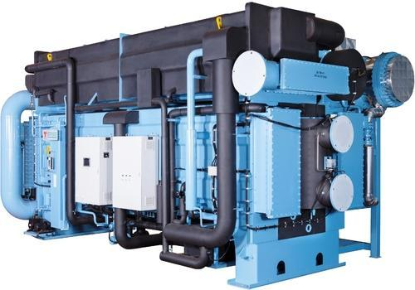
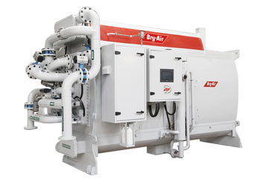
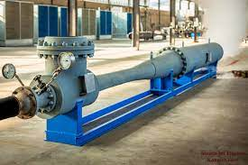
Heat driven heat pumps
Absorption
  Type I
  Type II
Adsorption
Ejector

Slide 27
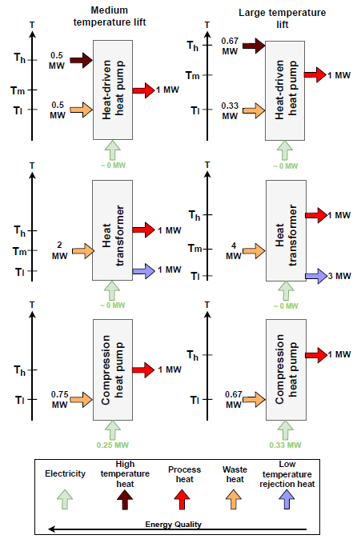
Absorption heat pump
Overview
Type I
COP = 2
COP = 1.5
Type II
COP = 1/2
COP = 1/4
COP = 4
COP = 3

Slide 28
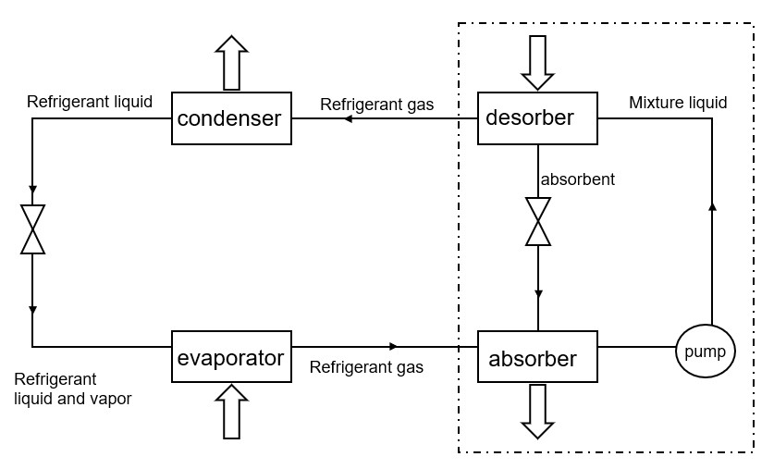
TYPE I

Slide 29
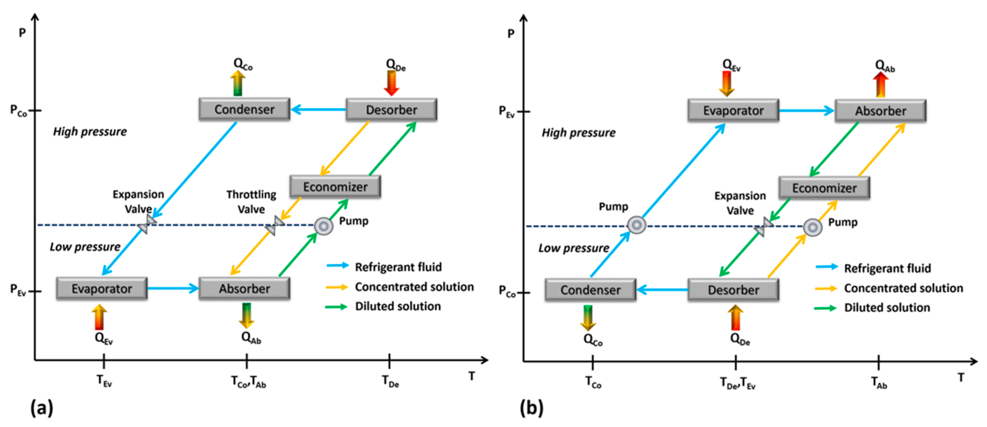
TYPE I & II
TYPE I
TYPE II

Slide 30

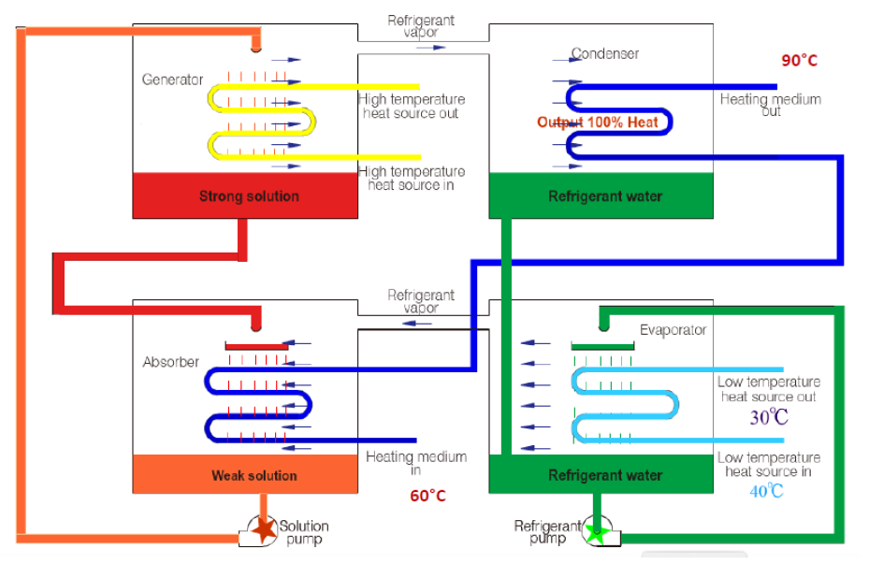
Absorption heat pump Type I
Heating capacity | 1.000-70.000 kW
Driving heat source | Hot water 80-180 °C Steam 1-8 bar Flue gas 250-520 °C Direct fired with oil or gas
Heat source in | 15-60 °C process water
Using side out | 70-100 °C hot water
Ambient temperature | > 5°C, < 40°C
Capacity control | 100-20%
Load conditions | Stable base load
COP_{heating} (Qg/Qc) | 1.65-1.8
Electrical power input | Qth << 5%

Slide 31
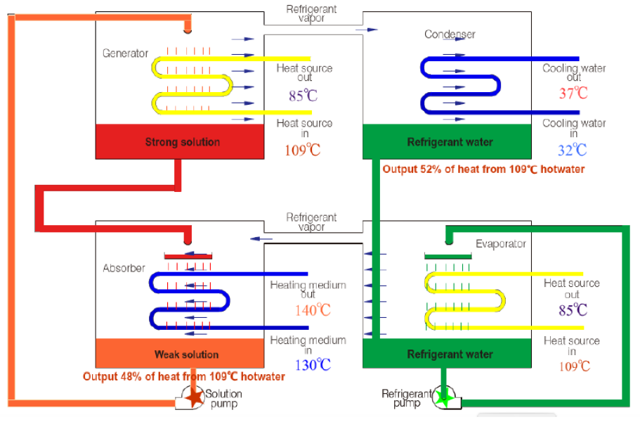
Absorption heat pump Type II
Heating capacity | 1.000-70.000 kW
Heat source in | Hot water > 60 °C Exhaust steam > 90 °C
Using side out | 100-170 °C hot water
Cooling water out | < 40°C
Ambient temperature | > 5°C, <40 °C
Capacity control | 100-20%
Load conditions | Stable base load
COP_{heating} (Qg/Qc) | 0.44-0.48
Electrical power input | Qth << 5%

Slide 32
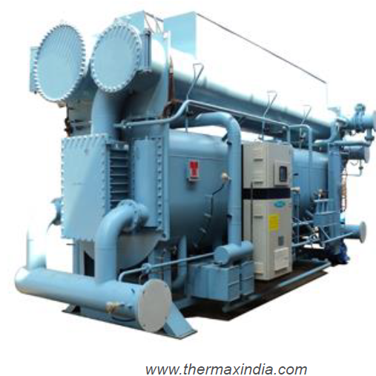
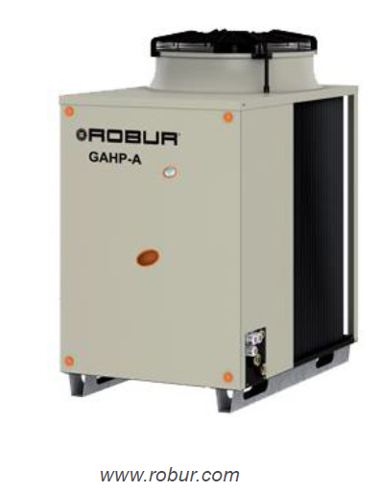
Absorption heat pumps market
Mainly Type I, 30 kWth to several MW
COP ~ 1.5-1.7
Temperature lift heat sink: 5°C to 40 °C
Heat sink outlet temperatures: 45°C to 95 °C
Manufacturers/suppliers:
  Robur
  Fulton
  Thermax
  Moretek Systems Inc
  Shuanglian
  Hitachi
  Yazaki
  Broad USA
  Colibri

Slide 33
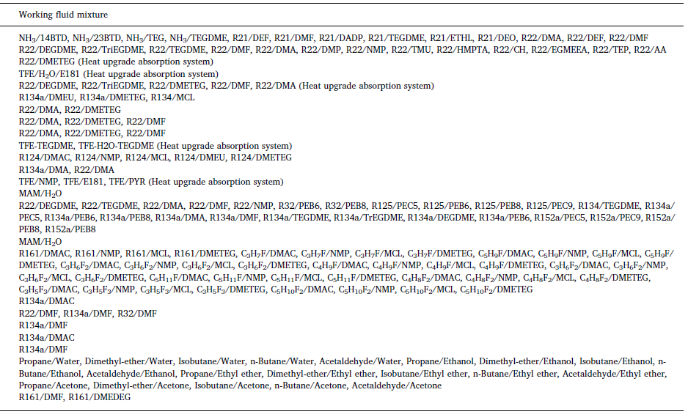
Thermally driven systems
Absorptioncooling: working fluid mixtures
Notes:
R134a met amide en ether

Slide 34
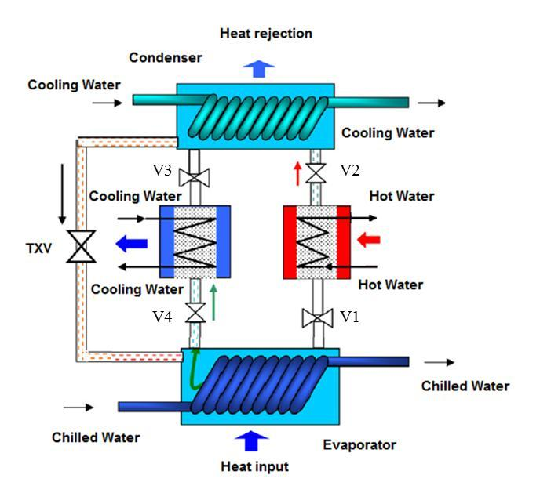
Adsorption cooling

Slide 35
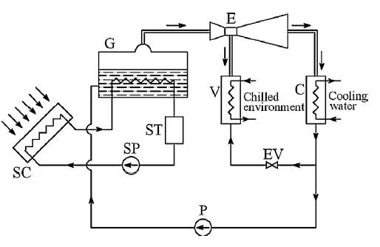
Ejector
Low COP
No moving parts, simple concept

Slide 36
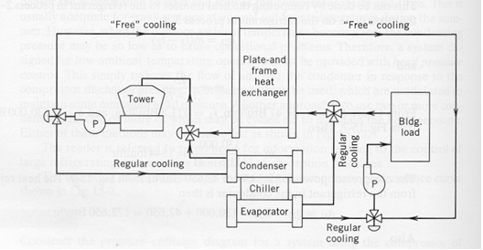
Free cooling

Slide 37
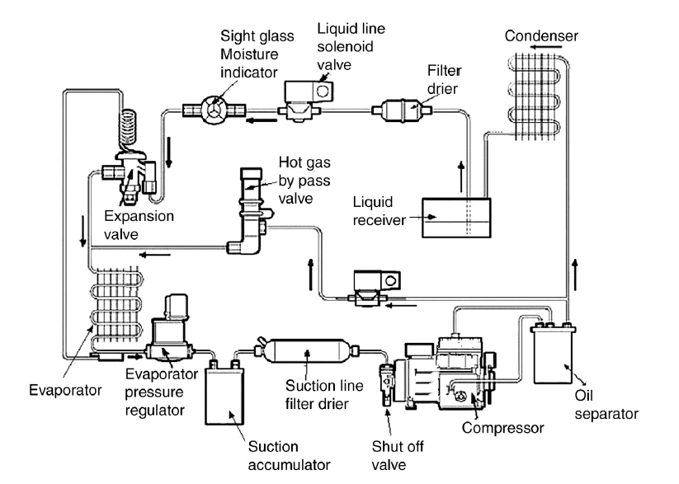
Auxiliary components

Slide 38
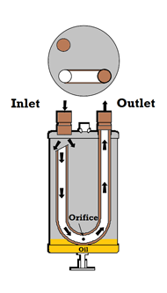
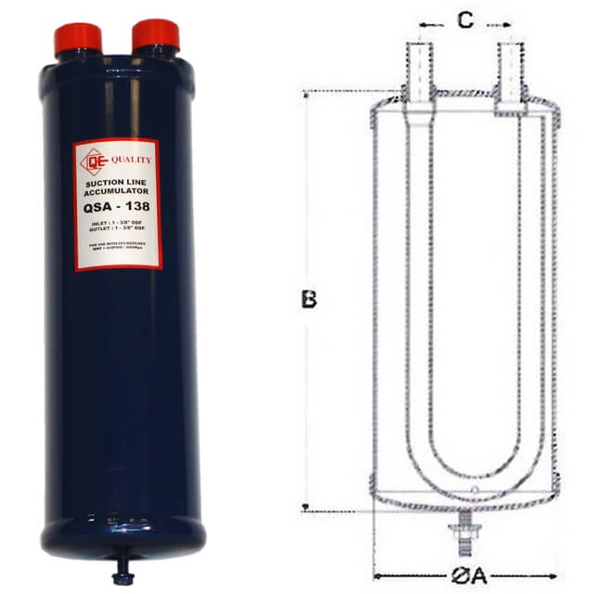
Auxiliary components: accumulator

Slide 39
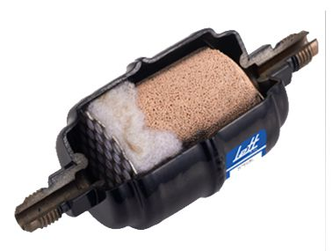
Auxiliary components: filter dryer

Slide 40
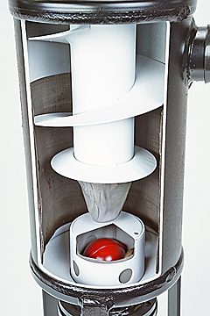
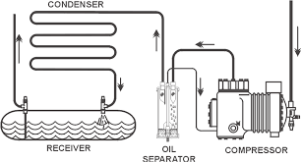
Auxiliary components: oil separator

Slide 41
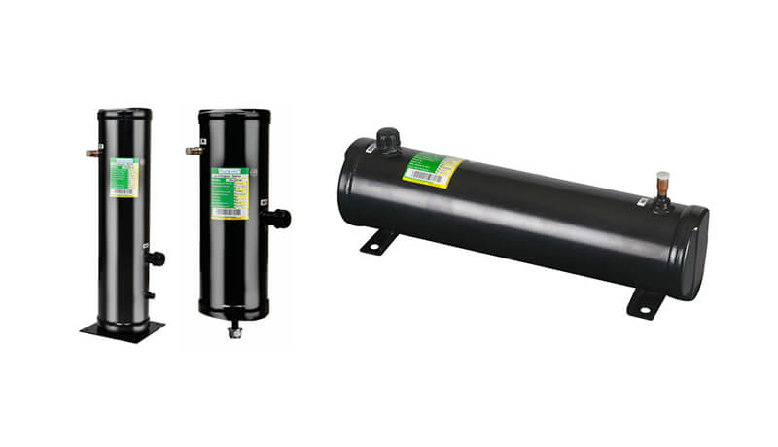
Auxiliary components: liquid reciever

Slide 42
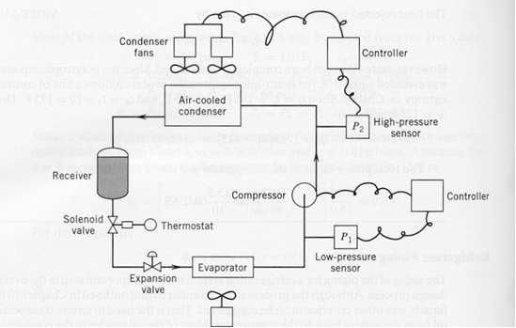
Pump down operation

Slide 43
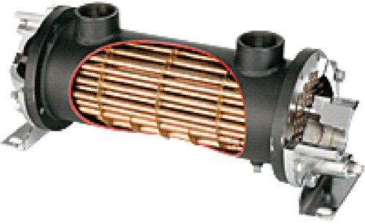


Heat exchangers
Shell and tube
For heat transfer with liquid
Refrigerant in shell

Slide 44



Heat exchangers
Fin and tube:
  Heat transfer with gas
Plates:
  Heat exchange with liquid
Tubes (refrigerant)
  Fins (air)

Slide 45


Fin and tube heat exchangers
Different circuits in parallel (reduce pressure loss)
  Distributor
  In each circuit the same amount of working fluid

Slide 46




Practical implementation: compressors
Volumetric compressors
  Piston compressor: 50 W - 110 kW
  Scroll compressor: 3 kW - 30 kW
  Screw compressor: 350 kW - 3500 kW
Turbo compressors
  Centrifugal compressor: > 200 kW, for large systems.

Slide 47
Safe operation of compressors
Superheating shouldn’t be too high
  Otherwise refrigerant temperature too high
    Damage to electrical engine due to insufficient cooling
    Chemical reaction of refrigerant at higher temperatures
    Viscosity lubricating oil becomes too low
Superheating shouldn’t be too low
  Liquid refrigerant droplets mix with lubricating oil
  Friction evaporates the refrigerant and pushes lubricating oil away
  Large amounts of liquid can completely fill the swept volume, blocking the compressor
Correct choice of expansion valves guarantees correct operation

Slide 48



Piston compressors operation
Clearance volume: cylinder never completely empty
Volume flow rate is smaller than swept volume x rotational speed

Slide 49



Scroll compressor
Typical hermetic, 3 kW - 30 kW
Fixed spiral and eccentric movement
No dead volume

Slide 50


Twin screw compressor
Semi-hermetic or open
No clearance volume

Slide 51




Turbocompressor
Energy transfer between rotor and fluid (flow)
Volumetric flow rate heavily depended on pressure ratio
Typically semi-hermetic or open, large powers

Slide 52
Compressor: Thermodynamic viewpoint
Actual compressors always give a periodic flow
  Piston compressor: stroke frequency
  Turbocharger: frequency with which blade passes
Average value over an appropriate period is constant!
  Both flow rate and discharge state
  So steady state analysis is possible
Three degrees of freedom per compressor for given pressures
  Mass flow
  Work (= electrical work)
  Heat transfer to the environment
Doesn't matter what type of compressor it is for the rest of the cycle!

Slide 53



Three performance metrics for a compressor
For known suction temperature, suction pressure and discharge pressure:
Work expressed as isentropic efficiency:
Mass flow rate expressed as:
  Volumetric efficiency (filling factor)
  Not for turbocompressors
Heat loss expressed as loss coefficient:
$$η_{s}=\frac{{\dot{W}}_{isen}}{\dot{W}}$$
$$η_{V}=\frac{\dot{V}}{{\dot{V}}_{ideal}}=\frac{\dot{m}v_{in}}{NV_{int}}$$
$$f_{Q}=\frac{{\dot{Q}}_{loss}}{\dot{W}}$$

Slide 54

off-design operation
$${COP}_{cooling}=\frac{Q_{in}}{W_{cycle}}$$
Notes:
Sustainable solution for heat provision
Extract heat from a cold body
Reject heat to a hot body
Not spontaneous, needs work
Clausius statement
(2nd law of thermodynamics)

Slide 55

Influence of temperature on COP
What if T condenser ?
What if T evaporator ?
(other boundary conditions identical)
Same trend as Carnot COP!
$${COP}_{carnot,heating}=\frac{T_{H}}{T_{H}−T_{C}}$$

Slide 56





Influence of temperature on Capacity
$${\dot{Q}}_{cond}=\dot{m}∆h_{cond}$$
Assume reciprocating compressor
High pressure ratios
Easy maintenance
Relatively cheap
Low capacity (RPM low)
Vibration prone
hermetic
semi-hermetic
open

Slide 57






Influence on mass flow rate
$$V_{cv}$$
$$\dot{m}={ρ_{suction}\dot{V}}_{suction}$$
$$V_{int}$$
Volumetric efficiency:
$$η_{v}=\frac{{\dot{V}}_{suction}}{N/60V_{int}}$$
Re-expansion loss:
p
$$pV^{n}=cst$$
volumetric efficiency (%)
V_{c}
V_{r}
V_{int}
V
pressure ratio (p_{out}/p_{in})
Leakage loss

Slide 58


Influence of temperature on capacity
$${\dot{V}}_{in}$$
$${\dot{Q}}_{evap}=V_{int}.\frac{N}{60}.η_{v}.ρ_{in}.∆h_{evap}$$
What if T evaporator ?
What if T condenser ?

Slide 59



Steven Lecompte
DEPARTMENT OF electromechanical, systems and metal engineering
E steven.lecompte@ugent.be
T +32 9 264 33 55
M +32 470 04 55 24 www.ugent.be
Ghent University
@ugent
Ghent University

