Slide 2
MEMBERS

Slide 3
Introduction: prices – affordability – competitivity

Slide 4
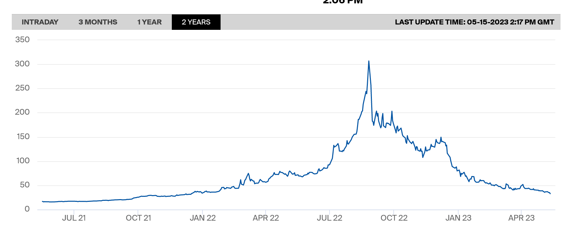
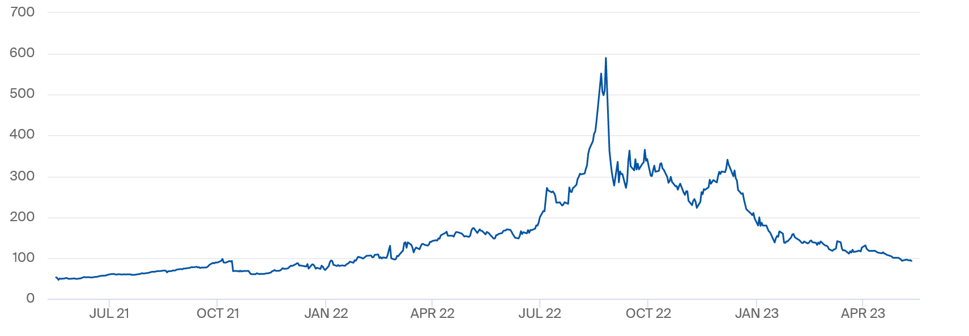
Energy prices calming down after unseen peak prices

Slide 5
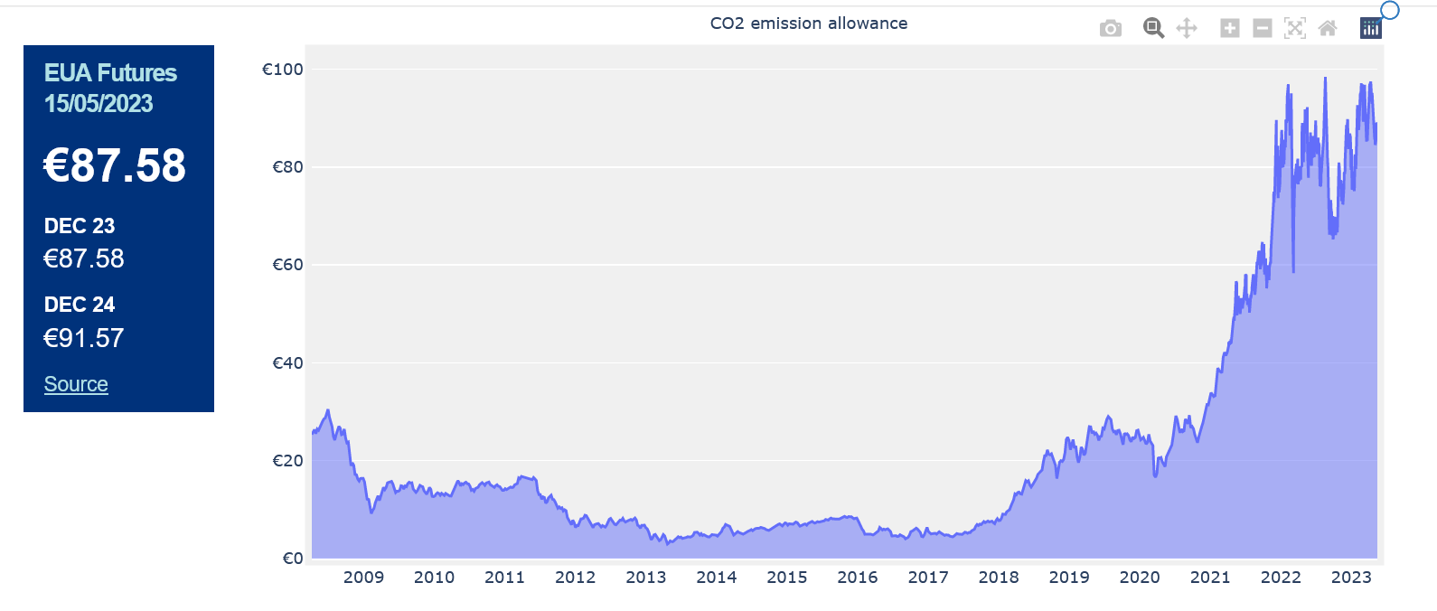
CO2 prices – at high level – higher than most scenario’s

Slide 6
B. SOS gas

Slide 7
Qatarese minister waarschuwt voor energietekorten in Europa (23/5/23 Belga)
doha 23/05 12:04 (ANP/AFP/BLOOMBERG)
De Qatarese minister van Energie Saad Al-Kaabi waarschuwt dat het "ergste nog moet komen" op het gebied van olie- en gastekorten in Europa. Dat zei de minister dinsdag tijdens het Qatar Economic Forum in Doha. Hij merkte daarbij op dat Europa in de afgelopen maanden wist te ontsnappen aan een energiecrisis dankzij de relatief warme winter.
"Het enige dat de mensheid en Europa dit jaar heeft gered, was een warme winter en de vertraging van de economie", aldus de minister. "Als de economie weer begint te draaien en de winter is normaal, dan denk ik dat het ergste nog moet komen."
Ook zijn Saoedische collega prins Abdulaziz bin Salman waarschuwde op de conferentie dat er een energiecrisis op de loer ligt. Volgende week komen de olieproducerende landen (Opec) weer bijeen om zich te buiten over de productie in de tweede jaarhelft, en volgens bin Salman "passen de speculanten maar beter op". Mogelijk wordt er dus opnieuw gesnoeid in de productie.
Het Russische staatsgasconcern Gazprom waarschuwde vorige maand al dat Europa het moeilijk zal krijgen met het aanvullen van de gasvoorraden voor komende winter. Door de oorlog in Oekraïne is Europa namelijk grotendeels afgestapt van Russisch aardgas. Dankzij het milde winterweer en een fors toegenomen import van vloeibaar gemaakt aardgas (lng) uit andere landen, konden de gasvoorraden wel voldoende gevuld worden.

Slide 8
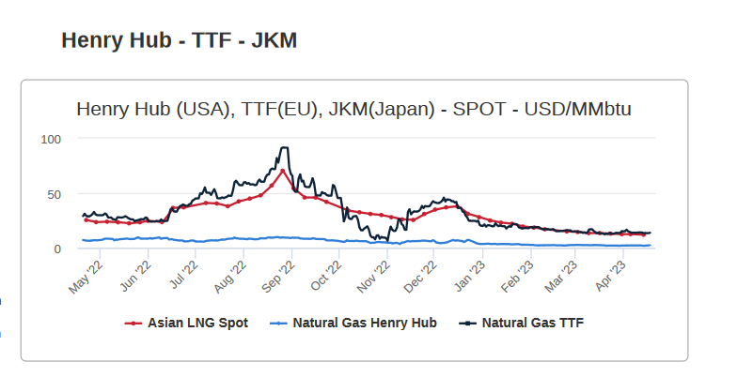
Gas prices – alignment with JPN - korea
Competition: Large price difference with US
Competition for LNG with other importing countries
Long term contracts?

Slide 9
EU GAS supply demand balance – sobriety needed to maintain balance

Slide 10
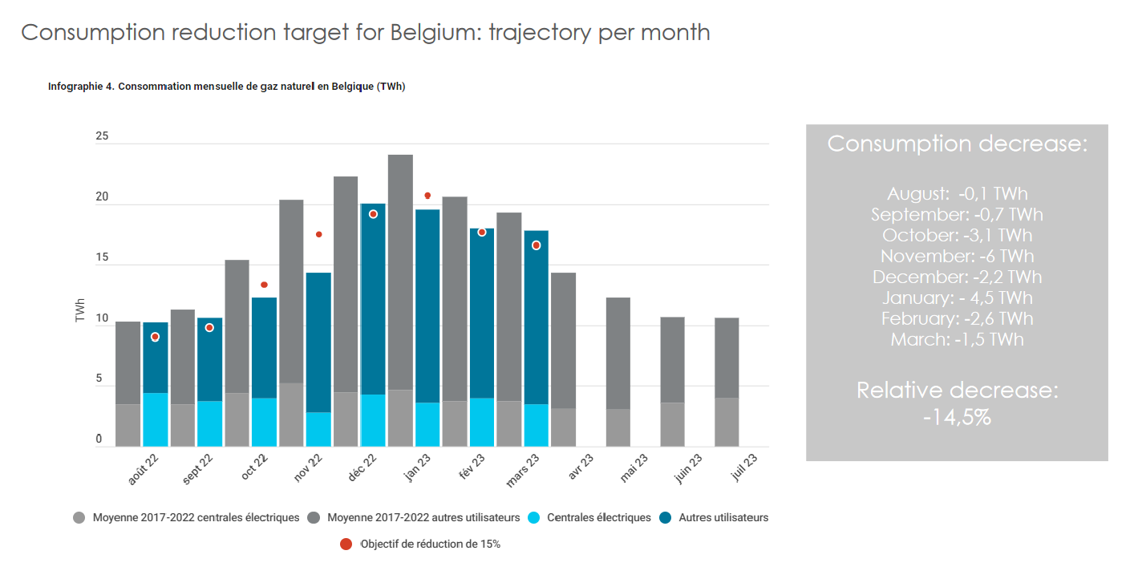
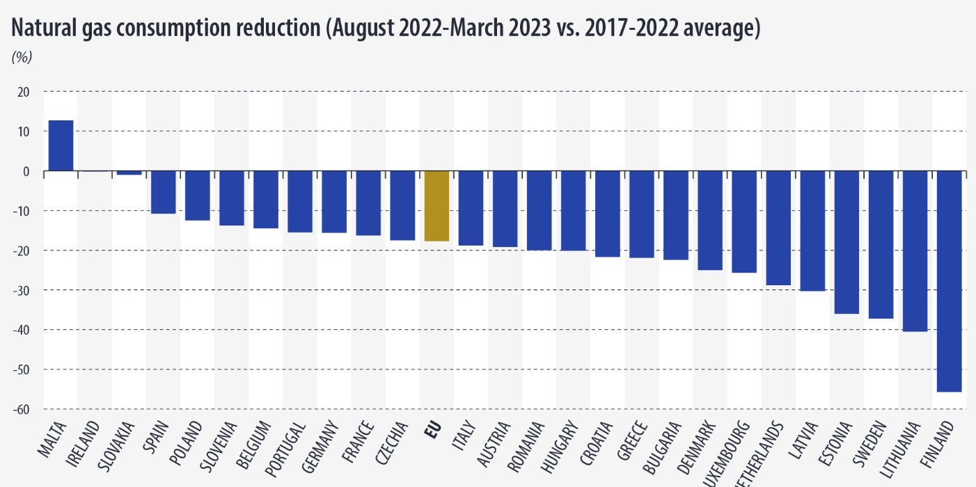
EU reduction target reached – 15% for B
Belgium
-14,5%
+ Increased volume in storage
= -15%

Slide 11
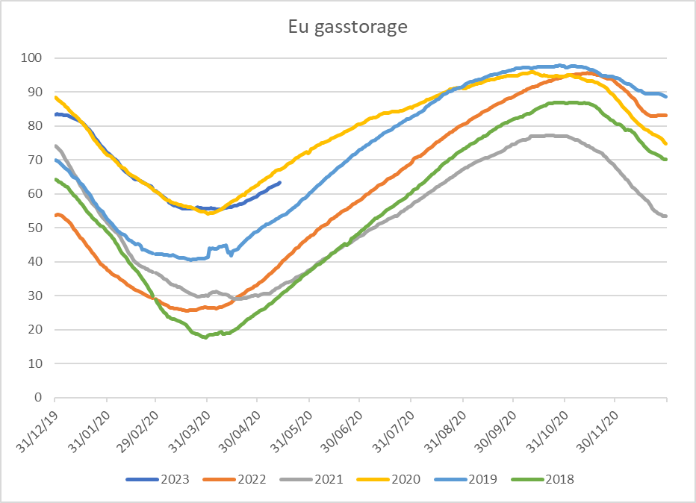
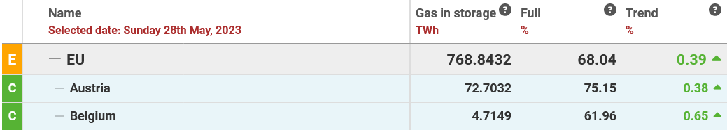
Gas storage at better starting point than last year
Low starting point in 2022
Rush on gas in august to fill storage
Better situation in 2023
  Mild winter 22 -23
  LNG installations up and running

Slide 12
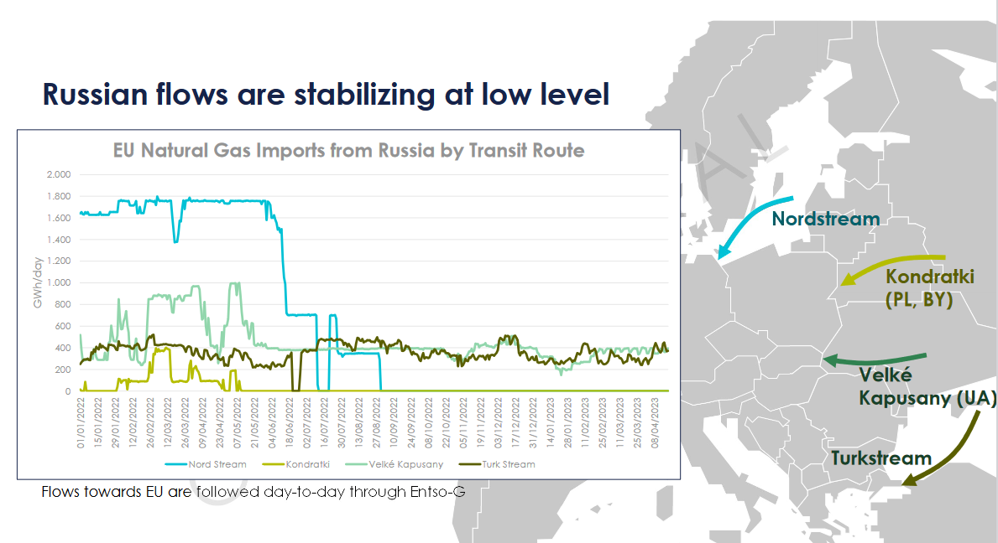
Still Russian gasflows coming to Europe

Slide 13
Winter 2023 – 2024 ENTSOG outlook – risks: cold winter and disruption Ru flows
The gas infrastructure can efficiently reduce the dependence on Russian supply
Even in case of the full Russia supply disruption, cooperation between the countries could allow for efficient injection during the summer 2023 and preparation for winter.
Storages play an essential role to ensure security of supply,
  An early significant storage withdrawals will result in low storage levels at the end of the winter season. => negative impact on the flexibility of the gas system.
From the security of supply perspective, it would be important to inject gas during the summer season and keep storage on adequate level until the end of the winter.
In case of full disruption of Russian supplies during winter, additional measures might
be needed to save significant volumes of the gas for the end of the season, and to
avoid risk of demand curtailment in case of cold winter and peak demand situations.
Simulation results showed that the introduction of possible measures such as
enhanced capacities, additional supplies and decrease in gas demand by 15% (as a
result of organic reduction due to high prices or policy-based demand measures)
would avoid demand curtailment risks and to reach adequate storage level.

Slide 14
Crisis and supply side

Slide 15
TIJSDLIJN IMPLEMENTATIES
2021, 2022 en Q1 2023
Update 14.2.2023
Nieuw communicatieplatform MIG6
(met aftercare in 2022)
???
KMO Gedrags-code?
Charter
Happy Customer ?
Consumenten- akkoord ?
2022
2023
JAN
FEB
MARCH
APR
MAY
JUN
JUL
AUG
SEP
Oct
NOV
DEC
JAN
FEB
MARCH
APR
juni
BTW Gas
Prof. 1/7/22
Omzetting CEP 26/10/22
Accijns-verlaging I Prof. 1/11/22
Accijns-verlaging Prof.II verlenging 1/1/23
Accijns: cliquet RES
Hervorming fisciliteit Btw- prof
Nieuwe Bijzondere Accijns 1/1/22
BTW EL RES
1/3/22
BTW Gas RES
1/4/22
Verwarmings-premie
Fase I + Fase II
1/7/2022 tot 2023
Basispakket I: EL en Gas tot in Fase 1 2022
fase II (manueel) 2023
Basispakket II: EL en Gas
Fase I+ Fase II (manueel)
BTW Gas PROF
Federaal
Wet verlengings-producten 1/1/22
Voorschotten aanpassen: AV en optout
31/3/22
Aanpassing vaste vergoeding var. contracten 1/7/22
Oktober release MIG6 22/10/22
Engagement I: transparantie
(1/11/22 - 31/12/22)
Engagement II: monitoring 31/3/23
Soctar: forfait 80 € - 31/1/22
Verlenging BIM/VT
soctar na 31/3/22
Verlenging BIM/VT
soctar na 30/6/22
Verlenging BIM/VT
soctar na 30/9/22
Verlenging BIM/VT
soctar na 31/12/22
CMS release MIG6
Wijziging Boek XIX WER ?
Capaciteits-tarief 1/1/23
BIM-aangepaste soctar
Energiedelen- protocol I 1/1/22
Maandfact. EL 200.000 klanten 1/4/22
Maandelijks Prosumenten- tarief 1/7/22
Maand-facturatie Gas 1/8/22
Aanpassing methode Prijsver-gelijkers
1/11/2022
Energiedelen - protocol III 1/1/2023
Vlaanderen
Protocol voorschot-verlaging
TRD E
(?)
Nieuwe V-test 1/1/22
Energiedelen - protocol II 1/7/22
Afschaffing Bijdrage Energiefonds (RES) 1/1/2022
IMV 1/4/23 (?)
TRD G
(?)
SODV aanpassing 1/7/22
Wallonie
Suspension des coupures et pose CAB 1/11/2022
Réforme Juge de paix 1/1/23)
DGO switch vers Arewal 1/2/23
Partage de l’énergies
sur les communautés 01/6/23 (?)
BXL
Nouvelles obligations sociales – ordonnance électricité 1/05/22
Fin de pose des limiteurs de puissance 1/7/22
Conversion Lgas finale Sibelga (1/9/22)
Transfert automatique CP 1/10/22
15

Slide 16
New contracts residential tariffs => normalization

Slide 17

The average EBIT margin has not recovered from 2021 and fell further into the negatives
Average EBIT to revenue ratio (or EBIT margin), period 2016-2022 (%)
2021
2022
After remaining consistently low during the period 2016-2020, the average EBIT margin¹ of energy suppliers turned negative in 2021 and declined further in 2022.
This comes after energy prices skyrocketed in the wake of the sanitary crisis.
The negative values can be explained, among other reasons, by fixed contracts that are not entirely hedged, high balancing (profiling & imbalance) costs and the expansion (doubling) of the number of social tariff beneficiaries.
¹The EBIT margin is a financial ratio to measure profitability. Revenue includes the full value of sales (commodity, distribution, taxes, etc.) for retail activities, whilst EBIT corresponds to earnings before interest and taxes.
See methodology on slide 4.

Slide 18


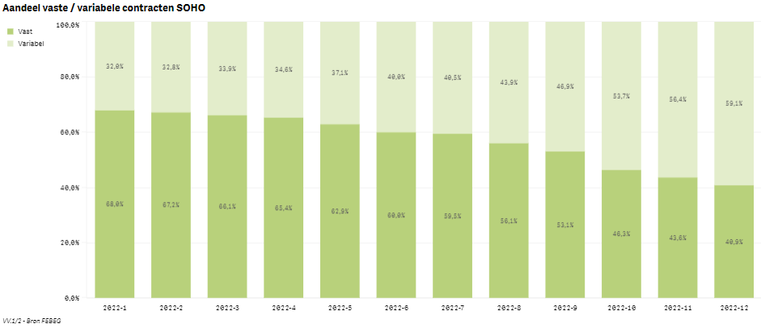




>50% SOHO clients protected thnx to fixed price contracts
Statistiques sociales (2022-12)
Deze indicator wijst op de lopende contracten, niet de nieuw opgestarte contracten.

Slide 19
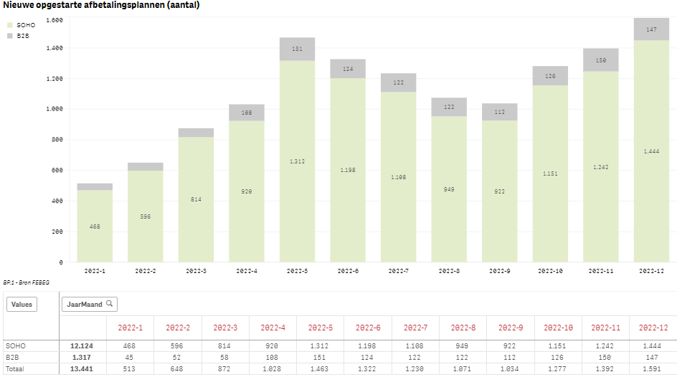
Sociale statistieken (2022-12)
Zowel voor SOHO als B2B is het aantal opgestarte afbetalingsplannen opnieuw gestegen in Q4 na de daling in Q3. T.o.v. januari is het aantal niuew opgestarte afbetalingsplannen verhoogd met een factor van 3 (zowel voor SOHO als B2B).

Slide 20
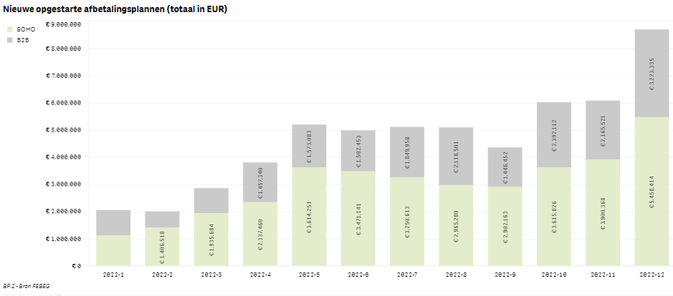




Sociale statistieken (2022-12)
Zowel voor SOHO als B2B zijn de opgestarte afbetalingsplannen in EUR opnieuw gestegen in Q4 met sterke stijging in december. De aantallen stijgen maar de bedragen in EUR stijgen meer. Voor SOHO zijn de afbetalingsplannen in EUR verhoogd met een factor van 4,9 (voor B2B x 3,4) t.o.v. januari.

Slide 21
Supply – conclusion
Governmental efforts towards residential clients
Estimate 3,7 billon Euro
Exclusive VAT reduction!!
Contrasting to limited support for SME en business clients
Fixed price contracts were useful for > 50% of clients
Payment plans allowed by supplier
New rules for fixed price contracts needed!!
Germany
gas and heat price cap :
  For private households and companies with a gas consumption < 1.5 million kWh/y, the gas price is to be capped at 12 ct/kWh (inc taxes, levies etc). Applies to 80% of the previous year's consumption
  For industrial customers, the gas price is to be capped at 7 ct/kWh (excluding all taxes, levies, surcharges and network charges) Applies to 70% of the previous year's consumption
  budget spending EUR 56 billion for 2023 and 2024.
electricity price cap :
  The electricity price for private consumers as well as < 30,000 kWh/y will be capped at 40 ct/kWh (including all taxes, levies, surcharges and network fees). This applies to the baseline requirement of 80% of historical consumption
  Consumption > 30,000 kWh (mainly medium-sized and large companies), the cap is 13 ct/kWh (excl. taxes, levies and surcharges) for 70 percent of historical consumption
Budget EUR 43 billion

Slide 22
E. The challenge of the energy transition

Slide 23






Megatrends …
CO₂ low society
Decentralisation
Technological evolutions
Energy efficiency
Digitalisation
Environmental conscience
Members invest in the transition
Notes:
Volop in energietransitie
Verankering principe terugdraaiende teller tot eind 2035 is Marktverstorend en belemmert energietranisitie
gemiste kans voor technologische, commerciële en innovatieve ontwikkelingen
Overgangsmaatregel voor PV installaties geïnstalleerd tot en met eind 2020 niet uitvoerbaar in de markt
Samenlezing van de modaliteiten mbt de overgangsmaatregel in het energiedecreet en de tariefmethodologie is onwerkbaar in de markt => Enkel mogelijk via manuele verwerking
Nieuwe installaties: terugkoopverplichting voor injectie van PV installaties na 2020: =>waken over prije prijsvorming
Overweeg degelijke marktoplossingen die de energietransitie stimuleren
Zoeken naar alternatieve mechanismen met garantie tot terugverdientijd van de PV
Wat zijn nu de opties?

Slide 24
In Belgium, the vast majority of the primary energy demand is being met by oil and gas, despite recent efforts
Primary energy consumption in Belgium [TWh; 2020]
85 TWh
Solar
6%
2%
Other
Feedstock
Industry
82
58
37
8
14
199
Wind
15%
Biomass
7%
Heavy comm. vehicles
2
Transport¹⁾
Passenger cars
LCVs
Others
80
1
8
0
91
Electricity production
Natural gas
32%
Residential & tertiairy
39
56
39
8
2
144
Other sectors²⁾
4
4
2
0
0
10
Nuclear
38%
Total
4%
444
100%
Fuel
Natural gas
Electricity
Renewables (3)
Others (4)
1) Excluding international aviation and shipping; 2) Agriculture, forestry and non-specified other sectors; 3) Renewables include energy from biofuels, biomass, geothermal, solar and heat pumps; 4) Heat, solid fossil fuels, manufactured gases and non-renewable waste
Source: Statistics Belgium; Federal Planning Bureau; FEBEG; Roland Berger
Notes:
The electricity production is linked to the final demand and not to the final production (network loss, sold pumping and turbining).
Oil use by type of vehicle in the transport sector is based on last year's proportions. The total of oil used in the transport sector is updated.

Slide 25
The expected 3 fold growth in electricity demand will require very significant investments
245 TWh (Elia)
Increased demand requires
evolution of installed capacity (in GW)
26 GW
Hydropower
Solar
Onshore wind
85 TWh
Offshore wind
Biomass
Natural gas
Nuclear
2020
2030
2035
2040
2045
2050
Elia Road to net zero
Sources: FEBEG, European Commission (interpolation des scénarios 1,5°C), Eurelectric
25
Notes:
84 TWh → https://www.creg.be/nl/opvallende-feiten-uit-het-jaarverslag-2021-van-de-creg#:~:text=De%20totale%20elektriciteitsproductie%20in%20Belgi%C3%AB,jaarbasis%20tot%2093%2C3%20TWh.

Slide 26
Increasing RES capacities installed
Production
+4,5 %
L’installation de nouvelles capacités principalement renouvelables pousse la capacité totale installée à un niveau record
La capacité nucléaire recule pour la première fois, avec le début de la mise en œuvre de la loi de sortie du nucléaire

Slide 27
Increasing renewables –accelerated development needed to reach targets
Towards 2030
2new CCGT
Strongh growth PV
  PV capacity > low demand peak
Flexibility needs!
  Evolution storage?
    Extra capacity?
Permitting issues
  Infrastructure
  Wind

Slide 29
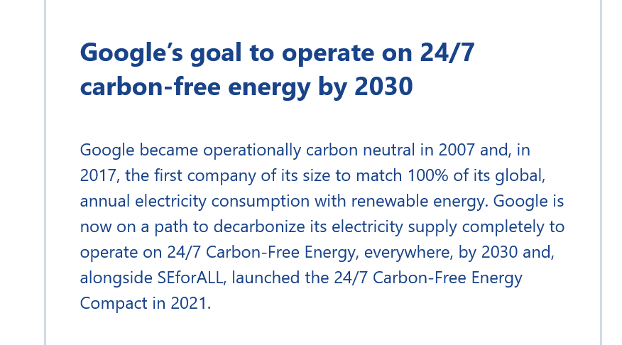
Pull from large consumers
Electrification
Huge needs from industry to electrify
Companies
  Efficiency
  Own production (solar, wind,..)
  PPA
  GO, …
  24/7 initiative

Slide 30
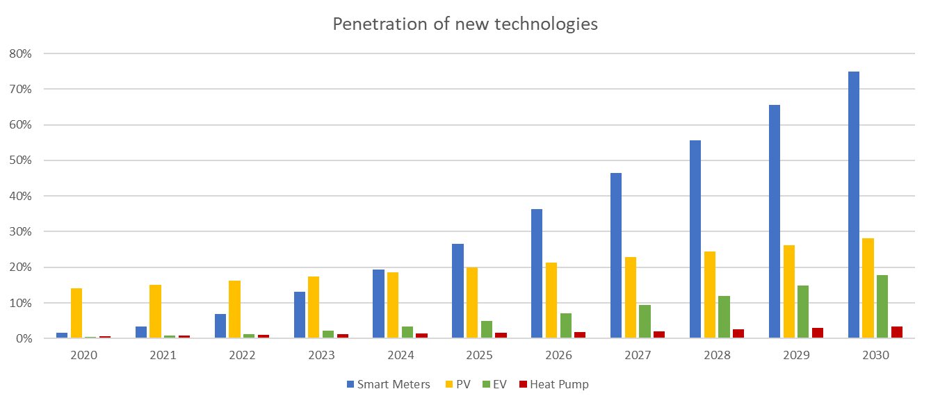
Technological evolution drives the consumer needs
Short term
Medium term
Long term
With high shares of PV/Wind/EV/HP, services to system operators will become relevant
Smart meters are a prerequisite for almost all consumer centric use cases
Technology penetration rates
Use cases related to EV and Heat pumps become relevant (dynamic tariffs, multiple suppliers
Use cases around PV are most relevant (sharing, storage)
FEBEG – Consumer-centric market design - Executive Summary

Slide 31




Use cases are triggered by technological evolution - but legal, metering and data management aspects are equally important and they need to be addressed in time.
PV & Sharing
PV
Smart meter
Peer-to-peer sharing / Collective self-consumption schemes
Atrias
PV & Battery
PV, Battery
(Smart meter)
Injection tariffs/Network tariffs
Atrias
Implicit Demand Response
Shiftable load (EV, heat pumps, batteries)
Smart meter, behind the meter communication
Dynamic price contracts
Atrias
Medium term
today
Metering infrastructure
Technology
PV
PV
(Smart meter)
Injection tariffs/Network tariffs
Atrias
Multiple Suppliers
EV / Heat pump
Smart meter, behind the meter devices
Framework for Multiple suppliers, regulatory scheme for BdM devices
Evolved Atrias
Data management & processes
Long term
Legal & Regulatory framework
Services to System Operators
Shiftable residual load (EV, heat pumps, batteries, PV)
Smart meter, real time communication
Aggregated services to TSO, market-based services for DSOs
Evolved Atrias, ToE or other alternative model, Reference profiles
Use Cases
FEBEG – Consumer-centric market design - Executive Summary

Slide 32
Sobriety, energy efficiency, electrification and decarbonization relies on investments and the commitment of the Belgian energy sector
Challenge of the energy transition
46% oil
27% gas
In Belgium, the vast majority of the primary energy demand is being met by oil and gas, despite recent efforts
Sobriety, energy efficiency, electrification and decarbonization are the solution to achieve carbon neutrality
To power Belgium's primary energy consumption
X 3 electricity
The expected growth in electricity demand will require a x3 increase of the installed capacity and very significant investments
Electricity generation capacity in Belgium by 2050
A secure investment climate will be key for the Belgian energy sector to lead Belgium to carbon neutrality
Market model to be adapted towards new applications

Slide 33
thanks

